Slide 1
A game to reinforce academic integrity: AI is not a game
Improving student learning by combining accessibility/inclusion with academic integrity
This project brings together inclusion and academic integrity. We define inclusion as follows: Inclusion involves celebrating differences in all aspects of who we are as individuals with every person respected, valued and supported. We aim to integrate it within our practice to enhance engagement, participation, learning and choice for all.
This game was originally developed by Miranda Dodd, Ran Peleg and the University Academic Integrity Network at the University of Southampton. It is intended to be used by groups of students, working together either in person or online, and thus providing support to each other. It explores a range of possible scenarios with the group working in the role of ‘academic integrity student ambassadors’. They select a student, hear their story and then decide on a range of possible advice to give. Depending on the advice given, they lose or gain points. It can be helpful, depending on the cohort, to allocate group roles within in each group, such as ‘group leader’, ‘score keeper’ and ‘equity officer’ (ensuring all participants are involved in the discussion). We generally recommend that the students play the game for about 1 hour.
It is designed to be used as a resource following an introduction to academic integrity to enable students to think through how academic integrity might work in practice. In order that it is easily editable, the game is presented here as a PowerPoint. Terminology, scenarios, sources of advice (and hyperlinks) may well need adapting for use in different institutions; text that is most likely to need editing is shown in green and/or has a Comment added. Once edited, for sharing with the students, it is best saved as a PowerPoint slide show (with the students keeping their own scores).
Full instructions are provided on the ensuing slides. For further information please contact the project institutional lead, Miranda Dodd, on M.Dodd@soton.ac.uk
This exercise is an output from a Collaborative Enhancement Project supported and funded by QAA Membership. The project is led by Oxford Brookes University in partnership with Bloomsbury Institute, University of Southampton and University of Westminster. Find out more about Collaborative Enhancement Projects on the QAA website.
This way …

Slide 2
AI is not a game …
… but you can still have fun and learn with this game
Your group has taken on a new role as student champions to help students with academic integrity (AI) matters.
Explore the campus ‘map’ and see who you meet.
When you click on a person they will explain their situation.
Work as a group to discuss the situation and decide on the best course of action. This is the most important part of the game. Then go through to the blue options page, check your answers and see how many points you have scored. You will need to keep a record of your scores.
Once you have helped one person, go back to the map to find another person needing your help.
See how many points you can accumulate across the game together.
Remember to keep a list of any questions that arise to discuss with a module tutor or your personal tutor.
Images used through the game were sourced from Creative Commons Online Pictures on PowerPoint, unless otherwise acknowledged. Full details of images are available on the final slides.
This way …

Slide 3
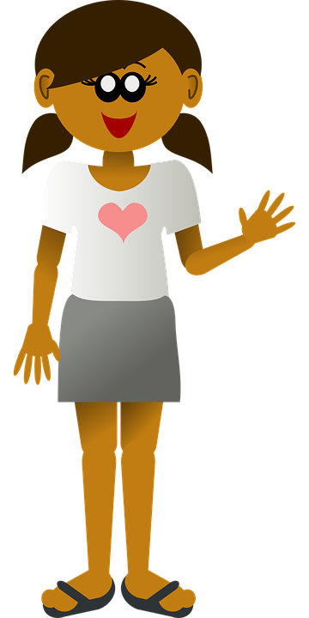
A few practical bits …
You can get help and advice from the places that are hyperlinked like this on the map.
Olly Owl will pose questions and advise you.
Click on arrows like this to navigate through the game
Kala is a member of your group – she will sometimes set out different options for you.
Back to map
Follow the arrow to the next slide to find out how to navigate through the game.
This way …

Slide 4
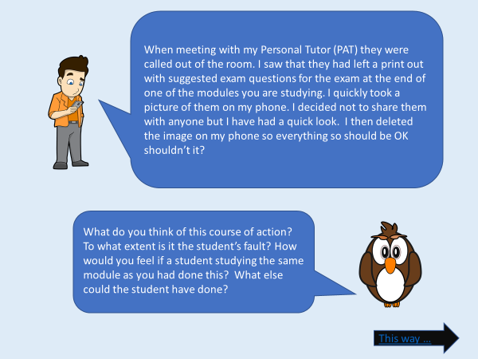
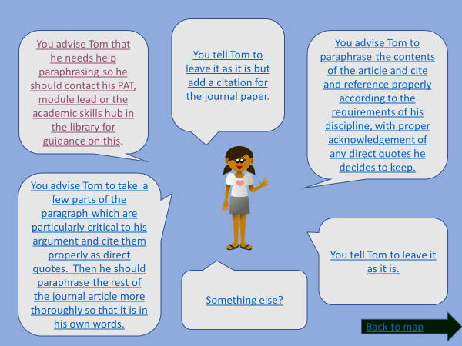
Navigating through the game:
Scenario pages
Once you click on a person you will reach their scenario page. They will explain the situation and Olly will give you questions to discuss as a group. Follow the arrow when you have decided on your responses.
Options pages
Compare your group’s advice with the options on the options page. Click on the option that matches your group’s decision most closely. This will take you to the relevant outcomes page.
Outcomes pages
On the outcomes pages you can find out how many points you have gained or lost based on your response - do keep a tally. Use the arrows to go back to the options page or the map.
This way …

Slide 5
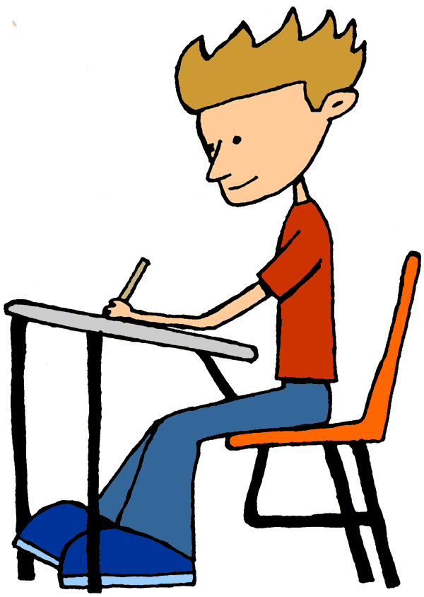
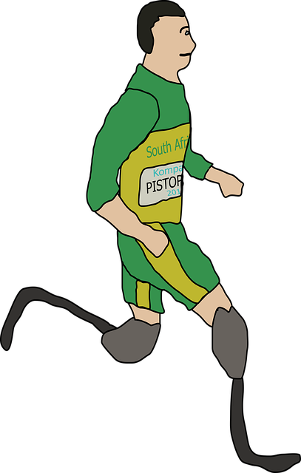
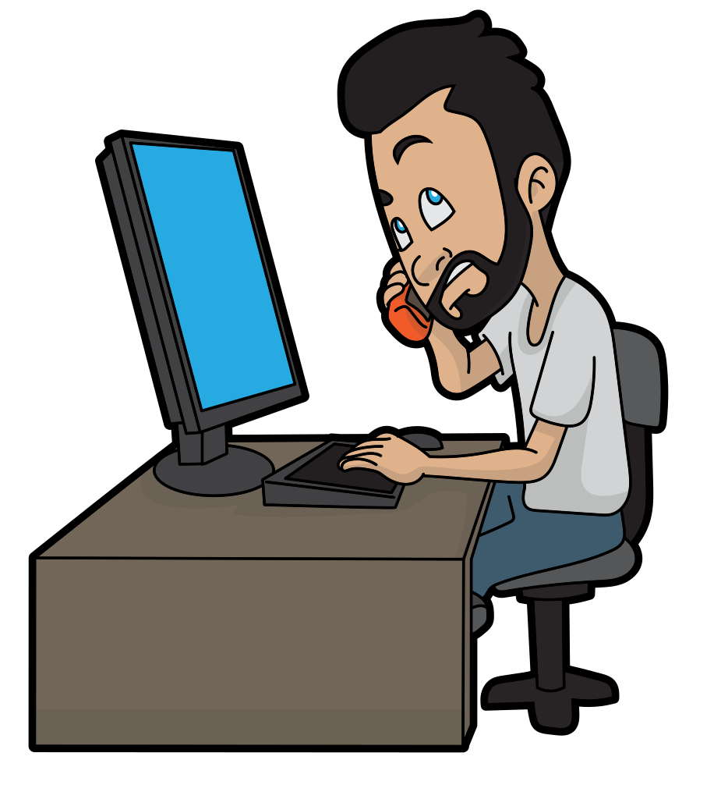
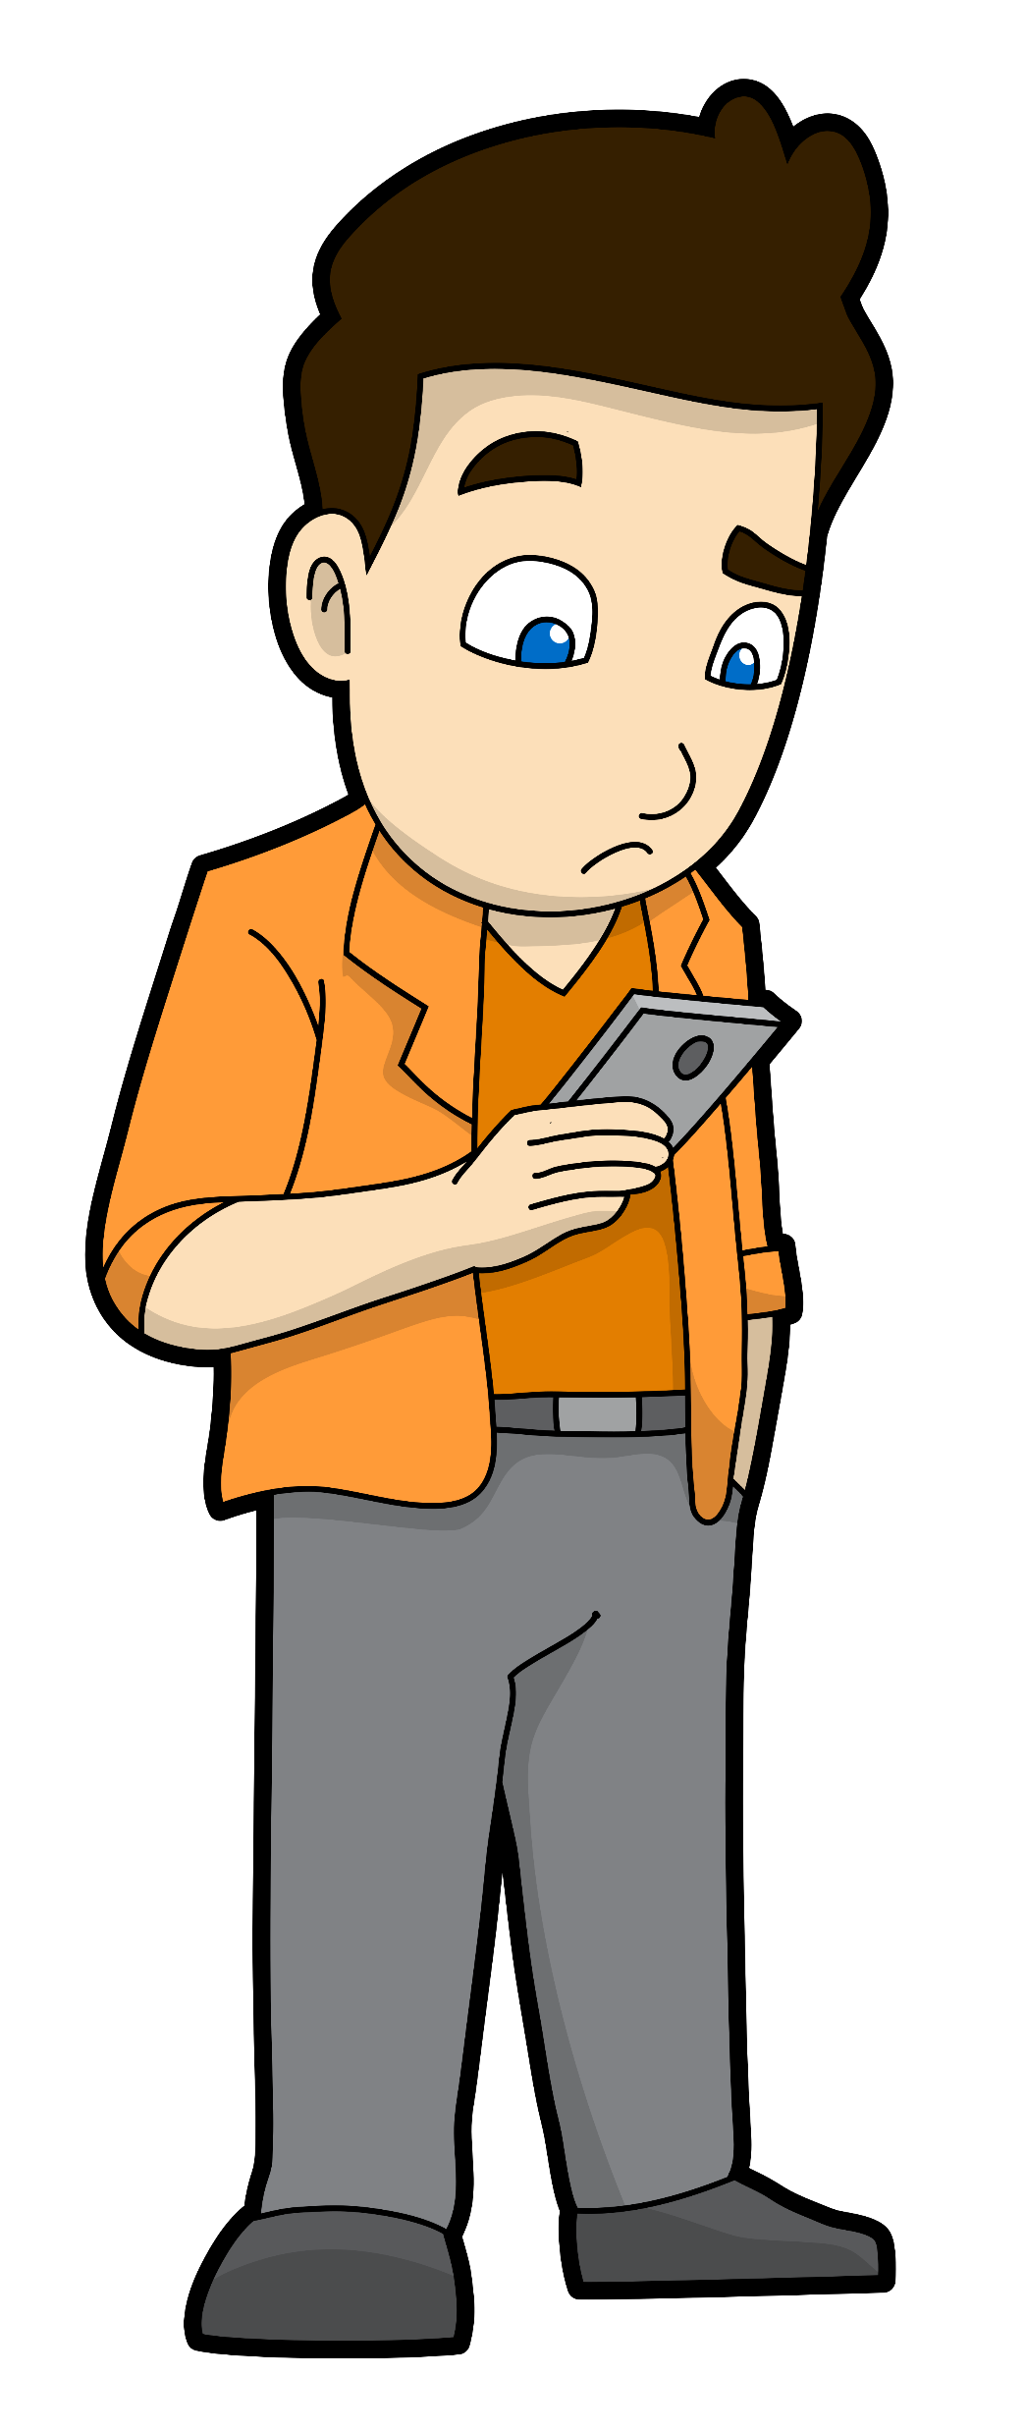
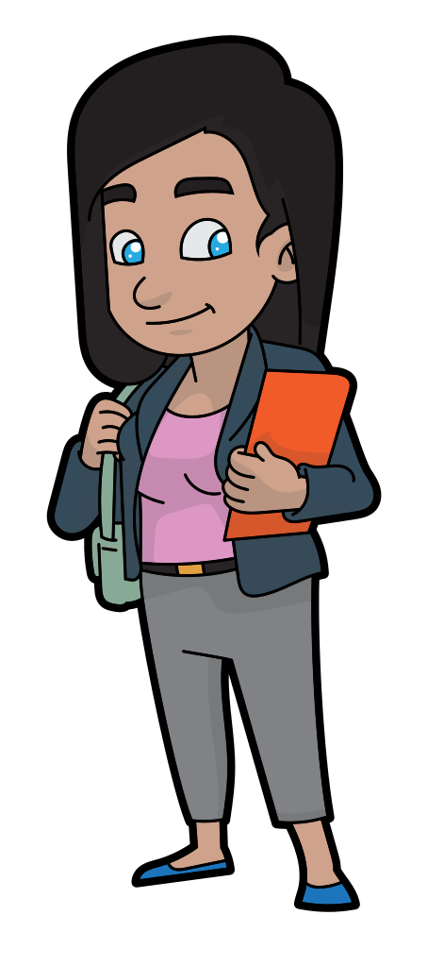
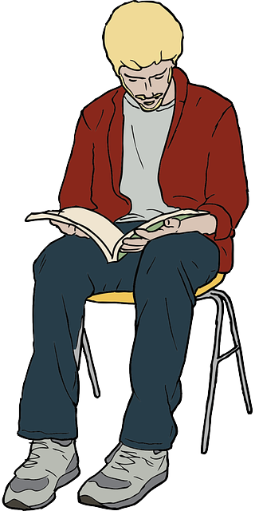
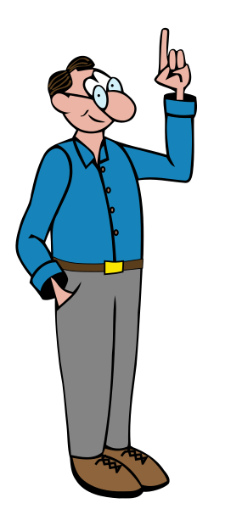
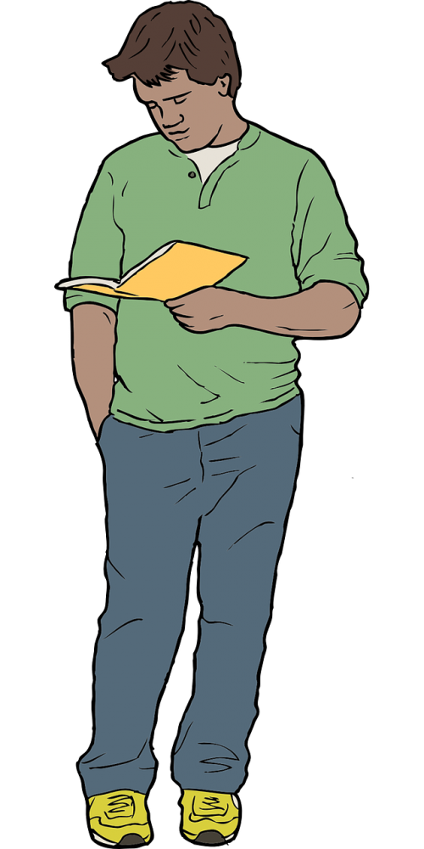
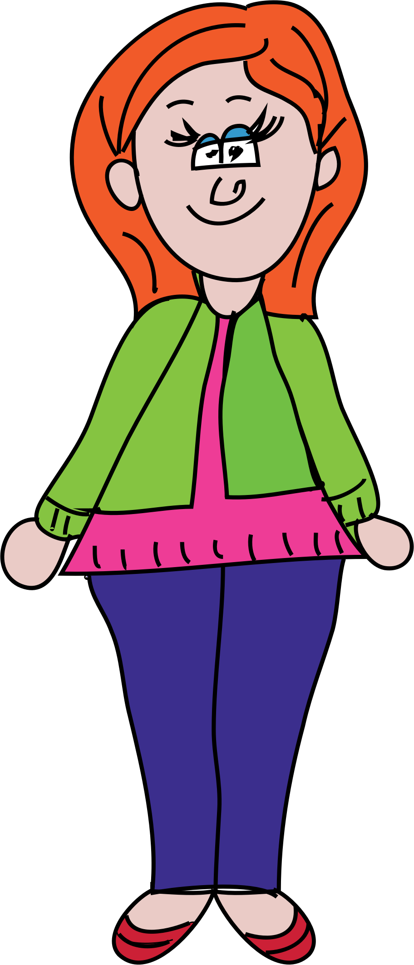
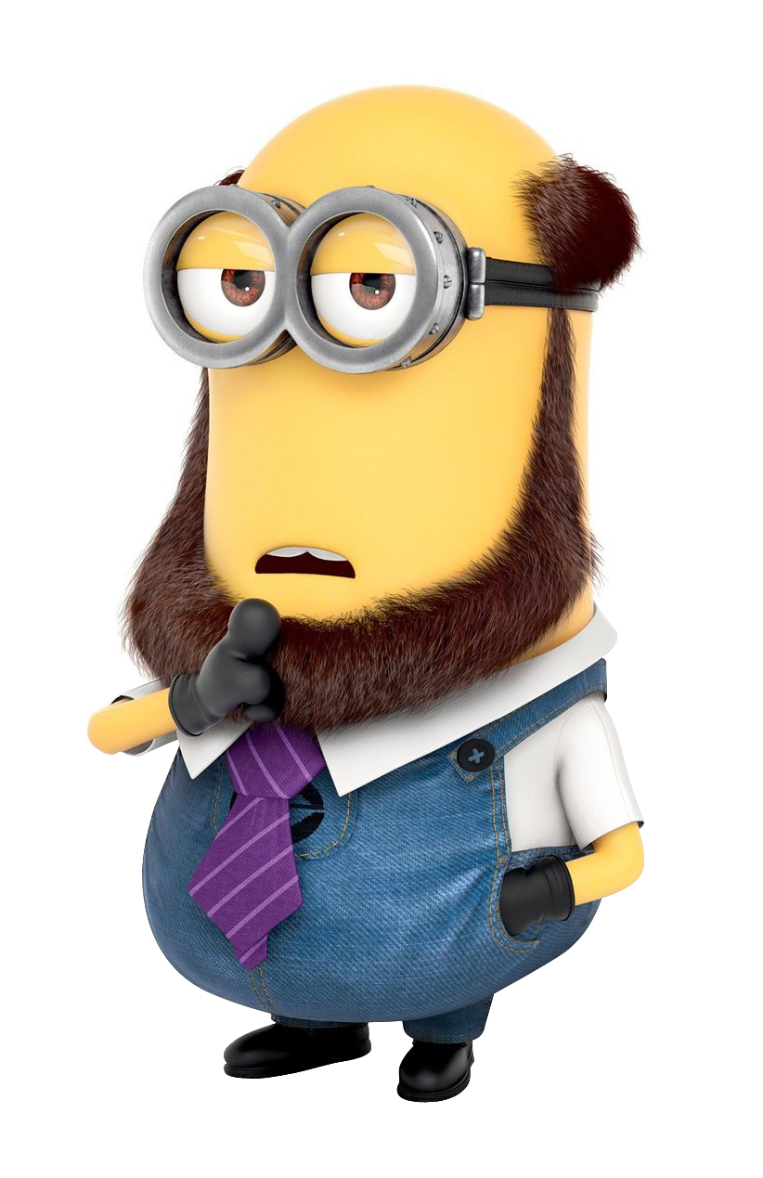
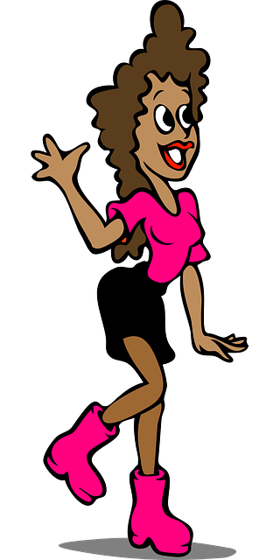
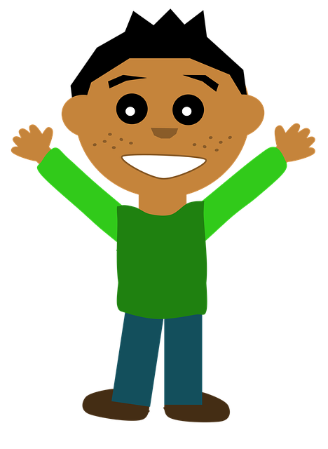
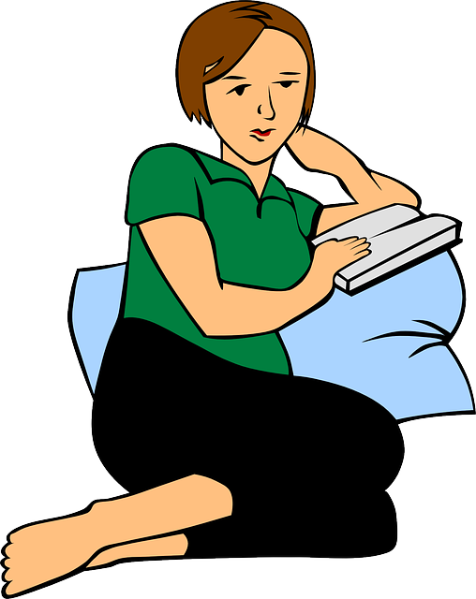
It’s best to start by clicking on the people whose names are in blue
Back to instructions
Seren
In the original, this slide has a background image representing the University campuses, referred to as the ‘map’ in the instructions.
Adam
Tomi
Kamal
Gil
Arun
Ken
Student Services
Kim
University Library
Students’ Union Advice
Samira
Baz
Sara
Finn
Jamie
Sam
Ali
Anna
Malik
This Photo by Unknown Author is licensed under CC BY-SA
This Photo by Unknown Author is licensed under CC BY-SA

Slide 6
As your personal tutor, I am pleased that you contacted me when you needed advice. That’s just what I am there for.
Great idea! Gain 10 points immediately.
Back to map

Slide 7
I’ve been writing my essay and I’ve found, in a journal paper, a paragraph that says exactly what I need to say about something so I have copied it and pasted it into my essay.
I know I should put things in my own words so I have adjusted it by substituting some words with their synonyms, altering the order of phrases a bit, removing a few phrases and adding one or two others.
The student now considers it to be “in her own words”. Is this right?
Has she breached the academic integrity regulations?
What would you advise her to do?
This way …

Slide 8
Leave it as it is but add a citation for the journal paper.
You should contact your personal tutor, module lead or the academic skills hub in the library for guidance on paraphrasing
Paraphrase the contents of the article and cite and reference properly according to the requirements of your discipline, with proper acknowledgement of any direct quotes you decide to keep.
Take a few parts of the paragraph which are particularly critical to your argument and cite them properly as direct quotes. Then paraphrase the rest of the journal article more thoroughly so that it is in your own words.
Leave it as it is.
Something else?
Back to map

Slide 9
Gain 10 points ☺
Knowing what you need help with, finding an appropriate person to ask about it and supporting other students to do this shows excellent understanding of your own learning and in the long run is a very good strategy to help everyone improve.
Back to options
Back to map

Slide 10
Lose 5 points ☹
She has still plagiarised the author’s work but at least she has added a citation.
Back to options
Back to map

Slide 11
Gain 10 points ☺
Well done – this is just what you should be doing. Please note that some disciplines use direct quotes more than others (for example Law). Make sure you know about the requirements for your discipline.
Back to options
Back to map

Slide 12
Gain 5 points ☺
This is an improvement. Note that some disciplines make more use of direct quotes than others.
Back to options
Back to map

Slide 13
Lose 10 points ☹
She has plagiarised the original author’s views without acknowledgement and without properly rephrasing the work in her own words. This would be a breach of academic integrity, especially if repeated across the assessment.
Back to options
Back to map

Slide 14
If you have thought of another solution you can discuss as a group how many points you think it should gain or lose. If necessary, it might be worth discussing with your module tutor or personal tutor.
Back to options
Back to map

Slide 15
I have just come back to Uni but had an awful time over the vacation because my Mum was ill. I’m finding it so hard to concentrate on work and the deadline is in 30 minutes time.
I started looking at the assessment yesterday but I don’t know much about the subject so I looked online. I found a report online in my home language that was covering the same topic so I decided to use it. I used an automatic translation tool and then edited it.
I’ve changed a few things but not much and now I am worried about the academic integrity declaration when I submit it.
What should Sara do? What could she have done differently?
This way …

Slide 16
Add a citation to the original report in the report and an entry in the reference list, and then submit it.
Submit the report now. It’s very different from the other report (and in another language), so you don’t need to acknowledge it.
Change the references back so that they are the original references, rather than English-language equivalents, and then submit it.
Don’t submit the report now but contact your personal tutor and/or module lead and ask to see them urgently so that you can discuss an appropriate course of action.
Add the original report to the reference list, and then submit it.
Something else?
Back to map

Slide 17
Lose 20 points ☹
Although Sara has put some work in on the essay it is heavily reliant on the one she found and is not her own work. She has plagiarised the material.
Back to options
Back to map

Slide 18
Lose 10 points ☹
Sara has still borrowed too much from an unsuitable source and has not cited it in the text.
Back to options
Back to map

Slide 19
Lose 10 points ☹
Sara has still borrowed too much from an unsuitable source.
Back to options
Back to map

Slide 20
Lose 10 points ☹
Sara has still borrowed too much from an unsuitable source.
Back to options
Back to map

Slide 21
Gain 20 points ☺
A situation like this where studying has been made more difficult because of significant, unusual family circumstances is likely to lead to a special considerations application. You can still apply even if you have had a previous application. The best person to discuss this with initially is your personal tutor or module lead.
Back to options
Back to map

Slide 22
If you have thought of another solution you can discuss as a group how many points you think it should gain or lose. If necessary, it might be worth discussing with your module tutor or personal tutor.
Back to options
Back to map

Slide 23
I have referenced all the text in my report appropriately for my subject. I have found some images from an internet search which I feel really fit with what I am writing and will make my report stand out from the rest so I have decided to include them. Will that be OK?
Arun needs some advice about what to do. What would you say to him?
This way …
This Photo by Unknown Author is licensed under CC BY-SA

Slide 24
Leave your work as it is. It will be fine.
Add appropriate citation in the text. Check in the guidance you have been advised to follow for citation and referencing in your discipline.
Add appropriate citation in the text and include the source in your reference list, following the guidance for your discipline.
Something else?
Back to map

Slide 25
Lose 10 points ☹.
Everyone should should properly acknowledge anything they use in their work, including images, graphs and computer code to avoid issues with plagiarism.
Back to options
Back to map

Slide 26
Gain 5 points ☺
This is a good start – Arun has at least acknowledged the source.
Back to options
Back to map

Slide 27
Gain 10 points ☺
Great advice! Just what is needed. You should cite and reference figures, images and tables as well as text.
Back to options
Back to map

Slide 28
If you have thought of another solution you can discuss as a group how many points you think it should gain or lose. If necessary, it might be worth discussing with your module tutor or personal tutor.
Back to options
Back to map

Slide 29
There was a great book that would have been perfect for my essay but I have not been able to see a copy of it before my essay is due. I know about it because the standard text book for my course quotes extensively from that book.
I think I can carefully cite and reference the one great book rather than the standard text book.
Is this a breach of academic integrity?
What else could this student have done?
This way …

Slide 30
Ask the library for help in tracking down the original source so that you can read it and cite it properly
Rather than citing the text you couldn’t track down, use ‘cited in’ or any other technique specified by your discipline
Leave the citation and reference as it is.
Something else?
Back to map

Slide 31
Lose 10 points ☹
Although the student has tried to acknowledge the source they have not found and read the original. You should only cite and reference sources you have actually read (or at least partially read – you do not necessarily have to have read the whole of a large book). If you have not managed to find the original source you should use ‘cited in’ or any other technique specified by your discipline.
Back to options
Back to map

Slide 32
Gain 10 points ☺.
It’s well worth asking and the library will do all they can to help.
Back to options
Back to map

Slide 33
Gain 5 points ☺
This is fine, especially at Undergraduate level and/or if the source is particularly difficult to track down.
Back to options
Back to map

Slide 34
If you have thought of another solution you can discuss as a group how many points you think it should gain or lose. If necessary, it might be worth discussing with your module tutor or personal tutor.
Back to options
Back to map

Slide 35
Unsurprisingly the programme I have decided to study at the University is related to work I have submitted on a previous course. The module I am working on now even asks a very similar question. I have dug out the course work I did on this and am thinking of submitting it.
What do you think about this course of action?
What would be a different approach?
This way …

Slide 36
Submit the work you have completed previously
Work on your new coursework writing a new answer but have the older work readily available to help you.
Read the work through and then consider carefully how you can now develop the ideas with further study
Something else?
Back to map

Slide 37
Lose 10 points ☹
This is recycling, or self-plagiarising work. You have already gained credit for it so you cannot resubmit it and gain more credit for the same material. It doesn’t matter whether the work was completed at this University or elsewhere and it includes work on preparatory courses such as pre-sessionals. The same applies when looking at assessments for different modules on your current course – you cannot just copy and paste across unless you have been advised otherwise.
Back to options
Back to map

Slide 38
0 points gained or lost.
You put yourself in a risky situation as you could copy material. Much better to have a look at it and then put it away. The same applies when looking at assessments for different modules on your current course – you cannot just copy and paste across unless you have been advised otherwise.
Back to options
Back to map

Slide 39
Gain 10 points ☺
It’s a good idea to build on your previous learning but it should be seen as a starting point rather than something more. The same applies when looking at assessments for different modules on your current course – you cannot just copy and paste across unless you have been advised otherwise.
Back to options
Back to map

Slide 40
If you have thought of another solution you can discuss as a group how many points you think it should gain or lose. If necessary, it might be worth discussing with your module tutor or personal tutor.
Back to options
Back to map

Slide 41
When meeting with my personal tutor they were called out of the room. I saw that they had left a print out with suggested exam questions for the exam at the end of one of the modules I am studying.
I quickly took a picture of them on my phone. I decided not to share them with anyone but I have had a quick look. I then deleted the image on my phone so everything so should be OK shouldn’t it?
What do you think of this course of action? To what extent is it the student’s fault? How would you feel if a student studying the same module as you had done this? What else could the student have done?
This way …

Slide 42
You should have ignored the print out and point out to your personal tutor that you have noticed the print out but have deliberately ignored it to ensure you did not gain an unfair advantage.
Share the photo with other students studying the same module.
Keep quiet and carry on.
Whilst you were waiting for your personal tutor to return, you should have ignored the print out and deliberately got your phone out to give you something else to concentrate on.
Make contact with the Programme Director or another academic straight away. This needs sorting out.
Something else?
Back to map

Slide 43
Lose 20 points ☺.
This is cheating – the student has gained an unfair advantage which is not fair on other students.
Back to options
Back to map

Slide 44
Gain 10 points ☺
This is a good course of action which makes it fair for everyone.
Back to options
Back to map

Slide 45
Lose 20 points ☺.
Sharing the photo does not resolve the issue around cheating – it just compounds the problem and means that the assessment is not fair for example in comparison to other modules or other years that the module has run.
Back to options
Back to map

Slide 46
Gain 20 points ☺.
This is an honest course of action and this allows the personal tutor to sort out the issue.
Back to options
Back to map

Slide 47
Gain 10 points ☺.
Although this would be difficult, this allows the problem to be sorted out.
Back to options
Back to map

Slide 48
If you have thought of another solution you can discuss as a group how many points you think it should gain or lose. If necessary, it might be worth discussing with your module tutor or personal tutor.
Back to options
Back to map

Slide 49
My smart watch looks like a normal watch but is able to carry data and text that I can access easily. I am really struggling to remember some quotations that I feel will really work well in the type of questions I know have been asked in previous exams.
I put these into my watch feeling it is only fair so that I can work at the same level as other people on my module who can remember these things easily. During the assessment I think I can pretend that I am concerned about how much time I am taking on each section of answers but instead I can read the quotations and use them.
Is the student’s behaviour really ‘fair’?
What should they do?
This way …

Slide 50
Make sure you have a watch that is suitable for use in exams and don’t use the smart watch.
Continue using your watch.
Seek help with remembering quotations from your module tutor, personal tutor and/or the Student Hub.
Something else?
Back to map

Slide 51
Lose 20 points ☹.
This is cheating and unfair on the student taking the exam, fellow students and future employers. The student runs the risk of their exam mark being declared null and void. Any devices such as this are not appropriate for use in exams.
Back to options
Back to map

Slide 52
Gain 5 points ☺.
This is good preparation for any exams or similar timed assessments in your course.
Back to options
Back to map

Slide 53
Gain 20 points ☺.
In the long run, developing your memory skills will be valuable for your course, employment and life.
Back to options
Back to map

Slide 54
If you have thought of another solution you can discuss as a group how many points you think it should gain or lose. If necessary, it might be worth discussing with your module tutor or personal tutor.
Back to options
Back to map

Slide 55
A friend asked me for help with an assignment. It’s a few days since I completed the assignment, so I looked at my own work to remind me. My friend seemed desperate because the deadline is not far off and they asked if they could look at it too. So I let them have a copy but reminded them they should not copy it.
Has this student breached AI regulations?
Has their friend breached AI regulations?
What advice would you give?
This way …

Slide 56
Talk through the ideas with your friend but don’t share the actual assignment.
Go ahead with letting your friend read your assignment.
Tell the module lead that you are concerned about your friend and that they have asked you to show them their assignment.
Encourage your friend to seek help from the module lead or tutor.
Something else?
Back to map

Slide 57
Lose 10 points ☹.
You have helped your friend gain an unfair advantage and therefore both you and your friend have colluded. You have both breached AI regulations. This applies even if you tell your friend not to copy the assignment. Once you have passed it on to someone else you have lost control and anything could happen, however good a friend they are.
Back to options
Back to map

Slide 58
Gain 10 points ☺.
Talking through and discussing ideas is an important part of learning. The only time you should be cautious about doing this is if you have been advised by the University that talking about an assessment like this is not allowed which may happen in some instances, especially with online assessments.
Back to options
Back to map

Slide 59
Gain 10 points ☺.
Academic staff are there to help when you are stuck. They will tell you if you are asking for more help than they can give.
Back to options
Back to map

Slide 60
Gain 10 points ☺.
If you are feeling under pressure to support a fellow student beyond what is acceptable this is a totally appropriate course of action.
Back to options
Back to map

Slide 61
If you have thought of another solution you can discuss as a group how many points you think it should gain or lose. If necessary, it might be worth discussing with your module tutor or personal tutor.
Back to options
Back to map

Slide 62
I often work on assessments in the Library. As I am there at busy times, when I go to get a drink I do not bother to close down my laptop and it has always been safe.
I have recently submitted some work and was called to see an Academic Integrity Officer. They told me that my work has a very high similarity to what another student on the module submitted slightly earlier. I don’t know what to do because I know it was my own work.
What has gone wrong here?
What steps should everyone take to ensure their work is safe?
What evidence could you encourage the student to provide to show that they were the original author of what was submitted?
What sources of advice and help would you encourage them to approach?
This way …

Slide 63
Carry on in the same way – it won’t happen again .
Ask the student what drafts of their work they have saved and encourage them to share these with the Academic Integrity Officer.
Suggest that the student approaches the Students’ Union advice centre, their personal tutor or the module lead for support.
Something else?
Back to map

Slide 64
Lose 20 points ☺.
For any student, failing to secure your work on any device risks breaching academic integrity and would be seen as collusion. You are responsible for ensuring you have a strong secure password and appropriately closing down where necessary. It is risky to leave an unaccompanied laptop anywhere – make sure you keep it safely.
Back to options
Back to map

Slide 65
Gain 10 points ☺.
You do not have to face situations like this on your own. There are lots of legitimate sources of support at the University.
Back to options
Back to map

Slide 66
Gain 20 points ☺.
This is good practice. If you save different drafts of your work and can show the dates and times of these which demonstrates that you were working on this well before the other student submitted the work it will help demonstrate that you have not breached Academic Integrity.
Back to options
Back to map

Slide 67
If you have thought of another solution you can discuss as a group how many points you think it should gain or lose. If necessary, it might be worth discussing with your module tutor or personal tutor.
Back to options
Back to map

Slide 68
I had such a good break over the holiday and managed to get on top of all my assignments, finishing some of the tougher essays before the deadline. I even enjoyed writing the first one due in.
One of my friends on that module did not have a good break. Their long-term partner broke up with them and since then they haven’t been able to think about studying much at all.
During a chat in a café (it’s about a week until the deadline), my friend asked me for help. They had clearly been crying, even if they were trying to hide it. When I asked what help they want, they suggested having a quick look at my essay, ‘just to get me started’. Of course, I want to help my friend, but what’s the best way to do it?
What would you advise this student and their friend to do?
This way …

Slide 69
Gather up all your sources and send them to your friend so they can get started.
Look your friend right in the eyes and tell them sternly “Stop crying and get on with the essay while there’s still time. People get dumped all the time and don’t go on about it for a fortnight.”
Cheerfully email your essay to your friend then go to bed knowing you’ve done your good deed for the day.
Get a cup of coffee, choose one of your other essays to work on and see if the two of you can get through this together. Don’t tell your friend anything about your essay for the module.
Offer to go with your friend to their personal tutor. It might not be too late to get an extension for the assignment and see whether other help is available.
Something else?
Back to map

Slide 70
Lose 10 points ☹.
You haven’t breached academic integrity but equally you have not supported your friend in gaining help.
Back to options
Back to map

Slide 71
Lose 5 points ☹
Whilst you might discuss ideas and resources, giving them all to your friend risks giving them an unfair advantage as often part of the assessment is finding appropriate sources.
Back to options
Back to map

Slide 72
Gain 5 points ☺.
This may help to some extent as you are providing moral support and you are not breaching academic integrity but it may not be enough in a demanding situation.
Back to options
Back to map

Slide 73
Lose 10 points ☹.
You have helped your friend gain an unfair advantage and therefore both you and your friend have colluded. You have both breached AI regulations. This applies even if you tell your friend not to copy the assignment. Once you have passed it on to someone else you have lost control and anything could happen, however good a friend they are.
Back to options
Back to map

Slide 74
Gain 10 points ☺.
Academic staff are there to help when you are stuck. They will tell you if you are asking for more help than they can give.
Back to options
Back to map

Slide 75
If you have thought of another solution you can discuss as a group how many points you think it should gain or lose. If necessary, it might be worth discussing with your module tutor or personal tutor.
Back to options
Back to map

Slide 76
My aunt is an expert in the subject that I am studying. Before I started my programme, she suggested that if I was uncertain about any work I was doing for my course, she would be happy for me to contact her and ask for advice.
In Semester 1, I was really struggling to get my essay to be sufficiently academic in tone. I emailed my aunt a copy of what I had written so far and asked her to proof read it.
She changed several parts of my phrasing and added in quotations – properly referenced – and the names of other books and articles she thought I needed to look at. That’s OK isn’t it?
What do you think about this approach to getting help with academic writing?
What should the student do with the advice given by their aunt?
What sources of help can you advise the student to access through the University?
This way …

Slide 77
Contact the Academic Skills Hub in the library or look at the other English support resources for help with your academic writing.
Look back at the notes you had made during one of your taught sessions when you discussed exemplar assignments in groups to see if there is information there that can help.
This is getting too much help so you need to thank your aunt but delete and ignore the document she sent you. You can look at some of the books and articles she has suggested.
Use all of your aunt’s suggestions and submit the essay.
Make an appointment to see your personal tutor to talk about your concerns.
Something else?
Back to map

Slide 78
Lose 10 points ☹.
Because your aunt has actually edited the essay and added material this would be classed as ‘external authorship’ and is a breach of academic integrity. If she had just pointed out some points that were not clear and left you to make all the changes it would have been fine.
Back to options
Back to map

Slide 79
Gain 5 points ☺.
This is fine – you can talk to people to gain ideas and follow these up but you should not accept direct help and editing of your written work.
Back to options
Back to map

Slide 80
Gain 10 points ☺.
This is an excellent idea – they are there to help you. You can find more information on the academic skills section of the library website.
Back to options
Back to map

Slide 81
Gain 5 points ☺.
You obviously need to be careful not to copy from exemplar assignments but they are there to help you learn and working from your notes is definitely safer than looking back at the actual assignments
Back to options
Back to map

Slide 82
Gain 10 points ☺.
Your personal tutor is there to advise you on such matters. Remember they will often refer you to appropriate sources of help in the University such as the Academic Skills support in the library.
Back to options
Back to map

Slide 83
If you have thought of another solution you can discuss as a group how many points you think it should gain or lose. If necessary, it might be worth discussing with your module tutor or personal tutor.
Back to options
Back to map

Slide 84
I have been battling with my assignment and have just received an message on my University email telling me there is support available from an organisation external to the University. They can help students with their academic writing and provide model answers.
It looks good but there is nothing to suggest that the University really has recommended this (such as a connection made through Student services). I am wondering whether it is OK to follow this up?
What would you advise this student to do?
This way …

Slide 85
Respond to the email and ask for further information.
Respond to the email, gain further information and buy an exemplar essay which you then submit as your own work.
You agree to share an essay that you have written in return for assignment support.
Ignore the email and seek support if necessary from proper University sources such as your module lead, personal tutor, the library or Students’ Union.
You report the website to (University contact for reporting)
Something else?
Back to map

Slide 86
Lose 10 points ☹.
By communicating with such companies or individuals you are opening yourself potential issues with academic integrity, under the category of ‘external authorship’. Many of these companies are unscrupulous and once you have contacted them you are laying yourself open to problems.
Back to options
Back to map

Slide 87
Lose 50 points ☹☹☹.
This would be regarded as a very serious breach of the regulations in relation to external authorship and should not even be considered. You lay yourself open to blackmail both during your time at the University and with future employers, and potentially identity theft.
Back to options
Back to map

Slide 88
Gain 20 points ☺.
This is a much better course of action. There are plenty of legitimate sources of support within the University.
Back to options
Back to map

Slide 89
Lose 30 points ☹.
If you engage with the company you open the possibility of a serious breach of academic integrity as you do not know what they will do with your assignment.
Back to options
Back to map

Slide 90
Gain 20 points ☺.
We monitor constantly to try and stop such emails. Reporting them is very helpful and can help stop unauthorised communications such as this.
Back to options
Back to map

Slide 91
If you have thought of another solution you can discuss as a group how many points you think it should gain or lose. If necessary, it might be worth discussing with your module tutor or personal tutor.
Back to options
Back to map

Slide 92
I’m on a great WhatsApp group for students studying my subject and really value the moral support and suggestions for reading that are often shared on it.
One day I noticed one of the members of the group (but not someone I actually know) was offering to help with assignments.
I thought this might be useful because this person will understand the challenges I am facing with the module and surely it’s OK to have help like this?
What advice would you give?
This way …

Slide 93
Report the approach to the module lead.
Ignore the approach and get on with your assignment using legitimate support such as groups of peers arranged within the module, the Academic Skills Hub, the Students’ Union and the Student Hub.
Contact the person concerned and ask for support. They might be able to help you with your work and you have found the group helpful.
Report the approach to (University contact for reporting)
Something else?
Back to map

Slide 94
Lose 20 points ☹.
If they are another person on the course there is a high risk of both of you being penalised for collusion. You can talk about ideas but not help directly with assessments that should be completed independently. If this person was external to the University then this would be classified as ‘external authorship’. If they are alumni of the University they are still subject to academic integrity regulations and run the risk of being seriously penalised. You would also be penalised.
Back to options
Back to map

Slide 95
Gain 20 points ☺.
We cannot monitor groups on social media if they do not come through University systems but we can take action if appropriate.
Back to options
Back to map

Slide 96
Gain 10 points ☺.
This is entirely appropriate – these are all legitimate sources of support at the University.
Back to options
Back to map

Slide 97
Gain 10 points ☺.
This helps the module lead to remind everyone that an approach like this from an unknown source is best avoided.
Back to options
Back to map

Slide 98
If you have thought of another solution you can discuss as a group how many points you think it should gain or lose. If necessary, it might be worth discussing with your module tutor or personal tutor.
Back to options
Back to map

Slide 99
English is not my first language and I am anxious about the clarity of my writing. I have sent the final draft of my essay to a commercial service that proof-reads your work to tidy up grammar and sentence structure. Now I’m worried that this might not be allowed.
Is this a breach of academic integrity?
What would you advise this student to do?
This way …

Slide 100
Ask a family member or friend to read through and point out where there are issues but not to make any changes.
Use the help provided.
Seek help from the Academic Skills support in the library.
Something else?
Back to map

Slide 101
Gain 5 points ☺.
It is acceptable to use help from others to identify small problems such as typos but you need to resolve them yourself.
Back to options
Back to map

Slide 102
Gain 10 points ☺.
This is a good course of action to get help with your writing.
Back to options
Back to map

Slide 103
Lose 10 points ☹.
This would be classified as external authorship as another person is making the changes to your work.
Back to options
Back to map

Slide 104
If you have thought of another solution you can discuss as a group how many points you think it should gain or lose. If necessary, it might be worth discussing with your module tutor or personal tutor.
Back to options
Back to map

Slide 105
I was really struggling to write the research report due in yesterday and in desperation I bought the report from one of the assignment-writing companies I saw advertised online.
It seemed really cheap but the company has now contacted me saying that unless I pay a further £300, they will alert the University to the fact that they provided the essay. What should I do?
How common do you think such situations are?
What advice would you give?
How can everyone avoid getting into situations like this?
This way …
This Photo by Unknown Author is licensed under CC BY-SA

Slide 106
You should just pay and hope that is the last of it.
Ensure your friend makes an appointment to see their personal tutor or another academic they know well and go with them to help them get there or arrange an online meeting.
It’s your own fault – you will just have to deal with the consequences.
Something else?
Back to map

Slide 107
Lose 10 points ☹.
This doesn’t help the situation. We all make mistakes at times and we need our friends to help us find a way through.
Back to options
Back to map

Slide 108
Gain 20 points ☺.
By supporting the student to seek help you are upholding both your friend and standards at the University.
Back to options
Back to map

Slide 109
Lose 10 points ☹.
You would be advising the student to do something that could lead to longer term problems.
Back to options
Back to map

Slide 110
If you have thought of another solution you can discuss as a group how many points you think it should gain or lose. If necessary, it might be worth discussing with your module tutor or personal tutor.
Back to options
Back to map

Slide 111
The staff in the library will be happy to help with queries and there is lots of valuable advice on the library website.
Great idea! Gain 10 points for going to a good source of advice.
Back to map

Slide 112
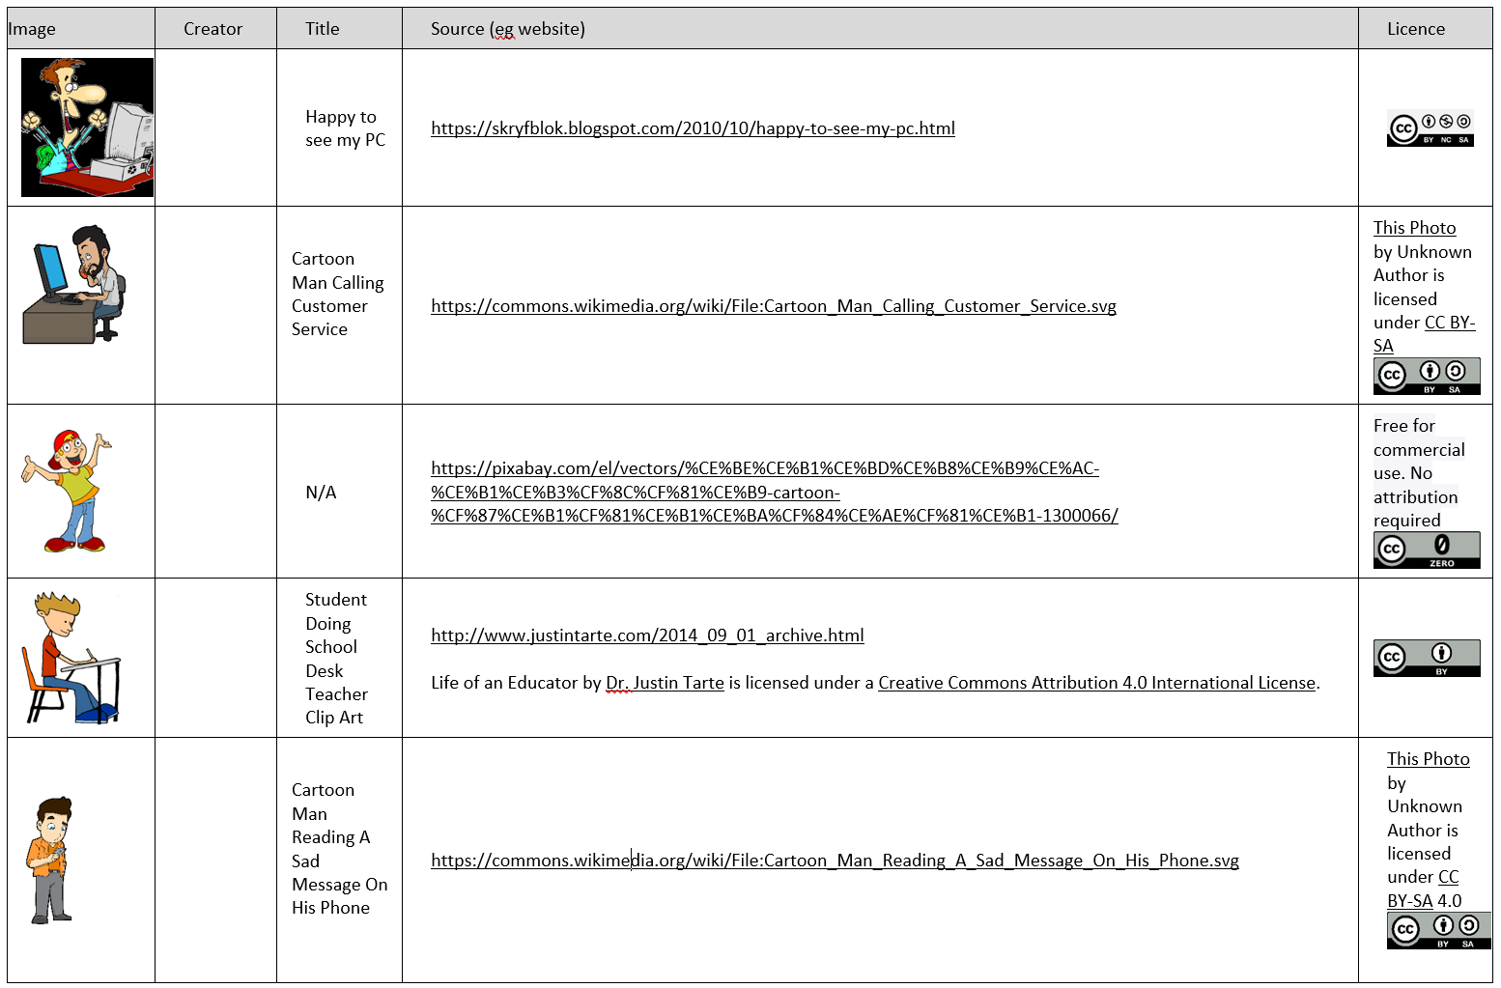
Image sources, licenses and credits 1
This way …

Slide 113
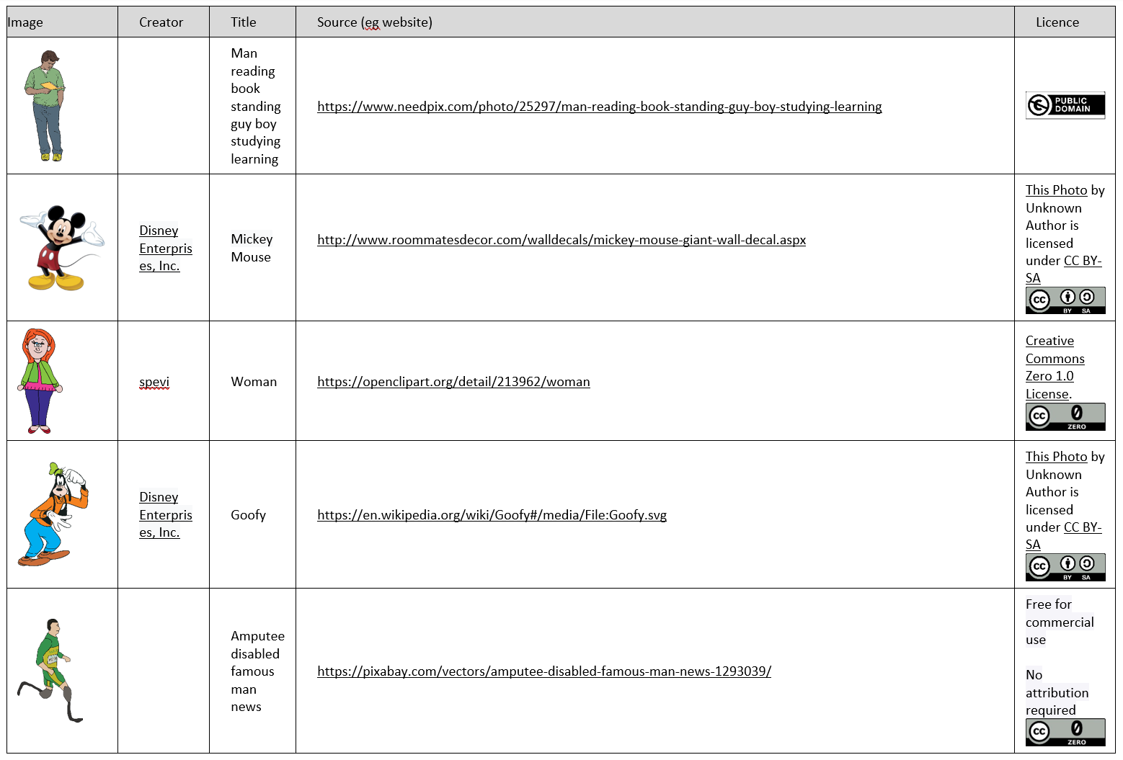
Image sources, licenses and credits 2
This way …

Slide 114
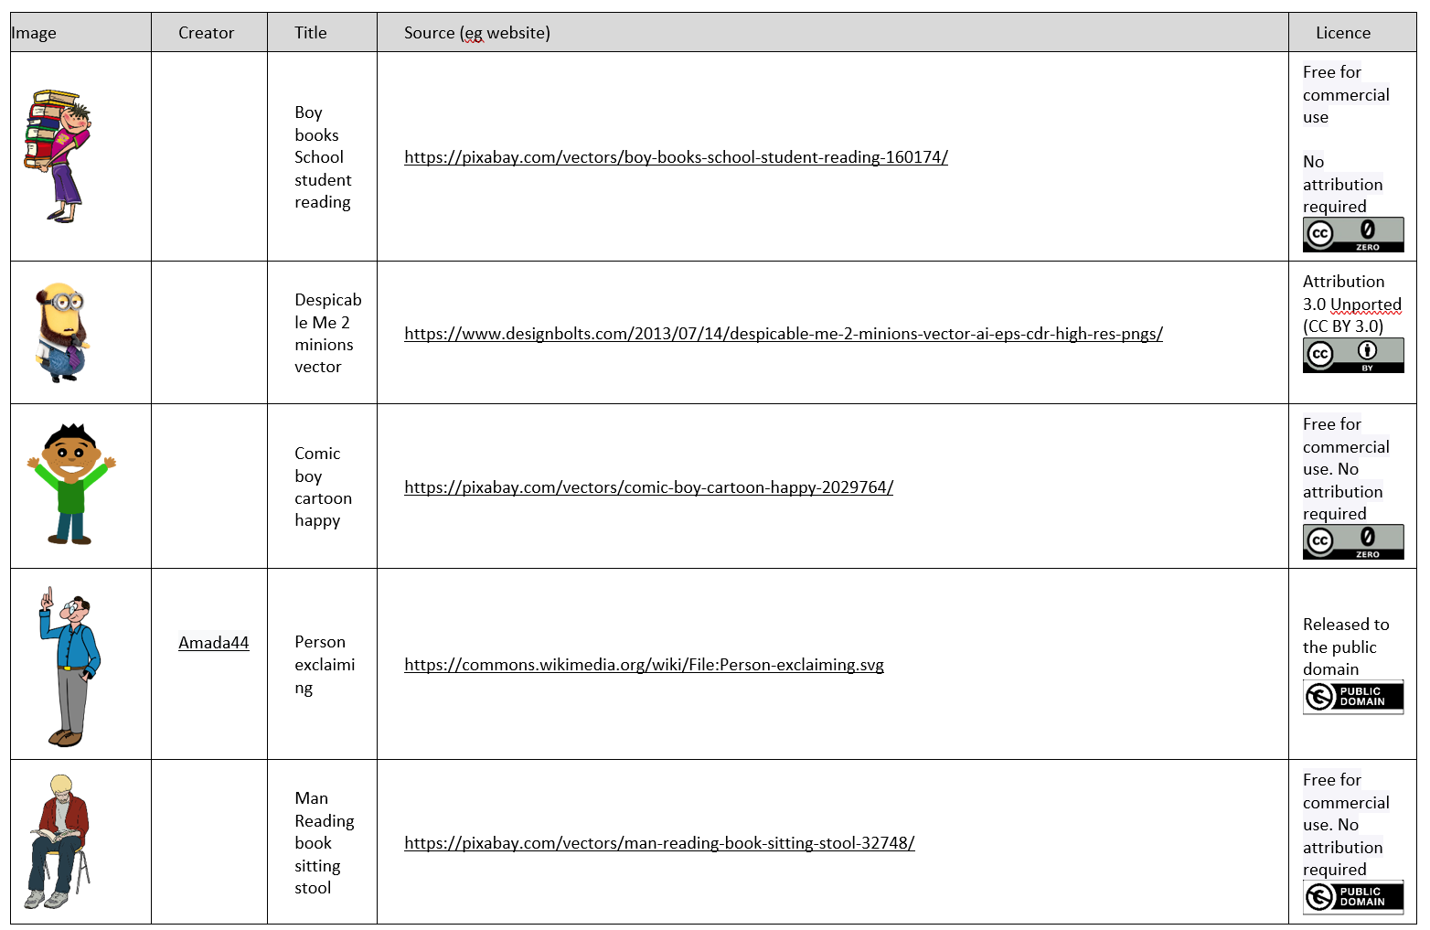
Image sources, licenses and credits 3
This way …

Slide 115
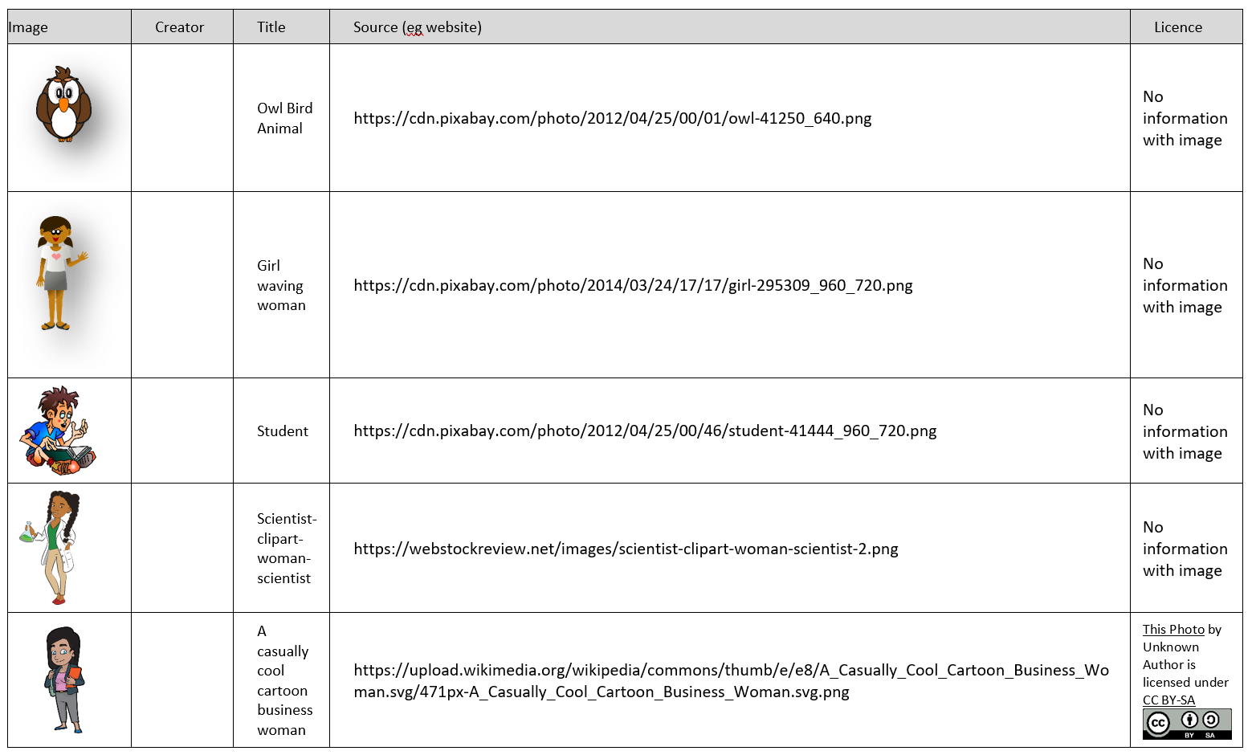
Image sources, licenses and credits 4
This way …

Slide 116
Image sources, licenses and credits 5
Back to instructions

