Slide 1
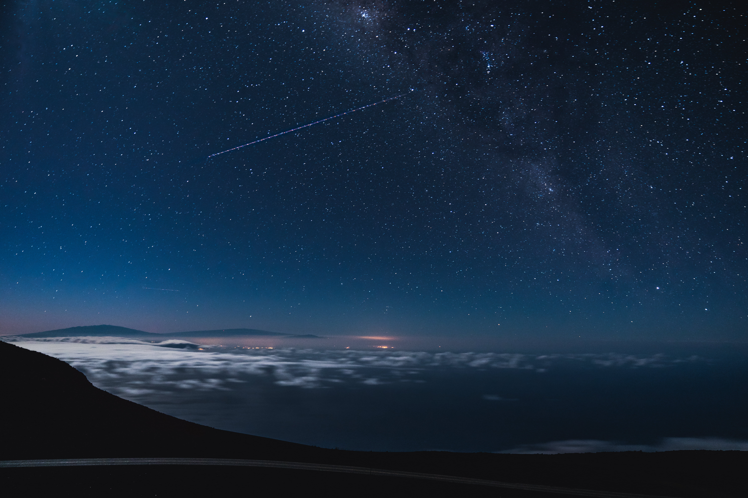



Introduction: Physiology is a subject that involves the application of knowledge in response to a wide variety of different scenarios. It is relevant to a wide range of different disciplines including the biosciences, forensics, sports science, nutrition, pharmacology and many more. As a result physiology modules are often taught to a broad cohort of students studying a variety of subjects in Higher Education. Therefore, it is imperative that students understand the relevance of physiological concepts to their own discipline in order to engage them with the physiology content.
Rationale: One of the best ways to achieve this is through the exploration of the physiological response in different scenarios (e.g. health and disease, varied environmental settings, situations of physical or emotional stress) from the perspective of the students’ primary discipline. Furthermore, such a diverse student cohort provides an opportunity for students to learn from others with different lived experiences from their own, and to understand the relevance of physiology not only to their own discipline, but to others.
Method: In the example provided here, students were allocated into groups to provide as much diversity as possible including a range of nationalities, cultures, subject specialisms, age, sex etc. Students were not provided with any access to research tools and given only one hour to plan a trip to space. For further details on this and some examples of typical student responses, please see the accompanying notes.
Evaluation and conclusions: Students are often surprised how much they can contribute with little or no background knowledge of space travel and realise the importance of physiology to their discipline. These tasks build confidence and relationships as students share their unique perspectives to contribute to the wider understanding of the scenario presented. Students benefit from learning how others think and gain an appreciation that any conclusions that they might make about a given scenario would be impacted by a more comprehensive consideration of different viewpoints.
Embedding Mental Wellbeing: Methods and Benefits
Collaborative Enhancement Project 2021
Building confidence through active and inclusive group work in physiology
The Task
Working in diverse, interdisciplinary teams, plan a trip to space.
Students might wish to consider:
Preparation – What should they do before they go?
Destination – Where will they go and what are the consequences of this?
Health and wellbeing – What health problems might they face and how would they maintain health whilst on board?
Protection – What should they be concerned about?
Return – When they arrive back on earth, what might they need to do?
Dr Abigail Rickard, University of Greenwich

Slide 2








Human Nutritionists: Calculations of daily biochemical requirements specifically for individuals travelling in space will need to be made and a consideration of what non-perishable food, free from the risk of food poisoning can be made available that is appropriate in terms of both nutritional value but that will provide satisfaction to account for various zero-gravity induced changes (e.g. alterations in taste therefore consider providing spicy foods).
Pharmaceutical Scientists: Medications will need to be carefully chosen to be taken on board and how space travel might interfere with drug metabolism and/or increase side-effects of drug actions in microgravity.
Bioscientists: Effects on circadian rhythm (in low orbit the sun rises and sets every 90 minutes, disturbing natural rhythms making sleep difficult). Weightlessness causing disturbances to vision (nearsightedness) and hearing (loss), cardiovascular (lower blood volume and lower erythrocyte count) and renal system (dehydration) due to redistribution of blood. A careful consideration on how these can be monitored and the risks associated with these changes minimised.
Psychologists: Isolation/solitude/loneliness/confinement of movement, small living quarters etc. all lead to monotony. Therefore, a range of activities and group bonding activities should be undertaken and the importance of crew selection (cultural background of crew, leadership qualities of commander, sex, age, emotional stability, expertise, cooperativeness) should all be considered.
Sports Scientists: Due to the reduced effort in standing/moving there is muscle atrophy associated with space travel. Coupled with this is a reduced bone density, thus making space-travellers more susceptible to bone fractures. Therefore, muscle-building activities before, during and after space flight are important to maintain physical health during space travel.
Physicists: Huge and varied sources of radiation in space (solar x-rays, solar-flare neutrons and gamma rays, solar-flare electrons, protons and solar particles, Jovian electrons, galactic and extragalactic cosmic rays). Consideration would therefore need to be made in both destination (varied levels of protection afforded from Earth’s atmosphere/Van Allen belt etc.) and spaceship/vessel design to prevent short and long-term effects of radiation exposure and magnetic fields.
Biochemical Engineers: A careful consideration of how to maintain a healthy internal environment within the space vessel, whilst recycling everything (e.g. H₂0, O₂, CO₂ etc.) and working with bioscientists and human nutritionists to develop environments to grow new food on board.
Examples of discipline contributions
Please note that this list is not exhaustive but designed to be indicative only. Other disciplines could be invited to consider how their knowledge would be useful in planning the trip to space

