Slide 1
Coaching and Mentoring:
an “How to” learning opportunity
Theme 2.1: Promoting the mentoring relationship - self-development

Slide 2
Content
Principles of self-development within the mentoring and coaching context
Developing standards, relationship forming
Application and utilisation of models of self and personal development
Notes:
An overview of session content

Slide 3
The story so far…
Coaching and mentoring are effective approaches to personal and professional development
Mentoring and coaching enable personal growth and the acquisition of new knowledge and skills. They both involve building rapport between two people.
A mentor enables the mentee to access the “inside knowledge… and contributes to long-term development
Coaching is typically the provision of an environment that enables the attainment of specific goals related to their work performance that are typically specific, and short term – capability focussed.
Coaching can be either a focused intervention with set boundaries, or a informal style or an approach used to manage everyday situations in the workplace.
Adoption of a coaching style in management and leadership roles will help to support and develop personal, team, goal, and contextual awareness
Notes:
This presents the six key messages and reinforces what has been discussed in the previous session

Slide 4
Self development?
A “fluffy” meaningless process?
Is it important in the M/C process?
Notes:
Explore the key tenets of user perspectives related to self development in organisations… an honest real world view sharing both positive and negative stories.

Slide 5
In breakout rooms (15 mins):
Consider what is self-development?
Is it really important?
What does successful self-development mean to you professionally, personally, socially?
Notes:
Small group activity that explores what participants view as “self development” and how this can be used to enhance their life – a multi-dimensional approach

Slide 6
Group feedback
What is self-development?
What is good self-development?
Notes:
Receive feedback on how self-development is viewed. Identify what is good self-development by reflecting upon experiences.
Link to: https://www.cipd.co.uk/news-views/nutshell/issue-121/leader-development

Slide 7
The ability to facilitate growth through self-development is a key function of the Mentor/Coach
Refer back to the role of the M/C
Notes:
Emphasise the mentor's role, illustrate with case examples and draw upon: Thompson C (2019) 'The magic of mentoring: developing others and yourself', Routledge.

Slide 8
Do values influence process?
In breakout rooms/groups (15 minutes):
Write down four values in your life that matter to you most
Back in the main room (30 seconds):
Out of the four values you identified, decide which two you find least important.
Questions:
How do you feel about the values identified in your groups? Were they the kinds of things you expected or were there surprises?
How do these values show themselves in everyday life?
What actions do people take to live by them?
What actions could we make to live by them?
If you could agree on one key value as a collective, what would it be?
Notes:
This activity explores the notion of values… social constructionism and that we are all different. There is likely to be a multiplicity of values with little agreement – reflecting the
The challenges that this brings to us as individuals and achieving consensus on value is difficult. The notion of multiple lenses.
This is underpinned by chapter 6 Exploring beliefs and values in Lancer, Clutterbuck and Megginson 2016 Techniques for Coaching and Mentoring 2nd Edition. Routledge

Slide 9
Feedback
Value consensus?
Each group feedback their key value and explain why
Notes:
Draw upon chapter 6 Exploring beliefs and values in Lancer, Clutterbuck and Megginson 2016 Techniques for Coaching and Mentoring 2nd Edition. Routledge

Slide 10
Models of self-development
Personal development is a lifelong process. It is a way for people to assess their skills and qualities, consider their aims in life and set goals in order to realise and maximise their potential.
Maslow (1970) suggests that all individuals have an in-built need for personal development which occurs through a process… self-actualisation.
Notes:
Joyce, B., & Calhoun, E. (2010). Models of professional development: A celebration of educators. Corwin Press, https://doi.org/10.4135/9781452219387

Slide 11
Maslow: a critique
At this point thought we’d spend the next 30 mins exploring the theoretical basis of Maslow….
Nah, not really! Just this…
Self-actualisation - the desire that everybody has ‘to become everything that they are capable of becoming’; the need to reach full potential as a unique human being.
Attainment involves being in touch with who you are, and who you have become.
Notes:
Useful reading to inform discussion: Hoffman, E., & Compton, W. C. (2022). The Dao of Maslow: A New Direction for Mentorship. Journal of Humanistic Psychology, 0(0). https://doi.org/10.1177/00221678221076574

Slide 12
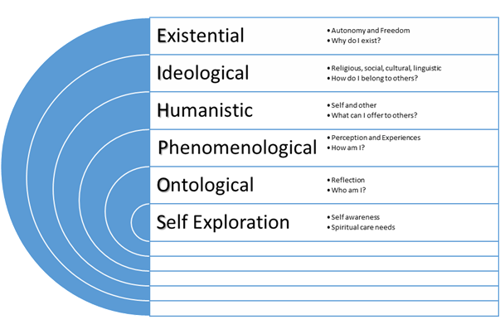
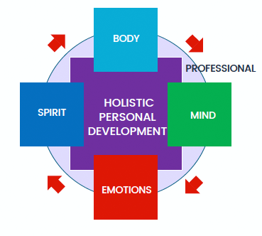
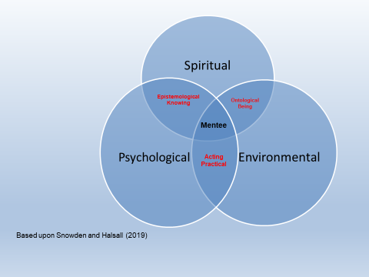
Holistic approach to development
Notes:
Emphasises the mentors role in holistic development and the notion of holism see and draw upon specifically: Ali, G., and Snowden, M (2019) SOPHIE (Self-exploration through Ontological, Phenomenological, Humanistic, Ideological, and Existential expressions) - A Mentoring Framework. In: Mentorship, Leadership, and Research: their place within the Social Science Curriculum. Snowden, M. & Halsall, J. (eds.). Springer International Publishing AG, p. 107-116
Snowden, M & Halsall, J. (2019) Mentoring and Post graduate Supervision. In: Snowden, M. & Halsall, J., 1 Jan 2019, Mentorship, Leadership, and Research: Their Place within the Social Science Curriculum. Snowden, M. & Halsall, J. (eds.). Springer International Publishing AG, p. 61-70

Slide 13
Build the relationship
1. Listening
In order to demonstrate emotional and social support, it’s important that both parties begin by offering to listen generously. After all, it’s only when we listen that we are able to hear and really understand our mentoring partner’s unique struggles and concerns but also strengths and capabilities.
2. Acknowledgement and validation
Once we’ve heard these struggles and concerns, it’s paramount that challenges are “heard” and that we validate the changes they are facing and will need to make. By providing a sounding board and supporting their decisions to help them move forward, you too can learn. Authentically sharing our own experiences, the inside knowledge/track, helps to create an environment of mutual understanding.
3. Support and affirmation
Ensure your mentee knows that you are there to provide support. Be clear about which ways you can help and which ways you can’t … engage in self-development.
4. Humour (respectful and empathic)
Whilst “heavy” topics maybe be explored, try to always end your conversations on a light, happy note.
Notes:
Draw upon Lance, Clutterbuck and Megginson (2016) and Starr, J (2016) The Mentoring Manual Your step by Step guide to becoming a better mentor. LearnStarr.
The focus here is to reaffirm the “real world” application of building the relationship.

Slide 14
How to support your mentee
Be understanding and empathic of issues and plans
Look for meaning of events and actions
Encourage reflection and honest appraisal
Focus on what they can control rather than what they can’t
Celebrate what they have achieved
Recognise and celebrate hard work and resilience proactively and prospectively
Identify and forward planning – consider next steps
Emphasise and adopt an holistic and empathic approach
Notes:
Brain storm Discuss each in turn…

Slide 15
Before your first meeting
Check their profile….
Send them a short bio or intro
Give them a bit of background on your career and some “U” bits…develop a “script”
Ask them to introduce themselves. If they haven't already, ask them to send you a short bio
Invite them to tell you which areas they'd like your insight on…accessing “what” of your inside knowledge
Consider your own experience and strengths…Development awareness
Identify what you can bring to this relationship
Consider what you want to get out of this relationship
Mentoring is always a two-way street. Reciprocity is key
Notes:
Looking ahead, the importance of making a good impression… friendly, approachable, etc. Think about the characteristics of a successful mentor

Slide 16
During your first meeting
Set the parameters- boundaries
Get housekeeping out of the way
Introductions!
Provide a more in-depth overview of your experience and career
Explore why you are both here
Let your mentee know why you’re offering your time and share how mentors have helped you along the way
Make sure you're getting it right – ask the mentee they are comfortable with the conversation and aims/goals
Make sure you come away with a clear idea of what your mentee’s needs and goals are
Notes:
Emphasise the empathic nature of the relationship… accessing experience…
Draw upon Lance, Clutterbuck and Megginson (2016) and Starr, J (2016) The Mentoring Manual Your step by Step guide to becoming a better mentor. LearnStarr.
The focus here is to reaffirm the “real world” application of building the relationship

Slide 17
Questions

