Slide 1
Coaching and Mentoring: an “How to” learning opportunity
Theme 3.1: Enabling and facilitating change – enabling insight and learning
Notes:
Emphasise the mentor's role in facilitating and enabling change

Slide 2
In this session
An exploration of Outcome Orientation models, that will bring about insight and learning of the protege / coachee
Approaches and the skills in supporting the protege / coachee to make desired changes will be explored and demonstrated
Decision making and rationality

Slide 3
Outcome and Orientation Models
What is a “OOM”?
An approach using skills in supporting the protege to make desired changes
The EMCC view this a fundamental skill in achieving mentoring and coaching capability
Notes:
Link to EMCC capability indicators

Slide 4
OOM should enable mentors to...
Assist protege to clarify and review desired outcomes and to set appropriate and congruent goals
Engage the protege to explore a range of solutions for achieving the goals
Assist proteges to effectively plan their actions including appropriate support, resourcing and contingencies and to develop and identify actions that best suit their preferences
Ensure protege is taking responsibility for their own decisions, actions and learning approach and enables the protege to identify potential barriers to applying actions
Describe and apply at least one method of building commitment to outcomes, goals and actions
Review with the protege progress and achievement of outcomes and goals and revises as appropriate
Encourage protege to explore wider context and impact of desired outcomes
Draw on a range of diverse techniques and methods to facilitate achievement of outcomes
Enable the protege explore their approach to change, promotes active experimentation and self-discovery
Notes:
EMCC CI’s

Slide 5
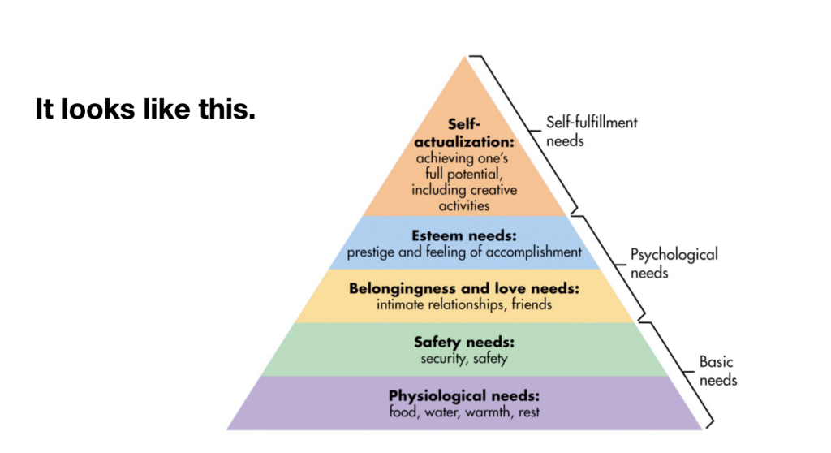
OOM
Notes:
Useful reading to inform this section:
Kamarudin, M. binti, Kamarudin, A. Y. binti, Darmi, R. binti, & Saad, N. S. binti M. (2020). A Review of Coaching and Mentoring Theories and Models. International Journal of Academic Research inProgressive Education and Development, 9(2), 289–298.
Clutterbuck, D. (2023) Coaching and Mentoring A Journey Through the Models, Theories, Frameworks and Narratives of David Clutterbuck. Routledge

Slide 6
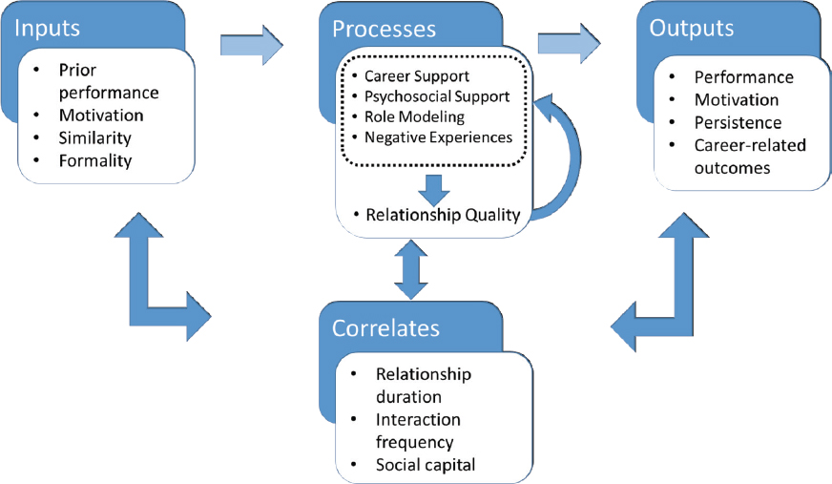
Or this….
Notes:
Draw upon Snowden, M & Halsall, J. (2019) Mentoring and Post graduate Supervision. In: Snowden, M. & Halsall, J., 1 Jan 2019, Mentorship, Leadership, and Research: Their Place within the Social Science Curriculum. Snowden, M. & Halsall, J. (eds.). Springer International Publishing AG, p. 61-70

Slide 7
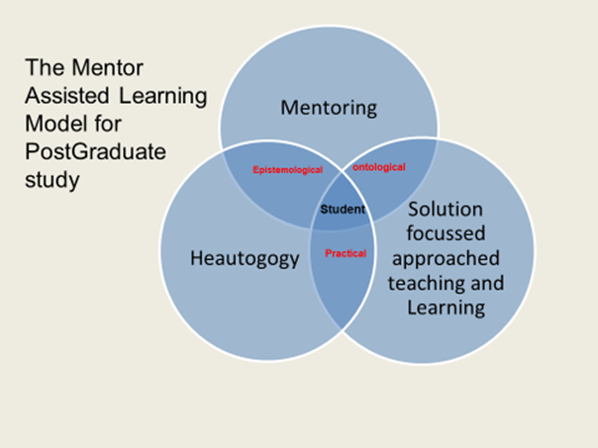
And it goes on…
Notes:
Emphasise the multiplicity of outcome models… emphasis the notion of context and dynamism… consider “fit for purpose”

Slide 8
Activity: 20 mins
How can we quantify “quality” mentoring relationships and programs—and at what point and from whose perspective?
What are the indicators of quality in mentoring relationships?
What measures assess effective mentoring relationships in your field?
What outcome measures are useful in assessing the most successful characteristics of mentoring relationships?
Notes:
Useful video Clutterbuck evaluating mentoring: https://clutterbuck-cmi.com/webinars/measuring-and-evaluating-mentoring-and-coaching/
Lancer Clutterbuck and Meggison chapter 21. Evaluating Your Coaching
Encourage self perceptions of quality and evaluation

Slide 9
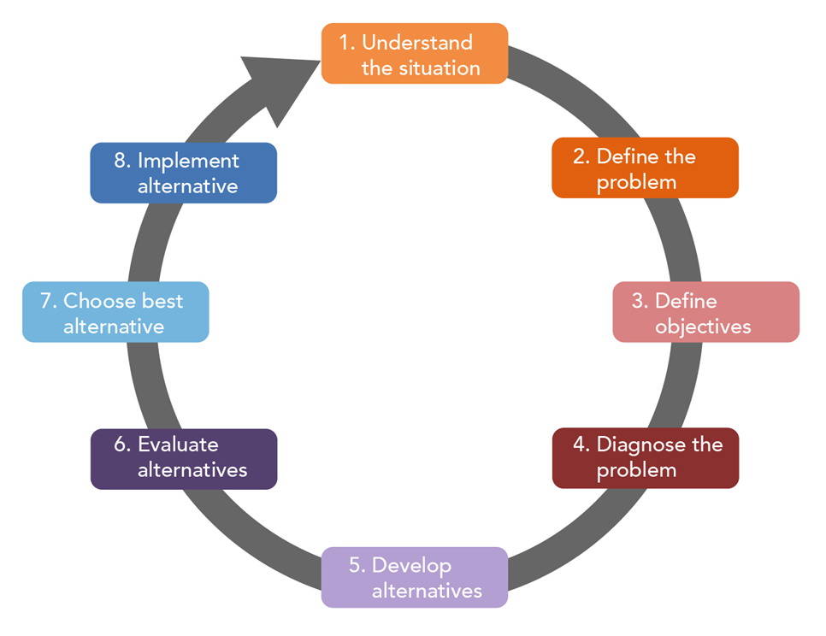
Decision making in mentoring - classic
Define and understand the problem
Identify the criteria and outcomes you will use to judge possible solutions
Decide how important each criterion and outcome is
Generate a list of possible alternatives
Evaluate those alternatives
Determine the best solution
Implement
Notes:
Draw from:
Zachary, L.J & Fischler, L.A. (2009) The Mentee's Guide: Making Mentoring Work for You
Practical illustration of how to from decision making process

Slide 10
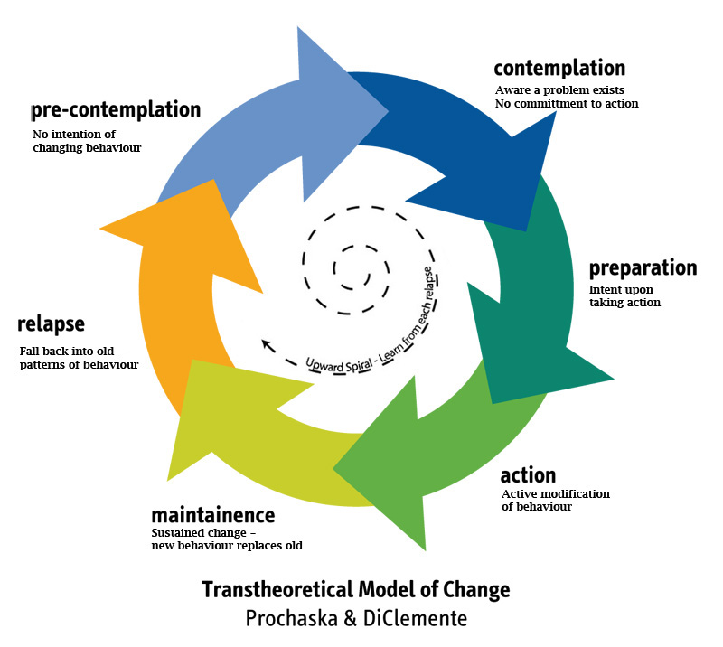
Changing behaviour: a key feature of the MC role
Mentoring and coaching is a powerful transmitter and modifier of behaviour
Classically draws upon Prochaska and DiClimente (1986)
Notes:
Prochaska, J.O. and DiClemente, C.C. (1986) Toward a Comprehensive Model of Change. Springer, New York, 3-27. http://dx.doi.org/10.1007/978-1-4613-2191-0_1.

Slide 11
Behaviour change in MC
The model includes four main constructs: the sequential stages of change; processes which people typically use to facilitate change; decisional balance, which predicts whether change will occur; and self efficacy.
The 5 stages of the model are:
Precontemplative (unaware): where you are not aware of any problems and hence are not yet ready for change.
Contemplative (thinking about it): where you see issues in need of change but cannot decide how best to react.
Preparation (doing homework): where you start learning about different approaches to dealing with those issues, deciding what works for you and developing some skills.
Action (making it happen): where you are looking for situations to develop your new behaviours, looking to improve performance.
Maintenance (focus on success) and relapse: where you seek feedback on the value of your changes. Negative feedback makes you revert to your old (more comfortable style). A mentor and Coach can be vital at this stage to help you maintain and develop your new style.

Slide 12
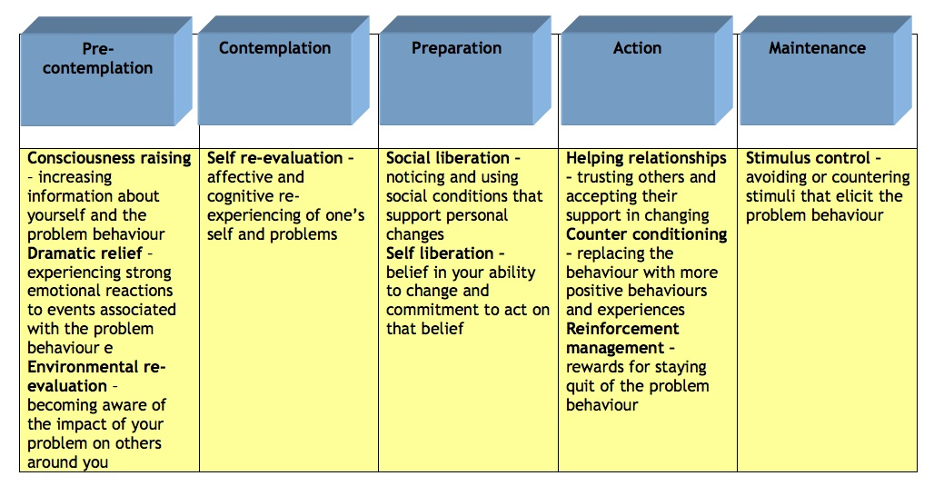

Slide 13
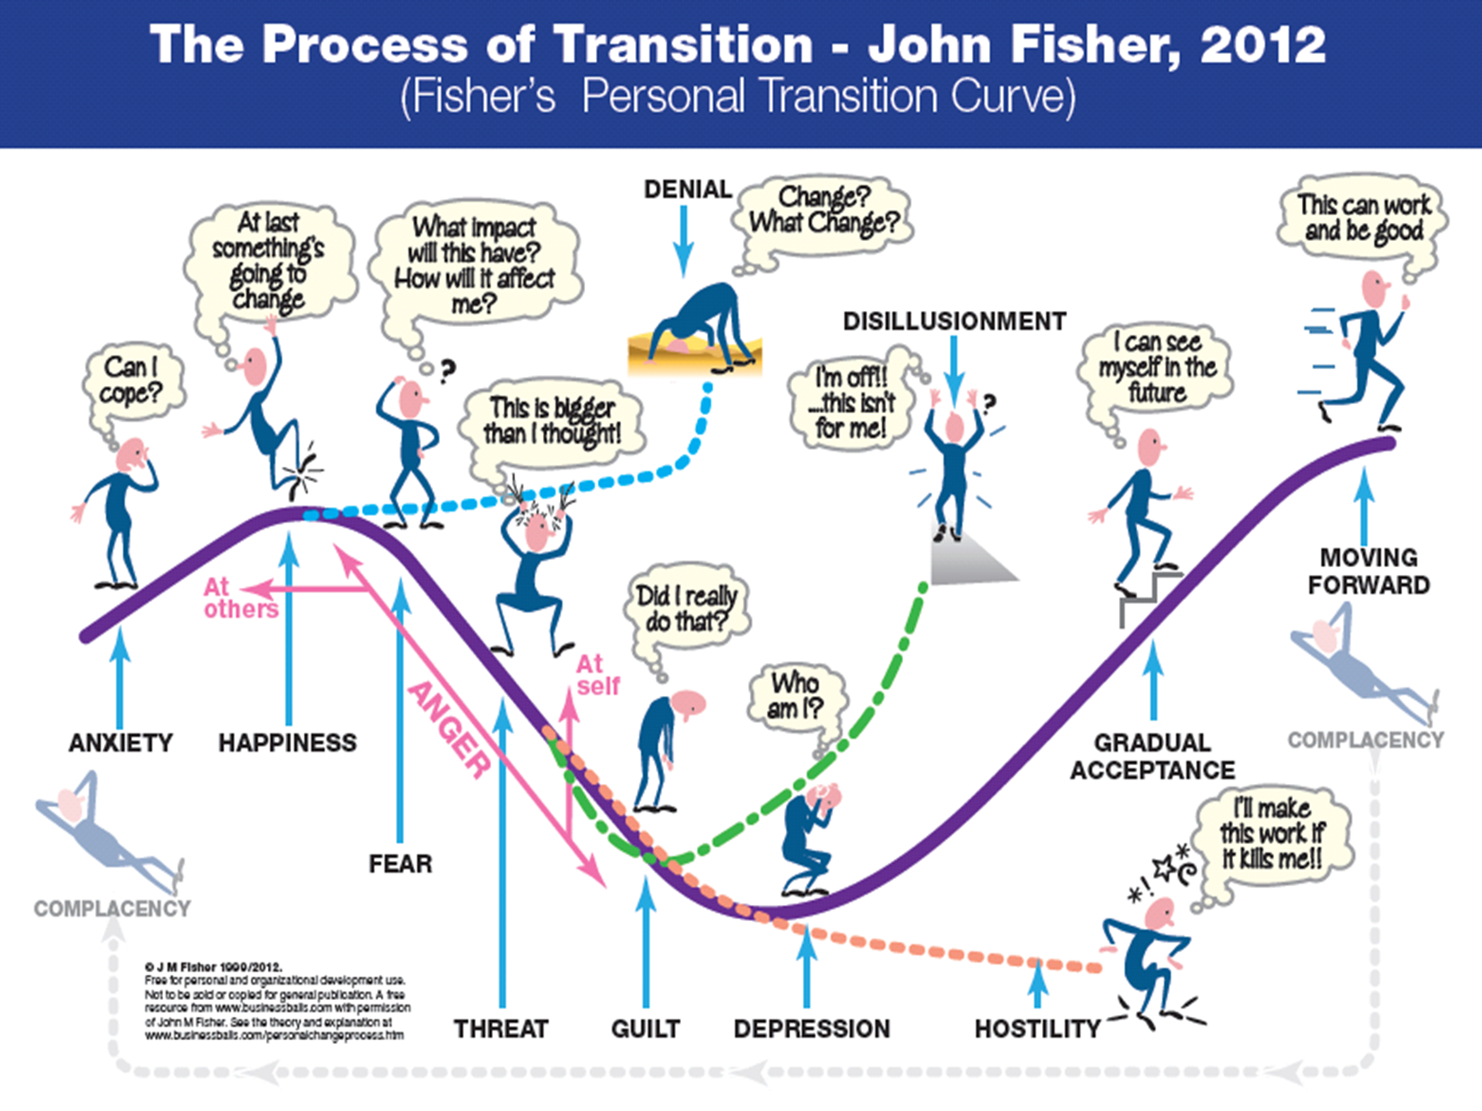
And for new roles…
Notes:
Draw upon and illustrate
https://www.r10.global/wp-content/uploads/2017/05/fisher-transition-curve-2012-1.pdf

Slide 14
Activity: 10 mins
How useful are these models when guiding practice?
What are their strengths and weaknesses?
Do they contribute to outcome measurement in assessing the success of mentoring relationships?
Notes:
Reflect upon how these or facets of these can be utilised to inform and structure practice

Slide 15
Feedback 10mins :
Q: How useful are these models when guiding practice?
A: New models to consider, helps to see where the process is at, models can be useful to understand stages of change the protégé goes through and the feelings involved
Q: Strengths/Weaknesses?
A: Weaknesses- can take the personal approach out of how a person is feeling during the process, focus on problem behaviour which may be unhelpful
Strength- can be used to gain clarity of where things are in the process, helps with reflection, understanding the process and clarifying the next steps
Q: Contribute to outcome measurement in assessing success of M/C relationships?
A: Can help to see progress made, helps mentee see how they have achieved goals and areas they need to change
Notes:
Reiterate strengths and weaknesses
Consider how they can be used in practice… would they be helpful?
Look ahead to the development of their preferred mentoring approach

Slide 16
Next time begin to develop “your” preferred and development of your mentoring framework for practice…
Questions?

