Slide 1
Theme Three: Enabling & Facilitating change
Coaching and Mentoring: an “How to” learning opportunity Theme 7: Use of Models and Techniques (2)
Notes:
Useful resources:
https://pc3coachingtoolkit.pbworks.com/w/page/52091926/Coaching%20Toolkit

Slide 2
How will you mentor/coach?
We will be considering:
1. Your mentoring approach – what is it?
2. The components of your approach
3. How you will facilitate this approach?
4. The design and application of your M/C model
Notes:
This session is based on Garvey, R Stokes, P (2021) Coaching and Mentoring Theory and Practice Fourth Edition chapters 3; 4 & 5
In addition, the following provides a raft of sources and supplementary material to inform this:
https://pc3coachingtoolkit.pbworks.com/w/page/52091926/Coaching%20Toolkit

Slide 3
What is YOUR mentoring approach?
Consider:
Nature – definition/role
Values
Philosophy
Model/conceptual framework
Contextual drivers, purpose and influences
Notes:
Invite participants to brainstorm and comment upon each of the five components… collectively these should inform their approach. Emphasise personal approach

Slide 4
Model
Your approach guided by your model
Strategy
Skills
8 key inter-dependent components for successful mentoring and coaching
Definition
Mentor
Purpose/ Context
Personality
Values
Role
Notes:
Mentoring comprises 8 inter-dependent components - reflect on the discussions presented so far in the previous sessions

Slide 5
Models
Classic Mentoring 5C model
GROW Model
SODAS
Conflict
Biggs’s Presage-Process-Product Model
Model
Notes:
Review collectively in turn. Invite participants to express preferences

Slide 6
YOUR Model
Models should not stifle the mentoring/coaching relationship
Use as a tool or guide to structure sessions
Typically, “we” are drawn to GROW and 5C models
Easily translated and visually understood
Model
Notes:
Invite discussion why preferred/or not

Slide 7
Purpose
Organisational contextual influences
Professional development
Personal development
Assessment
Professional capability
Motivations
Purpose/ Context
Notes:
Examine how each influences the mentoring relationship – reinforcing the contextually specific nature of mentoring within an heutagogical framework

Slide 8
YOUR Purpose
Why are you mentoring/coaching?
Conflict or alignment with organisational policies
Purpose/ Context
Notes:
Encourage a discussion of their perspective – motive for mentoring. Link to values and philosophy

Slide 9
Role
Dependent on context
Fit for purpose
Structured
Agreement
Defined
Role
Notes:
Discuss and illustrate the nature of mentoring and the role – reflect upon statutory and formal mentoring in comparison to informal mentoring, e.g. boundaries, role of matching, agreements/contracts, etc.

Slide 10
YOUR Role
Mentor v Coach
Role as a Practice Educator – not ‘classic mentoring/coaching’ but uses mentoring/coaching skills
Are you responsible for assessment of the protégé – influences the role
Role
Notes:
Discuss how they perceive the role… emphasise differences/similarities between mentoring and coaching – assessment of performance and professional developments. Reinforce the critical view of role.

Slide 11
Definition
Congruent
Agreement protégé expectations
Reflects values, role and purpose
Underpins philosophical approach
Visual and clear
Definition
Notes:
Discuss the importance of defining and establishing clarity; consider the place of heutagogy.

Slide 12
YOUR Definition
To support
Journeying with protégé
Sharing knowledge and skills
Enabling the protégé
Learning from each other
Definition
Notes:
Reflect upon how “they” view mentoring.

Slide 13
Skills – OOM!
Skills
Notes:
This image is taken from: https://www.open.edu/openlearn/theme/openlearnng/hidecourse.php?viewmod=0
Reinforce the “personal” nature of mentoring and how this fits with their views

Slide 14
YOUR Skills – OOM!
Identify your strengths/weaknesses
Lean into strengths
Ability to facilitate the mentoring/coaching process using skills
Role-modelling useful with a caring relationship as the foundation
Caring personal relationship - have a script of what you are comfortable sharing
Goals/challenges are the why, but relationship is important along the way
Genuinely listen and ask good questions
Skills
Notes:
Reinforce link to outcome and orientation models… and skills development.
Link to EMCC capability indicators

Slide 15
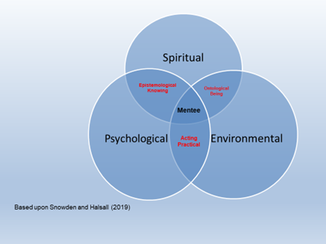
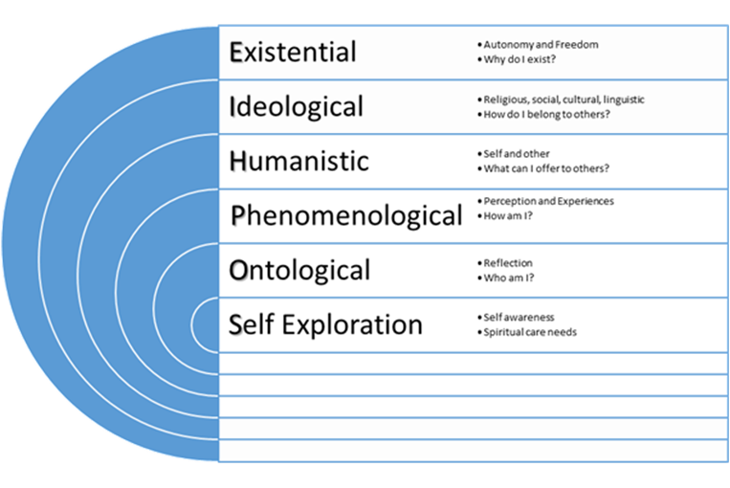
Values
Value consensus
Self-awareness
Values
Notes:
Explore and reflect upon the relationship of self-awareness and value consensus. Consider the philosophical basis of mentoring from their perspective

Slide 16
YOUR Values
Value consensus
Self-awareness and reflection
Respect
Open and honest
Commitment to process
Confidentiality
Listen
Values
Notes:
Explore what “their” values are and cognisance of approach

Slide 17
Personality
Approachable | Friendly
Nice | Non-judgmental
Patient | Enthusiastic
Negotiation skills | Trustworthy
Communication | Empathy
Empowering | Confident
Motivated | Reflective
Leadership | Willingness
Personality
Notes:
Reflect upon their views and examine in detail the relationship with Anne Darwin Characteristics ascribed to mentors by their protégés Chapter 4 in Clutterbuck, D. and Lane, G 2002 The Situational Mentor An International Review of Competences and Capabilities in Mentoring

Slide 18
YOUR Personality
Approachable and friendly
Trustworthy
Confidence
Personality
Notes:
How would the participants describe their personality? Where would it fit in the context of mentoring? How much will it influence their approach?

Slide 19
YOUR Strategy
The holistic nature of mentoring and coaching - a self-determined and enabling approach to learning and development. A crucial aspect of successful mentoring is sharing the inside knowledge.
But must or maybe:
Fit for purpose
Holistic
Developmental
Structured
Unique and self-determined
Strategy
Notes:
Reinforce that there is no one size fits all and their approach must be fit for purpose.
Consider what developmental needs they may have

