Slide 1


Embedding wellbeing in the classroom: Staff workshop
Embedding wellbeing in the curriculum:
What could this look like in your teaching context?
Embedding Mental Wellbeing: Methods and Benefits
Collaborative Enhancement Project 2021
Image: https://images.app.goo.gl/edtQ5fqzjr3XryPh7
Dr Alison Gilmour & Dr Rachel George, University of Greenwich
Notes:
These slides were developed for use at staff workshops to discuss how student wellbeing may be supported via the curriculum.
Key features are:
a broad definition of well-being (not only a focus on mental health),
curriculum refers to teaching, learning and assessment processes (as opposed to content), and
following discussion of principles, opportunities to apply to own teaching context.

Slide 2

Consider your experience as a university student…
What elements of your university experience had a negative impact on your wellbeing?
How and why?
What could be different?
Notes:
Workshop participants asked to reflect on their own experience as a student. Can be expanded to consider both positive and negative impacts, or focus only on negative – depending on time/ scope.

Slide 3

How do you support student wellbeing through your teaching, learning and assessment practices?
Notes:
Sets the scene for the discussion. As noted above, we are looking at the influence of curriculum processes (not content) on wellbeing, and the potential for this to be a positive relationship.

Slide 4
Definition of wellbeing 1
‘Wellbeing comprises a person’s mental health, physical health, financial sustainability, mood, family circumstances, workload, social life and many other things.
We want to be a community that embraces all facets of wellbeing, promotes positive actions that can be taken to enhance our own wellbeing, encourages a culture of support and discussion that acknowledges that wellbeing is dynamic and changing, and has a clear strategy to deal with the challenges and impacts of working and studying in higher education.’
University of Greenwich Health and Wellbeing Strategy, 2019
Notes:
We are using a broad definition of wellbeing. Others may wish to use local definitions or explore those included in the QAA Embedding Mental Wellbeing project webpages.

Slide 5
Definition of wellbeing 2
‘Wellbeing comprises a person’s mental health, physical health, financial sustainability, mood, family circumstances, workload, social life and many other things.
We want to be a community that embraces all facets of wellbeing, promotes positive actions that can be taken to enhance our own wellbeing, encourages a culture of support and discussion that acknowledges that wellbeing is dynamic and changing, and has a clear strategy to deal with the challenges and impacts of working and studying in higher education.’
University of Greenwich Health and Wellbeing Strategy, 2019
Notes:
Statement of the approach to wellbeing in University strategy. Others may wish to use local definitions or explore those included in the QAA Embedding Mental Wellbeing project webpages.

Slide 6
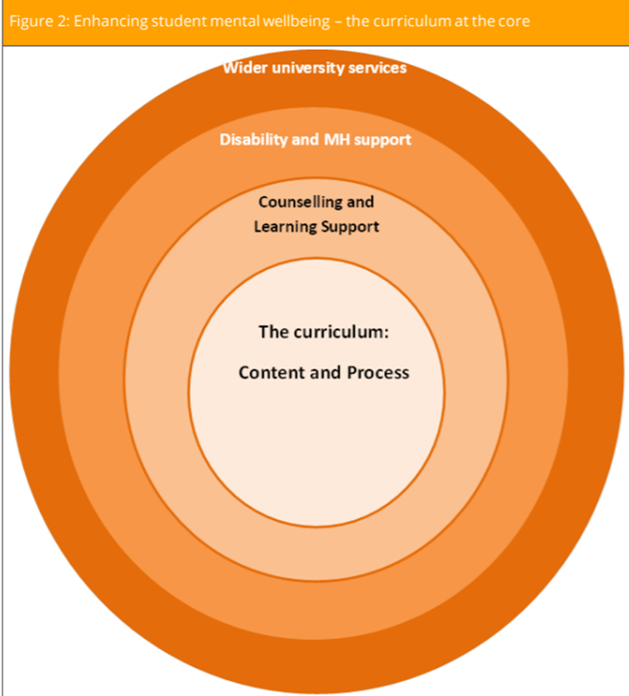
Embedding wellbeing in the curriculum
‘For students, their curriculum and their engagement with academics are their only guaranteed points of contact with their university.’ (Hughes et al., 2018: 12)
Ann-Marie Houghton and Jill Anderson (2017) Embedding Mental Wellbeing in the Curriculum: Maximising Success in Higher Education
Image: Houghton and Anderson, 2017: 15.
Notes:
While there are many layers of support available in the University context, the only guaranteed touch point is the curriculum. The pattern of engagement with other layers of support will vary between students, over time and according to contextual factors. Therefore the curriculum has the potential to be a powerful tool for enhancing wellbeing.

Slide 7
Affective and social dimensions of learning
Curriculum processes
Wellbeing outcomes
Normalising challenge and recognising achievement
Building connections
Active engagement and partnership
Sense of self-efficacy
Sense of belonging
Achieving deep learning and sense of ownership
Notes:
If we want to have a curriculum that supports wellbeing, what should we focus on? Look at the affective and social dimensions of learning.

Slide 8

Normalising challenge and recognising achievement
Successfully navigating challenge is associated with positive wellbeing and development of self-efficacy
Activities which normalise challenge (Jones et al., 2020), ‘maintain perspective’ (Turner, Scott-Young and Holdsworth, 2017) and support reflection
Remove unnecessary stressors in the academic context
Explicitly engage with challenge: make this visible via discussion with peers and via role modelling
Include opportunities for self reflection and peer feedback. Activities to support self-regulated development
Provide rationale so that challenges are meaningful and understood relative to progression
Notes:
Discussion points - what do we mean by challenge? Normalising not removing challenge. What is under our control to try and change? Some ideas for supporting students to successfully navigate challenge.

Slide 9
Normalising challenge and recognising achievement
Examples from your teaching practice?
Towards the start of your module, introducing an early task that engages students and is sufficiently challenging.
Exploration of ‘hopes and fears’ in small groups or anonymously to identify collective perspectives.
Role modelling and openness.
Normalising challenge in assessment through the development of assessment literacies: e.g. student-led assignment guidance.
Inclusion of self-reflection components to assessment.

Slide 10

Building connections and belonging
Social and academic connections.
A critical component of wellbeing and student persistence and retention.
Report: What Works?
‘supportive peer relations;
meaningful interaction between staff and students;
developing knowledge, confidence and identity as successful HE learners;
an HE experience that is relevant to interests and future goals.’

Slide 11
Building connections and belonging
Examples from your teaching practice?
Interaction and groupwork within live teaching sessions
Supporting the skills for groupwork e.g. Theo Gilbert (2017) and the micro-communication skills of compassion
Informal connections and spaces in your programme, module and classes
Supporting and valuing different forms of engagement

Slide 12

Active engagement and partnership
Designing learning that seeks to maximise active learning and engagement for individuals and groups.
Providing meaningful, authentic and relevant learning, teaching and assessment opportunities.
Enable opportunities for curriculum co-creation or partnership and a sense of ownership.
Inclusive teaching design and empowering learners.

Slide 13
Active engagement and partnership
Examples from your teaching practice?
Group annotation e.g. annotate the syllabus
Stop, Start, Continue and other opportunities for student voice.
Collaboration focused on an output or producing something – collaborative document/ blog post.
Student ownership through chat champions, Tutorial Takeovers.
Authentic learning beyond the University.

Slide 14
Practical application
Thinking about the processes of normalising challenge, building connections and active engagement, in your teaching context, how can you support student wellbeing in the context of…
1. Groupwork/ group discussions?
2. Presentations?
3. Assessment and feedback?
4. Your vote or wild card...
Notes:
Present and ask for examples of activities that could be reflected on in relation to key points. How can we remove unnecessary stress? How can we support students through challenge? Facilitate connections? Maximise active engagement and include opportunities for partnership?

Slide 15

Key take-aways
Taking a wellbeing lens to our practice is an opportunity to revisit good pedagogical practice.
To support student wellbeing in our curriculum processes we should focus on the affective and social dimensions of learning.

Slide 16
References
Baik, C., Larcombe, W. & Brooker, A. (2019) 'How universities can enhance student mental wellbeing: the student perspective', Higher Education Research & Development, 38: 4, 674-687, DOI: 10.1080/07294360.2019.1576596
Gilbert, T. (2017) ‘When Looking Is Allowed: What Compassionate Group Work Looks Like in a UK University’, in Paul Gibbs (ed) The Pedagogy of Compassion at the Heart of Higher Education. UK: Springer, 189-202
Hill, J., Healey, R., West, H. & Dery, C. (2019) 'Pedagogic partnership in higher education: encountering emotion and enhancing student wellbeing’, Journal of Geography in Higher Education, DOI: 10.1080/03098265.2019.1661366
Houghton, A. & Anderson, J. (2017) Embedding Mental Wellbeing in the Curriculum: Maximising Success in Higher Education. York: Higher Education Academy. www.advance-he.ac.uk/knowledge-hub/embedding-mental-wellbeing-curriculum-maximising-success-higher-education
Hughes, G. & Spanner, L. (2019) The University Mental Health Charter. Leeds: Student Minds

Slide 17
References continued
Hughes, G., Panjwani, M., Tulcidas, P. and Byrom, N. (2018) Student Mental Health: The Role and Experiences of Academics. UK: University of Derby, Kings College London, Student Minds.
Jones, E., Priestley, M., Brewster, L., Wilbraham, S., Hughes, G. & Spanner, L. (2020) 'Student wellbeing and assessment in higher education: the balancing act', Assessment & Evaluation in Higher Education, DOI: 10.1080/02602938.2020.1782344
Turner, M., Scott-Young, C. & Holdsworth, S. (2017) 'Promoting wellbeing at university: the role of resilience for students of the built environment, Construction Management and Economics, 35: 11-12, 707-718, DOI: 10.1080/01446193.2017.1353698

