Slide 1
Improving student learning by combining accessibility/inclusion with academic integrity
Using Turnitin inclusively
Staff awareness-raising activity
Developed by Dr Mary Davis, Oxford Brookes University

Slide 2
What do we need to know about Turnitin?
Turnitin is text-matching software used by universities, tutors and students to help them to check for plagiarism and to ensure students are following good academic practice.
It has a database of websites, academic journals, e-books dissertations and assignments (constantly updated), which new submissions can be checked against.

Slide 3
What are the possible accessibility issues with colours on Turnitin?
Some students and tutors may find the colour format inaccessible or make assumptions based on the coloured matches or overall similarity.
Look at these
student comments:
‘My score is highlighted in green, so that means it’s good, right?’
‘I am confused by the coloured matches. Which ones are bad?’

Slide 4
What are the accessibility issues for users with colour vision deficiency?
Comments from a user with colour vision deficiency:
“I can see that there are distinct colours, but I struggle to name them. On the example, one looks brown but could be green or red, one looks blue but could be purple and one is green, grey or pink. I wouldn't be confident reporting the colour to another person and I would be anxious if someone referred to a block by its colour.”

Slide 5
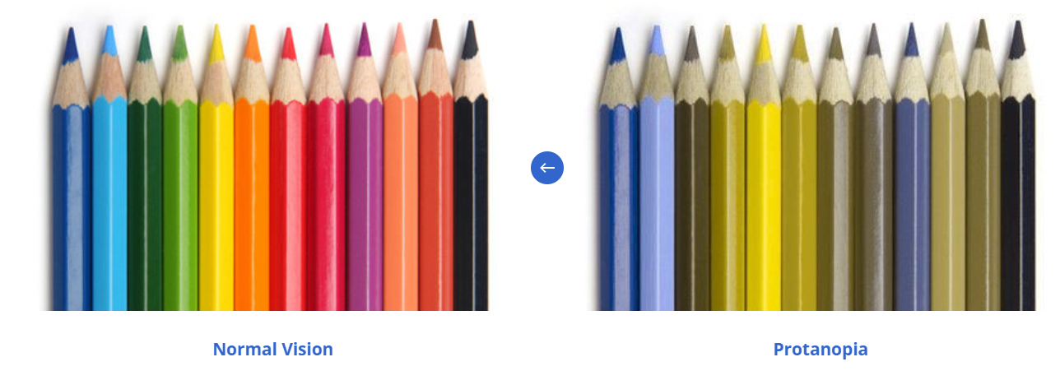
How does colour vision deficiency impact the appearance of colour?
(Colour Blind Awareness, 2022)

Slide 6
Recommendations about colours on Turnitin
Don’t use the traffic light system: it can lead to assumptions about what is OK or not OK
Don’t refer to the colours when discussing reports with students – instead refer to the numbered matches and the ranking of them (eg the first matched source, or the number 1 source on the list of matches)

Slide 7
What are the other inclusion issues with Turnitin?
It may be used and interpreted differently
Students may not be given any training on Turnitin, yet have to use it for all assignment submissions
Students may not have sufficient access to Turnitin reports
Some students may misinterpret Turnitin results if they do not receive support
Students may have many questions about Turnitin that they do not have opportunities to ask

Slide 8
Student questions on Turnitin that relate to inclusion
‘I have a high score because English is not my first language, and I can’t change the experts’ words. So will I fail?’
‘My previous institution said 30% is OK, is that right?’
‘This match is to another student’s work, but I didn’t work with them. Will I be called a cheat?’
‘My reference list is matched. How do I paraphrase the reference list?’
‘My tutor told me to use citations, but they are matched. Should I delete them?’
‘How do I paraphrase the names of organisations that are matched like World Health Organisation?’
‘I have to include appendices, but this gives me a 40% match. What do I do?’

Slide 9
Recommendations for responses to these student questions
Reflect on the student perceptions and problems
Debunk some of the myths around Turnitin reports
Provide formative opportunities to use, practise and interpret Turnitin effectively
Show students that some matches are OK, while some may not be
Help students avoid fixating on overall similarity and encourage them to gain confidence in their writing

Slide 10
Debunking myths: Is overall similarity equivalent to a plagiarism score?
NO! Never just look at the overall score!
High scores may be associated with correctly cited work with many references (though may indicate some over-reliance on source text eg many quotations)
Low scores can indicate plagiarism, little or no use of sources, and the use of custom writing services

Slide 11
Debunking other myths
1. Is there is an ideal overall similarity score above which is plagiarism and below which is OK? NO
2. Should you always reduce your overall similarity score? NO
3. Is zero similarity the best result? NO
4. Does a high overall similarity score always indicate plagiarism? NO
5. Do the matches show all of the sources that you used? NO
6. Do the matches to other students’ work always show you have colluded with other students? NO
7. Does Turnitin show every instance of copied text in a submission? NO
None of the above are true!!
Blog – Debunking 10 myths about Turnitin

Slide 12
How can staff use Turnitin inclusively?
Provide instruction to all students and recognise some students may have different needs
Provide formative opportunities for students to practise and learn before assessment
Help all students to understand how to interpret their Turnitin results
Help all students to distinguish between matches that are highlighted which show:
acceptable OR problematic
expected matches
good practice
matches
x
✓

Slide 13
OK – acceptable/expected NOT OK- problematic good practice
Large individual matches
Copied sentences and paragraphs
Not expected matches
Sections where words, ideas and visual content from other authors or other assignments are not attributed or used appropriately
Quotes not in quotation marks
Source text insufficiently paraphrased
Small individual matches
(eg matches with 1-2% similarity)
Expected matches
Cover sheet
Contents page
Template
Citations
Names of organisations
Quotes
Standard phrases (eg ‘the aim of
this study is to analyse…’)
References
x
✓

Slide 14
Matches that are ok: acceptable, expected or good practice

Slide 15
Title page, table of contents, templates
✓

Slide 16
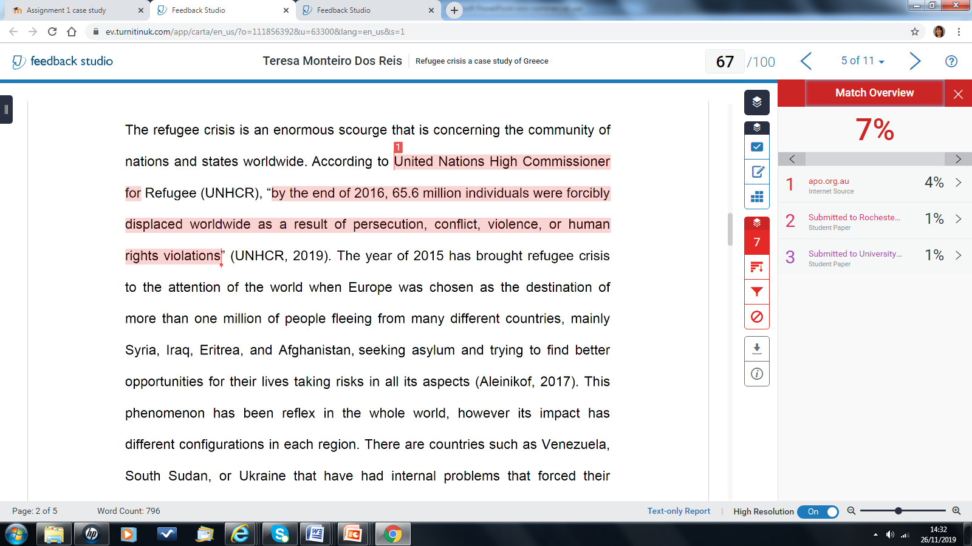
Quotations (properly formatted) with citation
✓

Slide 17
Standard academic phrases
✓

Slide 18
Small matches, matches to citation
✓

Slide 19
Reference list
✓

Slide 20
Matches that are not ok: problematic copying

Slide 21
Copied and pasted
x

Slide 22
Secondary citation
x

Slide 23
Insufficient paraphrasing
x

Slide 24
Checklist for good practice and to avoid problems indicated by Turnitin- advice to give to students
Make sure you have included citation in your text each time you have used a source.
Check that you have used quotation formatting “….” correctly around any quoted words, with citation.
Check that you have paraphrased effectively by comparing your text with the original.
Ensure that you are the author of your own text.
Make sure you upload the right file to the right dropbox!

Slide 25
Recommended resources for further reading
Blog – Debunking 10 myths about Turnitin
Formative feedback within plagiarism education: is there a role for text-matching software?
Top ten tips for avoiding plagiarism
Video guide for interpreting Turnitin
For further information, please contact the project lead, Dr Mary Davis, at marydavis@brookes.ac.uk
This exercise is an output from a Collaborative Enhancement Project supported and funded by QAA Membership. The project is led by Oxford Brookes University in partnership with Bloomsbury Institute, University of Southampton and University of Westminster. Find out more about Collaborative Enhancement Projects on the QAA website.

