Slide 1
Attend, engage, learn, and build community: Talking point online events
Anne Campbell, The Open University

Slide 2
The Open University: background
Part time distance students: part time distance staff
Largest in the UK with ~170,000 part-time students, around 40% of UK part time
World leader in flexible distance learning
Around 5,000 Associate Lecturers (ALs), our part-time tutoring staff
All work at a distance, usually from home
Around 5,000 academic, academic-related and support staff working in offices or from home across the country
Large, highly distributed workforce
Tutoring staff rarely have the chance to meet colleagues face to face

Slide 3
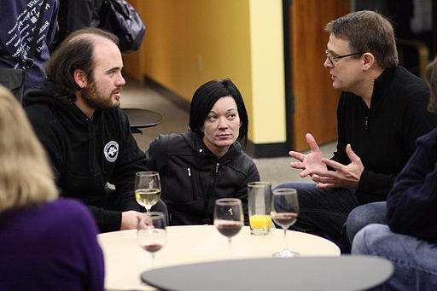
Challenges for distance developers
When staff are geographically distributed home workers …
How do we...
…create opportunities for development which distributed distance staff want to and are able to attend?
…design events which incorporate some of the features of informal, situated & social learning and collaboration, which usually happen naturally in the workplace? (Milligan et al, 2014; Clus, 2011)
…create a sense of presence and community? (Kear, 2011)
…make development relevant to staff’s own working practices? (Ottenbreich-Leftwich, 2010)

Slide 4
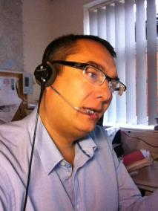
Online staff development at the OU
For part-time tutoring (and other) staff
Range of online initiatives, including self-study and moderated modules, and exemplars
Flexible participation within a structure
Caters to geographic separation
Brings staff together from across the distributed university
Time-limited – enhances sense of presence
Reflection and collaboration with peers – builds community, builds confidence, inspires new ideas for practice
(Campbell, 2016; Campbell & Storey, 2015; Macdonald & Campbell, 2012, 2010; Campbell & Macdonald, 2011)

Slide 5
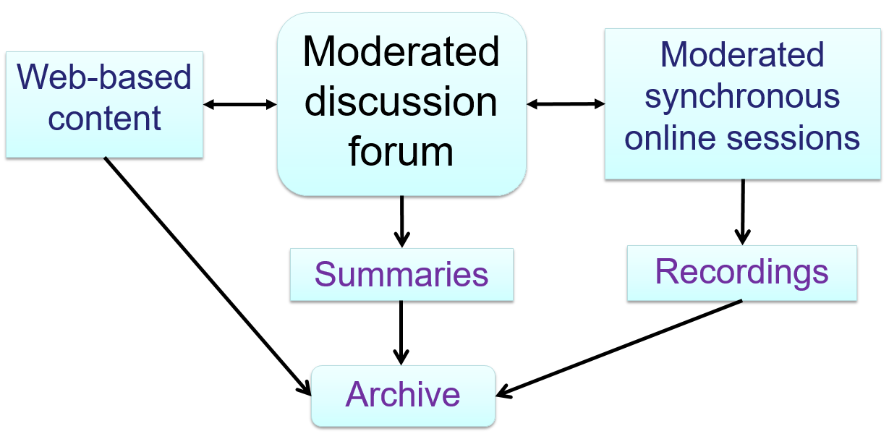
The ‘Talking point’ initiative
One day online staff development events
Campbell (2016)

Slide 6
Flexible design
Different topics, different participant numbers, different types of event
Topics have included:
online synchronous tuition
employability
graduateness
group tuition purposes
correspondence tuition
Event sizes range from 30 to 150 participants
Event type ranges from ‘conference’ style to ‘workshop’ style events
(Campbell, 2016; Campbell & Jones, 2014; Campbell & Edwards, 2012)

Slide 7
Participant perceptions
Post-event questionnaire free text comments
… loved feeling part of a live community – interacting and contributing and learning.
The experience of connecting with colleagues from all over the university is always enjoyable on these occasions…
(It was good)… hearing from OU staff that I wouldn’t ordinarily ever get to meet with.
… great interactivity from the group taking part.
Generally very informative and stimulating discussions in the forum. Lot of policies going on that I was previously unaware of.
I picked up a lot of good pointers from experienced practitioners.
More events like this please, it’s easy to feel isolated as ALs especially with technology, so this was great.

Slide 8
Lessons learned
Flexible design allows knowledge building, discussion & reflection on the topic at hand
Forum and live chat spaces allow staff to meet informally, share practice and reflect
Helps build & maintain a sense of community and belonging
Allows building and maintaining of personal ties
Can reinforce a shared sense of purpose and belief
Brings staff together across geographic space and across discipline areas
Staff attend and engage when topic is directly relevant to their own practice
Key to success is having skilled peer presenters/moderators involved in planning and delivery – they have particular insight into challenges and issues face by part time distance staff
For participants and presenters/facilitators it can be an intense and stimulating experience

Slide 9
Practical points
In large events, some participants can feel lost or not heard – useful to use breakouts in the live sessions
The message base in the forum can get very large, even in smaller scale events – use summarising and archiving
The restricted timing (usually over one day) means staff commit the time needed
Need to choose dates which don’t clash with other commitments where possible – so early planning and advertising to key members of staff is critical
Signpost dates early to intended delegates, timely reminders before the event
Technical help on the day is critical
Don’t think it is a cheap option!

Slide 10
Thoughts…
This is an adaptable concept…
Could a similar design be used for CPD for distance or local staff in your institution?
Could we use a similar design to run events for students?

Slide 11
Contact details
Anne Campbell
Educational developer
The Open University
anne.campbell@open.ac.uk
Published article on Talking Point at:
Campbell, A (2016) Talking Point – Flexible Targeted Online Staff Development that Works, Journal of Interactive Media in Education, 2016(1): 3
DOI: http://doi.org/10.5334/jime.395

Slide 12
References
Campbell, A (2016) Talking Point – Flexible Targeted Online Staff Development that Works, Journal of Interactive Media in Education 2016(1):3, DOI: http://doi.org/10.5334/jime.395
Campbell A & Edwards C (2012), Engaging staff in institutional discussion using a one day online event, Presentation at the 9th annual Enhancement themes conference, March 2012, Edinburgh. Retrieved from http://www.open.ac.uk/blogs/LearnDevDist/wp-content/uploads/2016/05/2102-ET-presentation_AC_CE_05Mar2012.pdf
Campbell, A and Jones, M (2014), A community approach to online staff development design, Presentation at the SEDA Spring Teaching, Learning and Assessment Conference 2014 'Engaging staff: Engaging students', 15 – 16 May 2014, Newcastle. Retrieved from http://www.open.ac.uk/blogs/LearnDevDist/wp-content/uploads/2014/09/SEDA-spring-conf-presentation-2014_FINAL.pdf
Campbell, A and Macdonald, J (2011), Experiential learning in online staff development. Proceedings of the 2010 18th International Symposium on Improving Student Learning, incorporating the 7th ISSOTL conference. Global Theories and Local Practices: Institutional, Disciplinary and Cultural Variations, Ed Chris Rust, Oxford Centre for Staff and Learning Development
Campbell, A and Storey, G (2015), How do we develop part-time teaching staff in best practice for using Blackboard Collaborate with student groups?, Presentation at Blackboard Teaching & Learning Conference: ‘Innovate and Educate 2015’, 15 –17 April 2015, Liverpool, available at http://www.slideshare.net/BlackboardInternational/anne-campbell-grahamstoreytheopenuniversity
Clus, M L (2011), Informal learning in the workplace: a review of the literature, Australian Journal of Adult Learning 51 (2), 355-373
Kear, K (2011), Online and social networking communities. Oxon: Routledge
Macdonald J and Campbell A (2012), Demonstrating online teaching in the disciplines: A systematic approach to activity design for online synchronous tuition, British Journal of Educational Technology 43(6) 883-891, DOI: 10.1111/j.1467-8535.2011.01238.x
Macdonald, J and Campbell, A (2010), Activity design in online professional development for university staff. European Journal of Open, Distance and E-Learning 2010/1, published 09/03/2010. Retrieved from http://www.eurodl.org/index.php?p=archives&year=2010&halfyear=1&article=388
Milligan, C, Littlejohn, A and Margaryan, A (2014), Workplace Learning in Informal Networks. Journal of Interactive Media in Education 2014(1):6, DOI: http://dx.doi.org/10.5334/2014-06
Ottenbreit-Leftwich, A T, Glazewski, K D, Newby, T J & Ertmer, P A (2010), Teacher value beliefs associated with using technology: addressing professional and student needs. Computers and Education 55, 1321 – 1335

