Slide 1

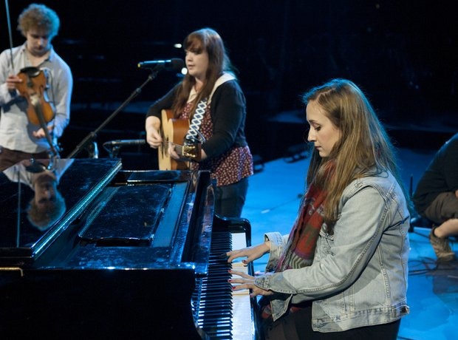
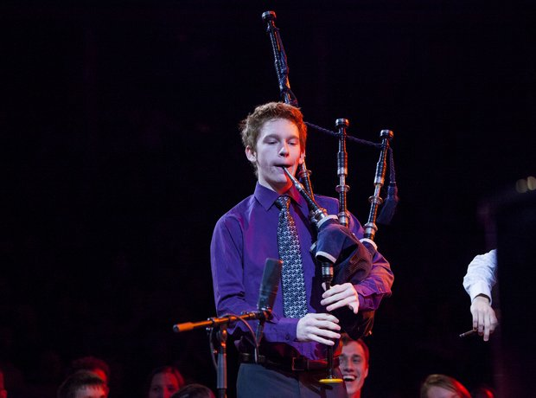
Building a learning community of music students across the Highlands and Islands and beyond

Slide 2
Building a learning community of music students across the Highlands and Islands and beyond
Anna-Wendy Stevenson
Programme Leader
BA (Hons) Applied Music
Anna.Stevenson@uhi.ac.uk
01851770517

Slide 3
Overview
BA (Hons) Applied Music
Innovative
Notes:
Is the first fully networked, blended learning multi-genre practical music degree in the UK
Has successfully delivered all four years of an honours degree with the first students graduating with BA (Hons) in August 2016
Currently has 101 students enrolled
Was re-approved in April 2016 and highly commended for the national and international engagement made possible by the residencies

Slide 4
Overview
BA (Hons) Applied Music
Innovative
First graduates
Notes:
Is the first fully networked, blended learning multi-genre practical music degree in the UK
Has successfully delivered all four years of an honours degree with the first students graduating with BA (Hons) in August 2016
Currently has 101 students enrolled
Was re-approved in April 2016 and highly commended for the national and international engagement made possible by the residencies

Slide 5
Overview
BA (Hons) Applied Music
Innovative
First graduates
101 enrolled students 2015-16
Notes:
Is the first fully networked, blended learning multi-genre practical music degree in the UK
Has successfully delivered all four years of an honours degree with the first students graduating with BA (Hons) in August 2016
Currently has 101 students enrolled
Was re-approved in April 2016 and highly commended for the national and international engagement made possible by the residencies

Slide 6
Overview
BA (Hons) Applied Music
Innovative
First graduates
101 enrolled students 2015-16
National and international engagement
Notes:
Is the first fully networked, blended learning multi-genre practical music degree in the UK
Has successfully delivered all four years of an honours degree with the first students graduating with BA (Hons) in August 2016
Currently has 101 students enrolled
Was re-approved in April 2016 and highly commended for the national and international engagement made possible by the residencies

Slide 7
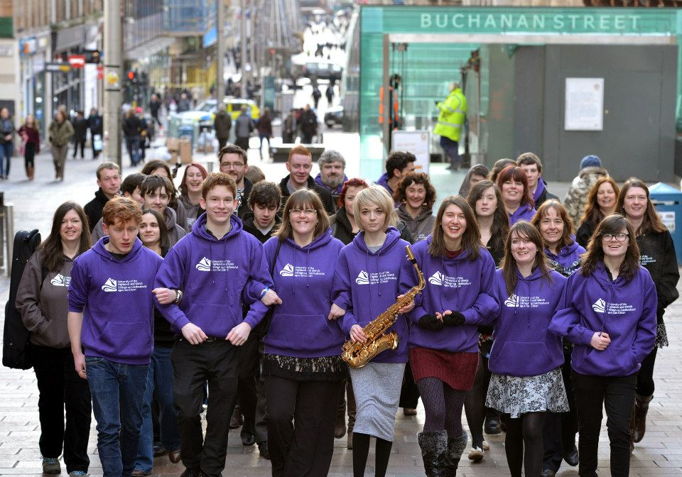
Community of Practice
Notes:
The first year of the degree and the 3rd residency – at Celtic Connections in Glasgow – these are our current graduates. These students are located in Shetland, Orkney, Outer Hebrides, Glasgow, Edinburgh, Moray

Slide 8
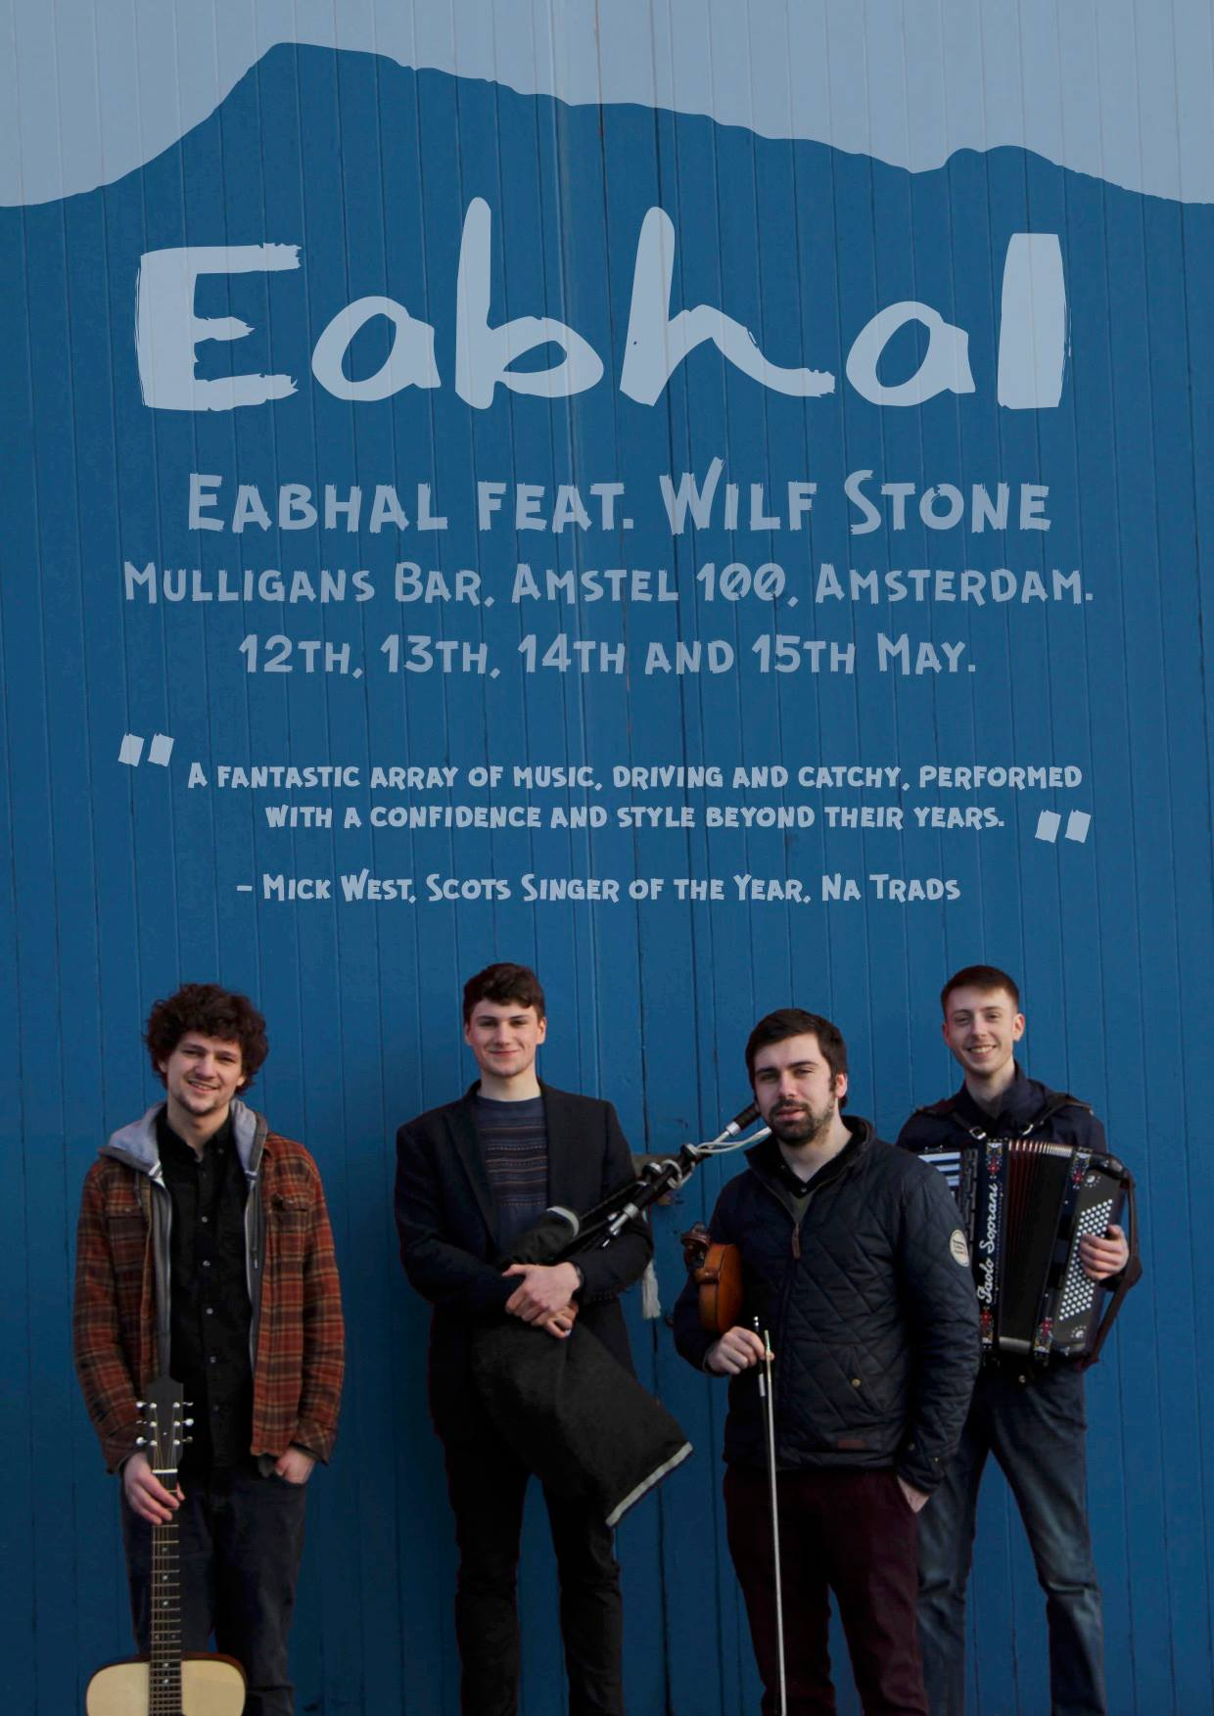
Opening doors
The Student Experience and Flexibility
Notes:
‘The course makes it possible for students to learn wherever they want to be based.
………The fact that lectures are delivered over Video Conference makes this course really flexible, which is especially useful for musicians: it gave me the chance to gain experience outwith my education (for example playing tours in Scotland or Europe) without missing any lectures’. (4th year student)

Slide 9
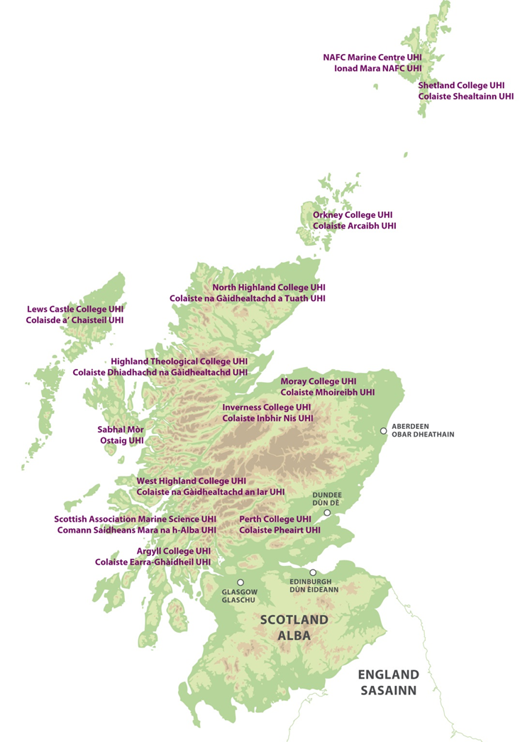
Landscape of Learning
9 academic partners
Notes:
Students are enrolled through 9 academic partners
Teaching and support staff are distributed across the network
Student body is located all over Scotland
Demographic is varied – current cohort includes school leavers, HNC/HND direct entry and existing music professionals seeking a qualification

Slide 10
Landscape of Learning
9 academic partners
Distributed staff
Notes:
Students are enrolled through 9 academic partners
Teaching and support staff are distributed across the network
Student body is located all over Scotland
Demographic is varied – current cohort includes school leavers, HNC/HND direct entry and existing music professionals seeking a qualification

Slide 11

Landscape of Learning
9 academic partners
Distributed staff
Scattered students
Notes:
Students are enrolled through 9 academic partners
Teaching and support staff are distributed across the network
Student body is located all over Scotland. We also have a student who is enrolled who works on a cruiseship.
Demographic is varied – current cohort includes school leavers, HNC/HND direct entry and existing music professionals seeking a qualification

Slide 12
Landscape of Learning
9 academic partners
Distributed staff
Scattered students
Varied demographic
Notes:
Students are enrolled through 9 academic partners
Teaching and support staff are distributed across the network
Student body is located all over Scotland
Demographic is varied – current cohort includes school leavers, HNC/HND direct entry and existing music professionals seeking a qualification

Slide 13

Blended learning model
Online

Slide 14
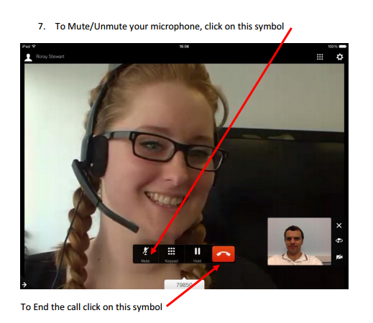
Blended learning model
Video conference
Notes:
95% of students using jabber as opposed to college access using VC technology

Slide 15
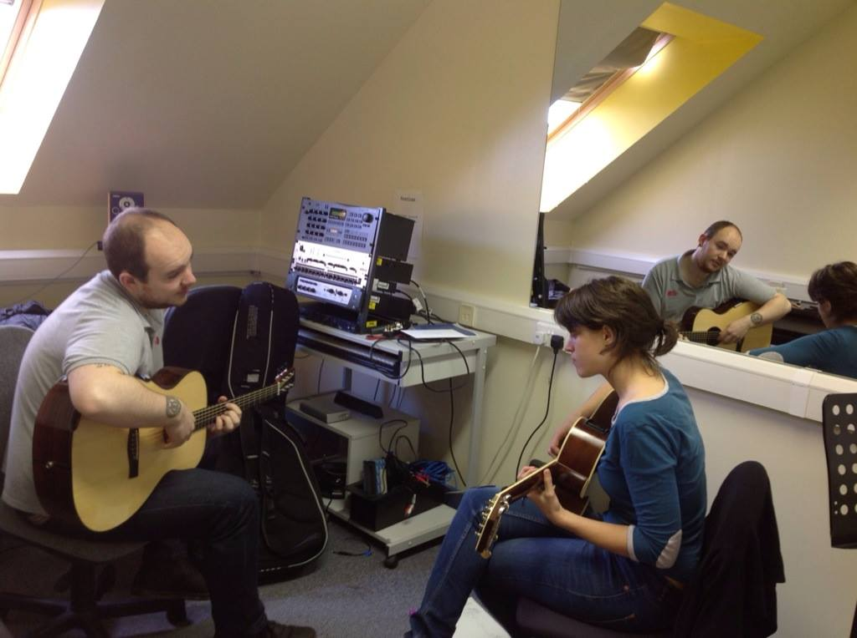
Blended learning model
Face to face tutoring with performance practice tutors in home community
Notes:
We have also facilitated performance practice tutoring with professional tutors located abroad in the USA through using Skype. E.g American bass tutor Carol Kaye famous for her session recordings including Beach Boys albums.

Slide 16
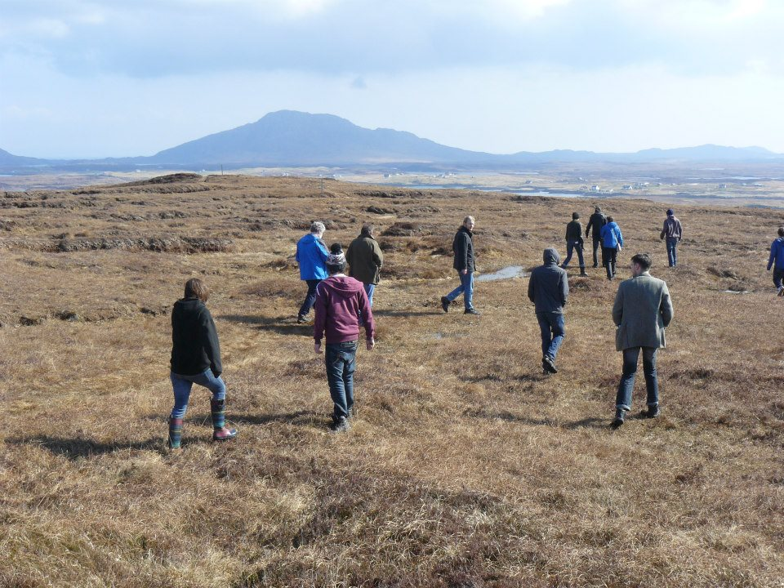
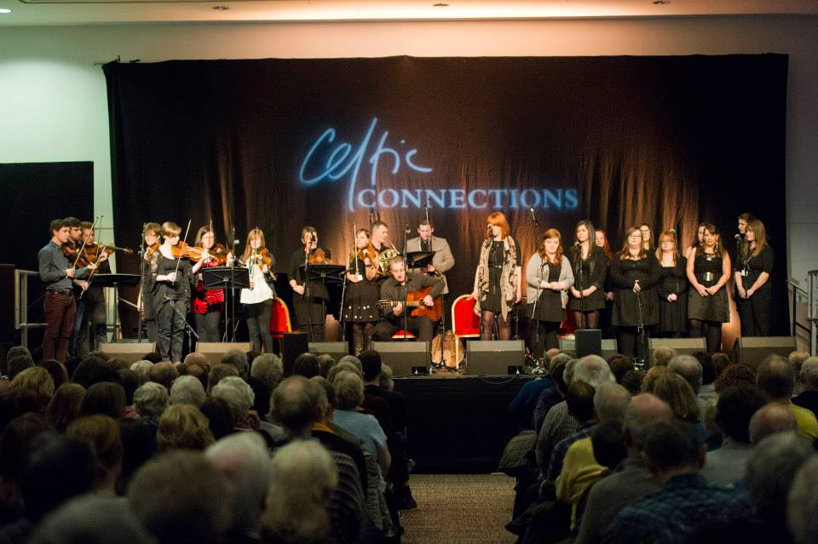
Blended Learning Model
Residencies
Notes:
Key to the success of collaboration and music making amongst student cohort
Face to face in different locations throughout Scotland
Provide learning and exploration of different cultural landscapes.
Promotion of degree through high profile performance opportunities integrated into residencies
Students pay and organise their own transport and accommodation.
Residencies are mandatory and attendance and participation is embedded into ensemble modules

Slide 17
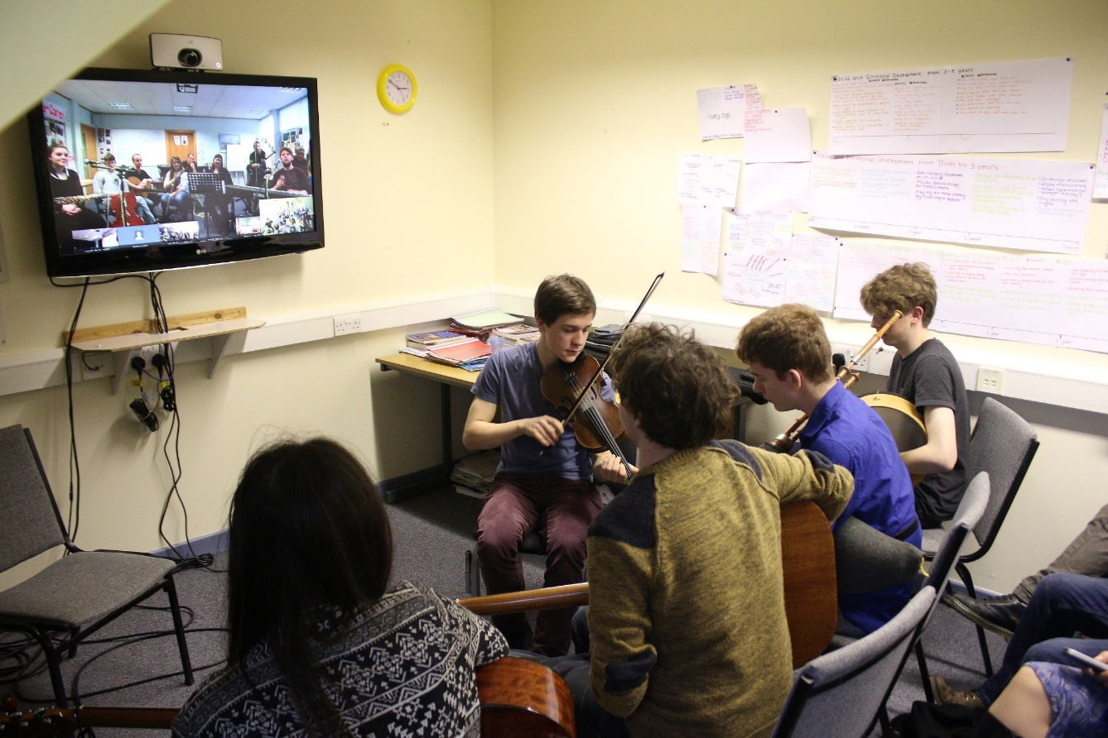
Blended learning model
Virtual residency
Notes:
an initiative to enhance learning through working in student groups and address issues of access.

Slide 18
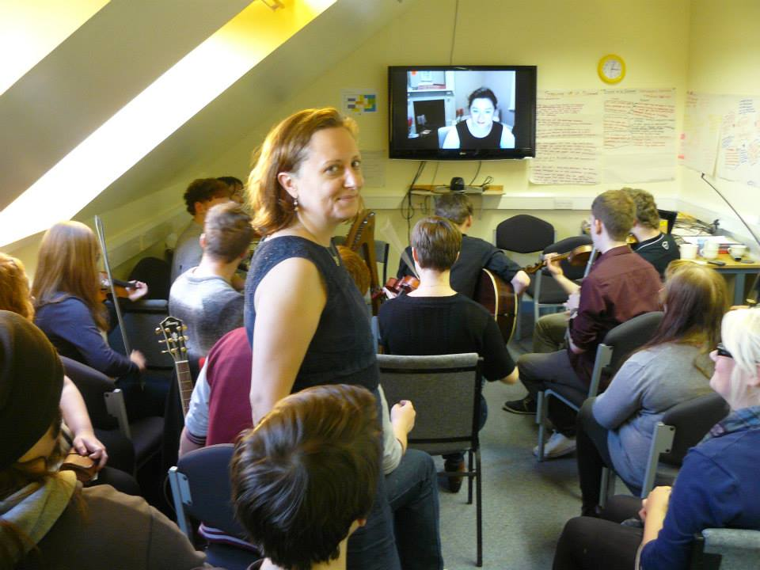
Blended learning model
International Collaboration
Notes:
International collaborative dimension provides enhanced learning a sense of wider sense of connectivity. Collaborations with Universities in Australia and Sweden.

Slide 19
Challenges
Engagement - balancing freedom and flexibility
Notes:
Engagement -Balancing freedom and flexibility
VC playback
No register. Residencies compulsory assessed in a single module.
Referencing Task

Slide 20
Challenges
Engagement - balancing freedom and flexibility
Managing student expectations
Notes:
Managing student expectations
Point of audition and interview – communication and monitoring of process

Slide 21
Challenges
Engagement - balancing freedom and flexibility
Expectation
Isolation
Notes:
Isolation
PAT role
Online Applied Music Student Area – enrolling PATS too
Study Buddy

Slide 22
Challenges
Engagement - balancing freedom and flexibility
Expectation
Isolation
Parity of experience
Notes:
Parity of experience
Residencies – travelling to different locations
Clear communications
Role of the student development fund

Slide 23
Challenges
Engagement - balancing freedom and flexibility
Expectation
Isolation
Parity of experience
Direct entry into 2nd & 3rd years
Notes:
Students direct entry from HNC/HND – getting to grips with new delivery method
1st residency - treat all new students as a single cohort
Referencing task – academic engagement
Dedicated IT, UHI libraries, Video conference team training

Slide 24
Challenges
Engagement - balancing freedom and flexibility
Expectation
Isolation
Parity of experience
Direct entry into 2nd & 3rd years
Distributed and remote staff
Notes:
Distributed and remote staff
regular staff meetings
course committee
PAT training

Slide 25
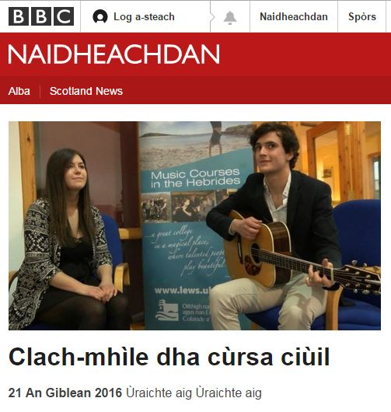
16 residencies on…..
http://www.bbc.co.uk/naidheachdan/36107893?SThisFB
‘With the talent being showcased at this event, I think we can all rest assured that Scottish music is alive and well in all its varied and wonderful forms.
To say that the students in this programme are accomplished is a gross understatement’
-Tim Durbin, www.welovestornoway.com

Slide 26
Building a learning community of music students across the Highlands and Islands and beyond
Anna-Wendy Stevenson
Programme Leader
BA (Hons) Applied Music
Anna.Stevenson@uhi.ac.uk
01851770517

