Slide 1
Building Student Learning Communities at a Distance
Dr Maggie King
Head of Academic Quality
QAA Focus On: Collaborative Activity, 19 May 2016
Learning and Teaching/ Enhancement
Quality Assurance
Quality and External Partnerships
Student
Learning Experience
External Partnerships

Slide 2
A Global University
HWU has c.33,000 students:
Five campuses: Edinburgh, Scottish Borders, Orkney, Dubai, Malaysia – c.14,000
Independent distance learning: c.8,000
Partnerships: c.11,000
So with 8,000 students in Edinburgh, the vast majority of our students are “at a distance”.
Learning and Teaching/ Enhancement
Quality Assurance
Quality and External Partnerships
Student
Learning Experience
External Partnerships

Slide 3
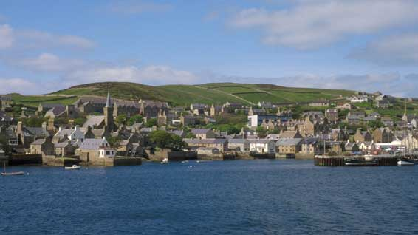
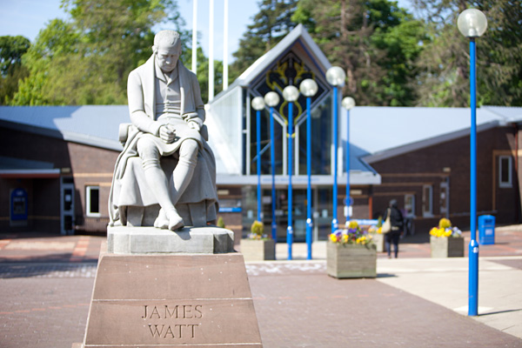
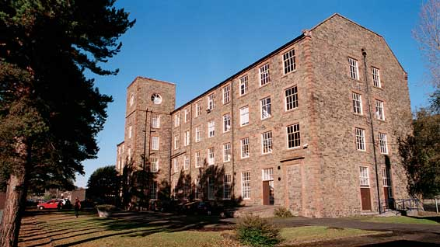
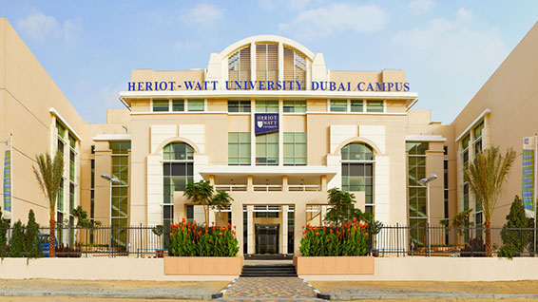
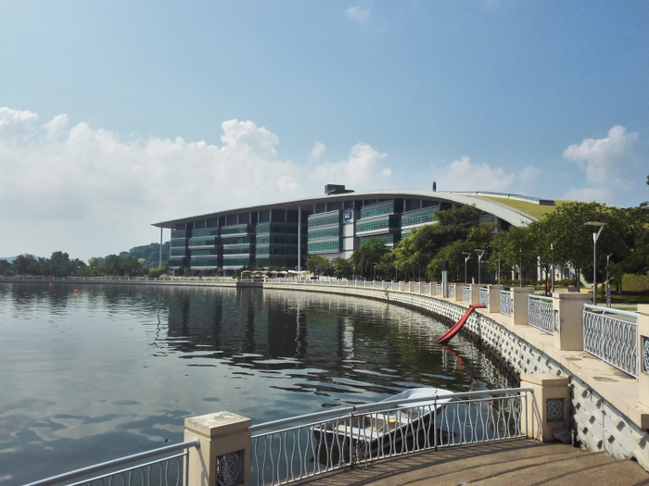
Five Campuses
Orkney
30
Edinburgh
8,400
Borders 645
Dubai
3,825
Malaysia
1,000

Slide 4
Partnerships in 35 Countries
Europe
4,765
(including
2,280 UK)
North America
3,545
Middle East
925
Asia
3,175
Africa
5,430
380
South America
120
Learning and Teaching/ Enhancement
Quality Assurance
Quality and External Partnerships
2014/15 Independent Distance Learners and Approved Learning Partner Student Headcount by Continent
Student
Learning Experience
External Partnerships

Slide 5
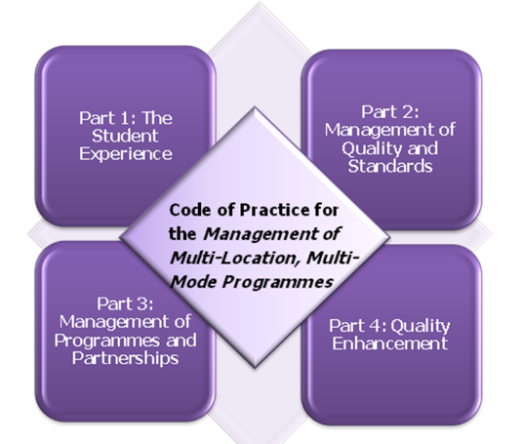
“One Heriot-Watt”
Initial focus on Assurance: “identical academic standards”
Now an increasing focus on Enhancement:
  Campuses: Global teaching teams; Course Leaders in Dubai; cross-campus student projects;
  Partnerships: Enhancement Plans; Enhancement as part of Annual Monitoring and Review
Learning and Teaching/ Enhancement
Quality Assurance
Quality and External Partnerships
Student
Learning Experience
External Partnerships

Slide 6
Inter Campus Student Engagement
Professor Fiona Grant
Director of Academic Quality
School of Energy, Geoscience, Infrastructure and Society
QAA Focus On: Collaborative Activity, 19 May 2016

Slide 7

Inter Campus
Student Engagement
Focus on student engagement and sense of belonging to HWU community/ethos, regardless of mode of delivery or campus location.
Example of good practice will include:
UG - group work activities across Edinburgh/Malaysia campuses,
PG – group work activities across Edinburgh/Dubai campuses
Visibility of cross campus teaching teams working together to deliver and assess course material
Go global – our initiatives to encourage students to have a truly international learning experience.

Slide 8

UG inter campus working
Undergraduate year two Edinburgh/Malaysia students
Working in groups of two to write a structured paper.
Develops awareness of cultural differences
Working in different time zones
Clear communication skills and different methods to communicate
Student Feedback – mixed, as it was difficult to communicate and work with someone you did not know but overall a good experience and would do it again.

Slide 9


PG inter campus working
Postgraduate Edinburgh/Dubai students
Design Project using BIM – cloud bases
Communicate design details and changes
Similar to real world working practices in an international collaborative project.
Links closely to HWU Graduate Attributes

Slide 10

Teaching teams
Visibility of cross campus teaching teams
Working together to deliver and assess course material
Collegiate working as if colleague is in the next room to you
Consistency of processes to establish methods of working together

Slide 11


Go Global
working well with students who are undertaking exchange visits between campuses

Slide 12

Baku Higher Oil School –
An Academic Partnership
Professor John Ford,
School of Energy, Geoscience, Infrastructure and Society
Professor Kevin McCullough,
School of Engineering and Physical Sciences
QAA Focus On: Collaborative Activity, 19 May 2016

Slide 13
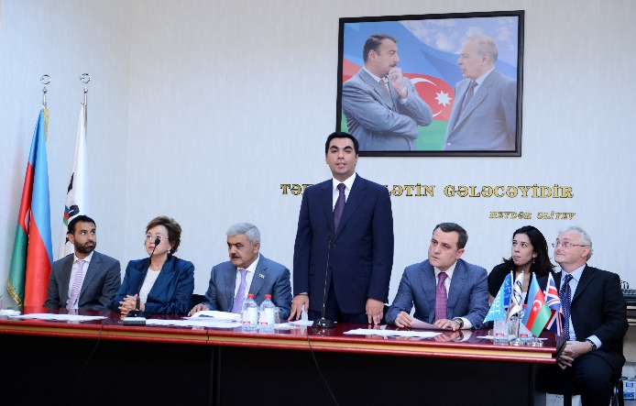
BHOS – The History
SOCAR Initiative:
  Produce next generation of leaders in O&G for Azerbaijan
  Graduates with knowledge, skills and attributes of graduates from Western Universities
Selected HWU as partner based on reputation and ability to deliver
Timeline:
  Dec. 2011: Initial enquiry to HWU
  Mid 2012: BHOS established
  Feb. 2013: Contract signed
  Sept. 2013: First Intake of 115 students
  Sept. 2016: Opening of new BHOS campus
  June 2017: Graduation of 80+ students
Notes:
Alignment with Bologna
Problem solving
English language – foundation year
Internationally
Academic and QA reputation - accreditation

Slide 14
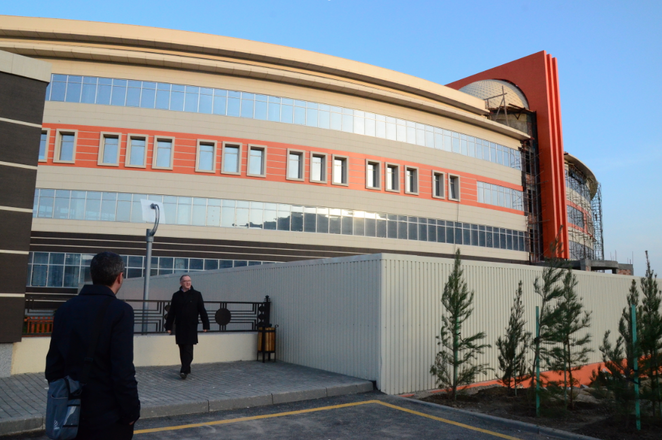
Commitments
HWU:
  Develop and deliver L&T materials for 2 BEng programmes - 45 Courses
  Set and mark all assessments
  Train and support BHOS staff
  Award Degrees
BHOS:
  Physical Infrastructure
  Recruit 100 students p.a.
  Financial support for students
  Delivery and support of Courses
Notes:
Same progs in Edin/Dubai/Malaysia
HWU:
Develop and deliver L&T materials for 2 Beng. programmes - 52 Courses
Set and mark all assessments
Train and support BHOS staff
Award Degrees
BHOS:
Physical Infrastructure
Recruit 100 students p.a.
Financial support for students
Delivery and support of Courses

Slide 15
Staff
Commitment at all levels in both BHOS and HWU
BHOS:
  Highly qualified academics
  Experience with FSU style of teaching and assessment
HWU:
  Engagement across Schools/admin. units
  Multi-school project team
  CRP Ownership of project
    Development of materials
    Global delivery and assessment
Notes:
– schools -UG Degree
F2f and skype
Fundamental Requirements:
Commitment at all levels
Trust, open mindedness and deep engagement
Personal relationship between CRPs
Regular F2F and Skype meetings
Reciprocal Visits
BHOS:
Academically sound academics
Trained in FSU Style of teaching and assessment
HWU:
Ownership of project
Development of materials
Global delivery and assessment

Slide 16
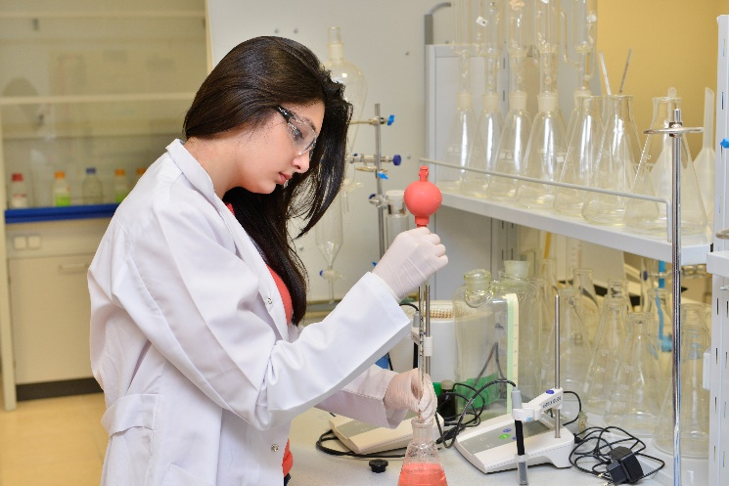
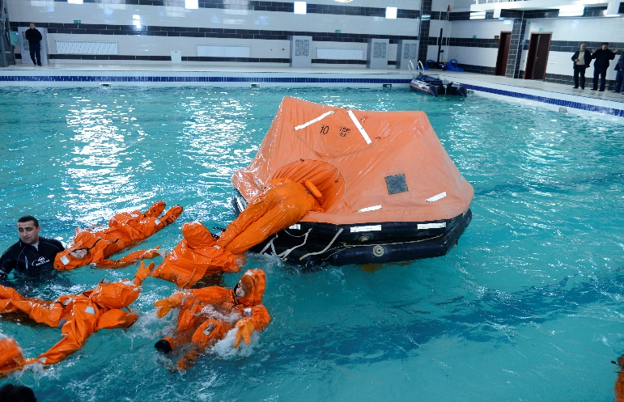
Students
Academically - A* Equiv. maths and Sciences
Practical, project and transferable skills - Limited
UK Learning process/experience - Unfamiliar but highly adaptable
Live with parents
Notes:
Academically – A* Students
Practical/Project and Transferable Skills– Limited
Live with Parents:
Maturity levels - lower than UK
Significant Travel Time to campus
Personal/Family commitments
Limited access to internet
Expectations - Very High
Exam process/experience - Unfamiliar

Slide 17
Impact
Student Population:
  300+ students studying for HWU BEng Degrees (in English) in Baku
  90+ entering 4th Year
  1st 80+ graduates entering O&G workforce in 2017
Approx. 45 BEng. L&T Packages developed, delivered and supported since 2013
14 BHOS Academic staff and 5-10 support staff trained and supported in delivery of HWU courses/programmes
4800+ Exams sat in Baku and marked in Edinburgh
New Campus to Open in Sept 2016

Slide 18
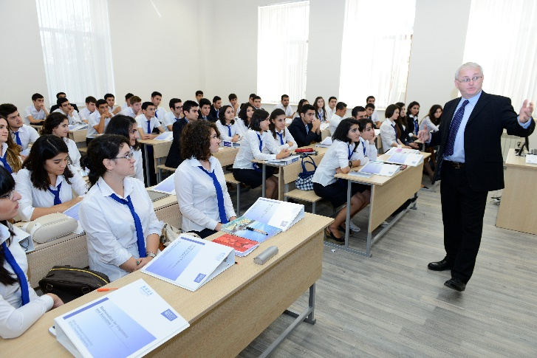
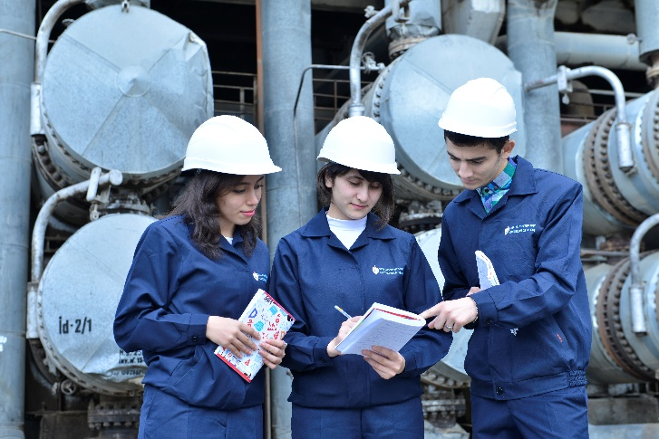
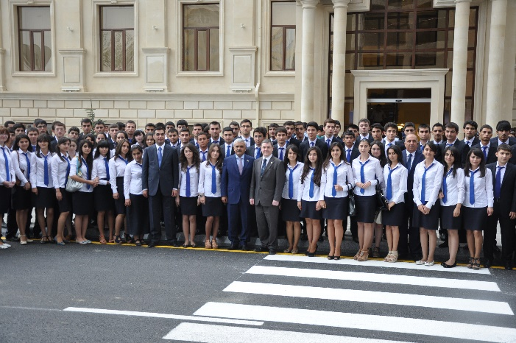
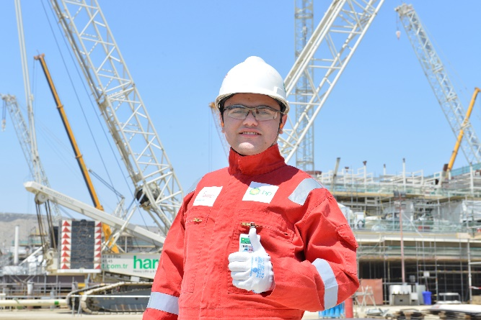
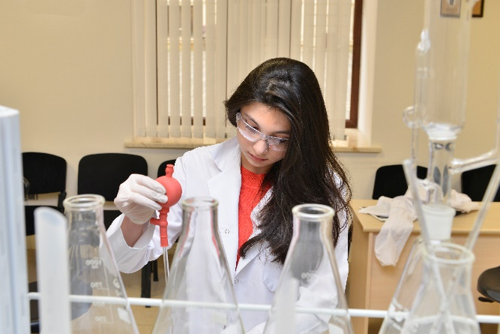
Impact

