Slide 1
QAA Scotland:
Focus on Assessment and Feedback
Policy and Practice Summit
Professor John W Sawkins,
Deputy Principal (Learning and Teaching)
Heriot-Watt University
14 May 2015

Slide 2

Challenges of Institutional Implementation
The challenges of implementing policy on assessment and feedback consistently across an institution

Slide 3

Key Challenges
Developing the policies
Articulating the policies
Communication
Monitoring
Supporting and challenging
Reviewing

Slide 4

Developing the Policies
Preliminaries
  Helpful to have clear strategy and overall policy framework
Who will have to understand and implement the policies?
Consultation is worth while
  Listen to, and respect the views of consultees – they know more about it than you!
  Build consensus and support
Due process is important
  Avoid ‘short cuts’ – you never know where you will end up if you take one!

Slide 5

Articulating the Policies
Articulate the policies clearly
  Verbally – check, can you explain it clearly and succinctly to a user?
  Written – style is important
    The virtues – simplicity, clarity, brevity
    The vices – verbosity, pomposity, padding
Format is important
  Think about the user
  What formats are most user-friendly?

Slide 6

Communicating the Policies
Who needs to know about the policies?
What is the best type of communication for them?
  Targeted? Multiple methods?
Check
  When do they need to know about / use the policies? Can they find them if they need them?
  These policies will not be the single focus of their working day!

Slide 7

Monitoring Implementation
‘Hard-wire’ robust monitoring processes in place
Remember…
  Security of academic standards is paramount and must never be compromised
  The more complex and extensive the system the more difficult it is to communicate and run and the more points of potential failure there are
  Processes must be clearly understood

Slide 8

Supporting and Challenging
Processes must have checks and balances
Scrutiny and challenge built in
Senior management must offer support and challenge
  Support implementation. Consistency of message and approach – close down conversations which seek to tinker with agreed policies
  Challenge those seeking to undermine or subvert implementation

Slide 9

Reviewing
Review regularly and systematically
Support the development of an institutional culture in which honesty, openness and transparency are valued
Welcome constructive feedback

Slide 10

Heriot-Watt Experience
How have we gone about some of this?
HWU Context
  5 campus locations (Scotland, Dubai, Malaysia)
  Approved Learning Partners (50 universities and college Partners, in 30 different countries - 9,000 students)
  Independent Distance Learners (MBA, PG provision > 10,000 students)
  HWU degree programmes delivered in 150 countries world-wide
  HWU examinations (2013/14) – Organised by our International Centre for Examinations exams held in 495 locations around the world

Slide 11

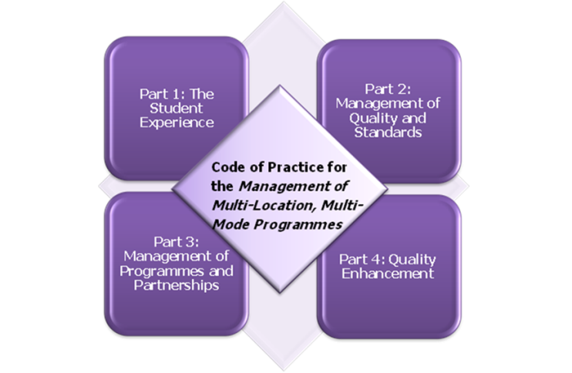
Developing the policies
Clear strategy and policy framework
Priorities for HWU
Consultation must be inclusive
  Academic and Professional Services staff
  All campus locations
Consultation methods must be varied and appropriate
  Obvious – different timezones
  Less obvious – cultural differences
Due process vital for all to be engaged

Slide 12
Articulating the policies
Consider the users
Short policy documents
Longer procedural guidelines
Summary briefing papers
(for busy staff!)

Slide 13

Communicating the policies
Multiple methods
‘Usual’ channels
  Paperwork passed through committees
  Presentations to key committees Senate etc
Other channels
  Workshops (at different campus locations)
  Podcasts online
  Senior management presentations at open meetings

Slide 14





Monitoring implementation
The importance of good structures and processes

Slide 15

Supporting and challenging
Processes, checks and balances
Scrutiny and challenge built in
Role for senior management in intervention

Slide 16

Reviewing
Strive to continually learn and enhance
Use internal and external processes

