Slide 1
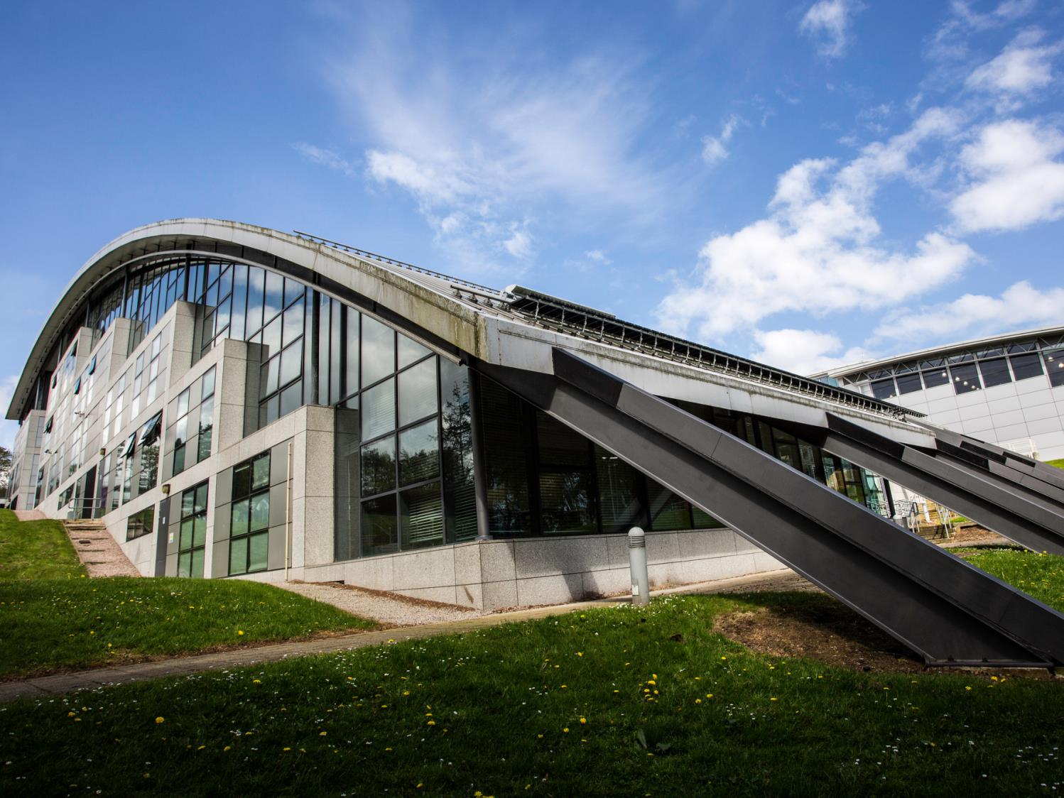


Developing ways of engaging and representing students at a distance
Edward Pollock and James Dunphy

Slide 2

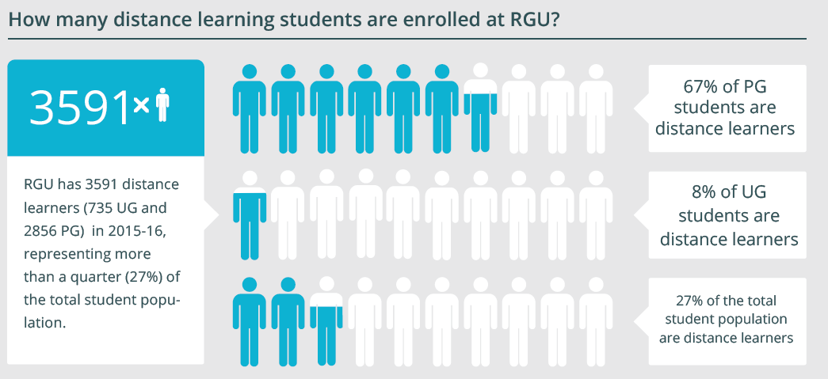
Our Distance Learning Community

Slide 3
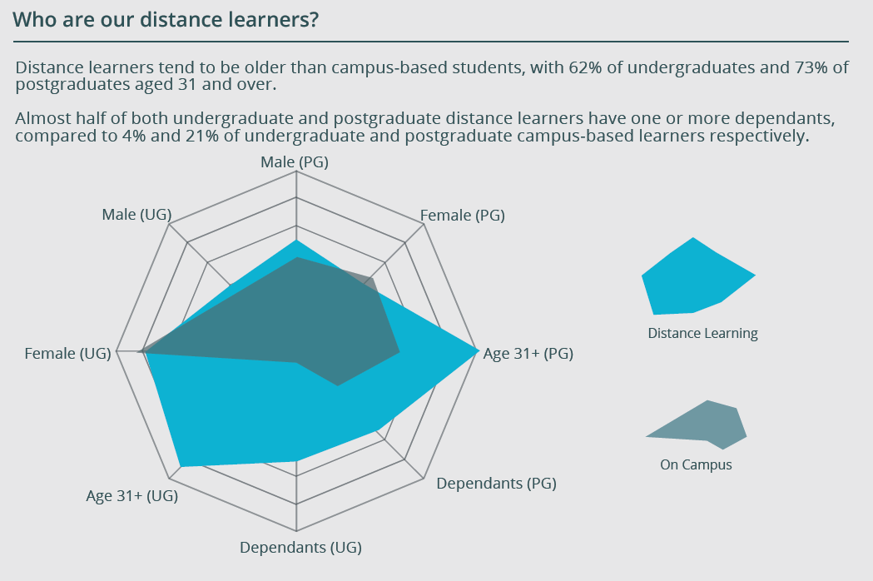

Slide 4
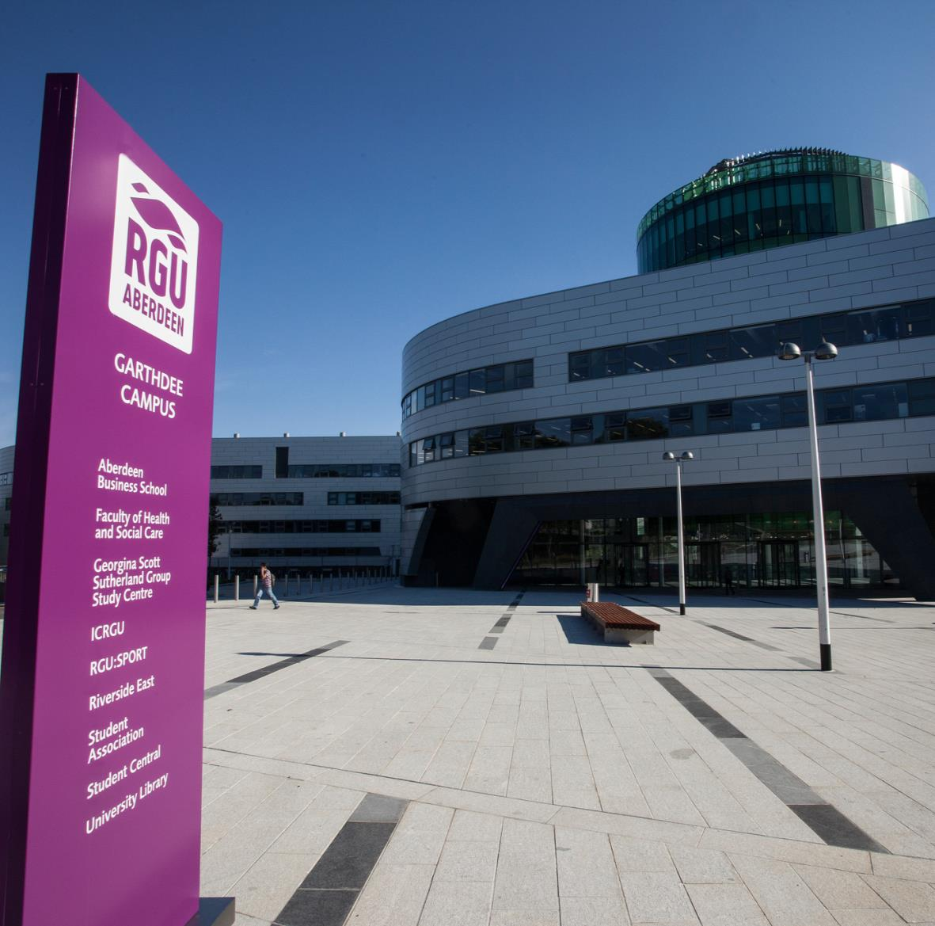
Our Partnership Approach
Student Partnership Agreement
Part One: Roles
Distance Learning Student Representatives
Distance Learning Student Faculty Officers
Distance Learning Facebook Group

Slide 5
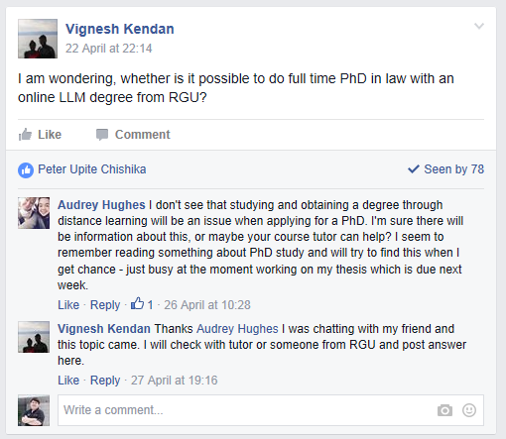

Slide 6
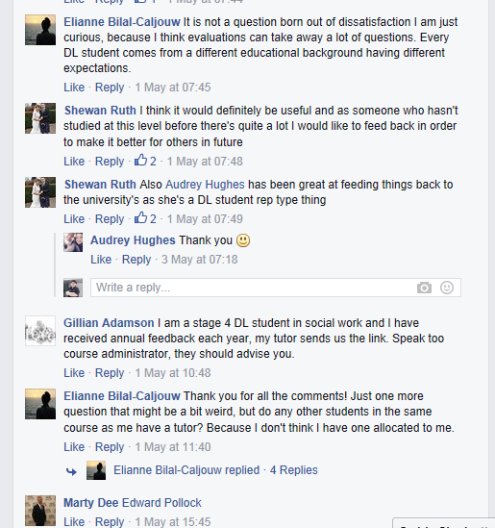

Slide 7
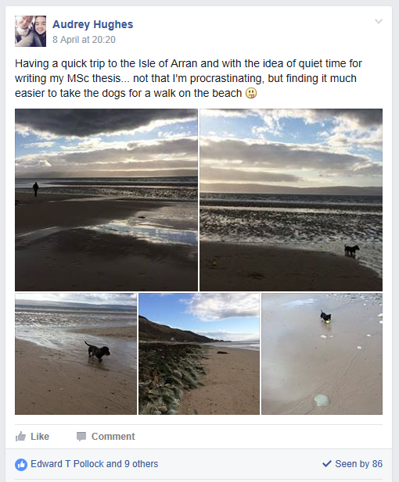

Slide 8
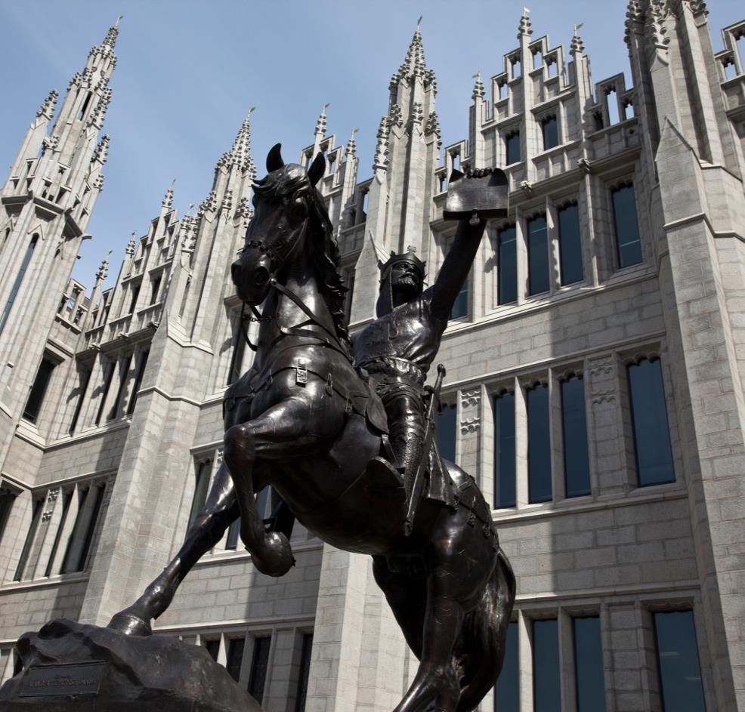
Our Partnership Approach
Student Partnership Agreement
Part Two: Changes
“RGU Identity”
  New ‘Connected’ Distance Learning Newsletter
  Live Streaming of Events
  Video Induction Materials

Slide 9
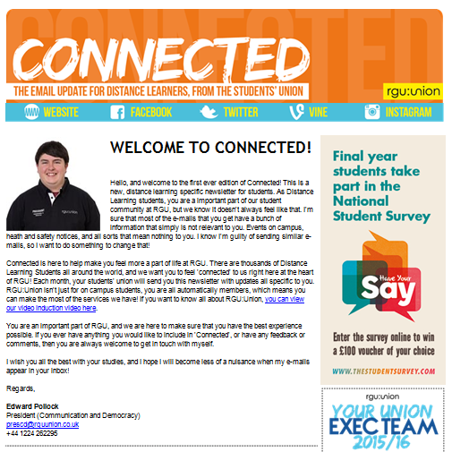

Slide 10
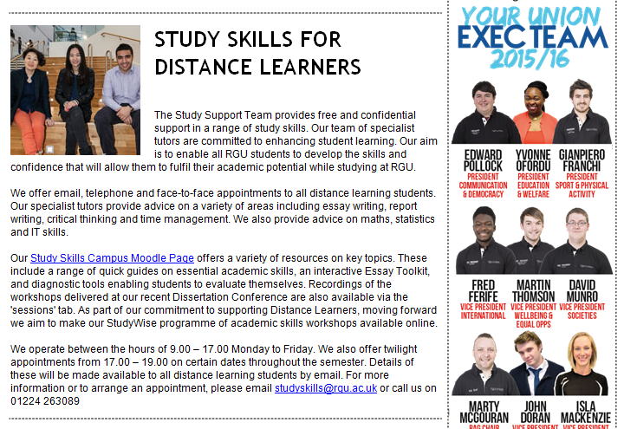

Slide 11
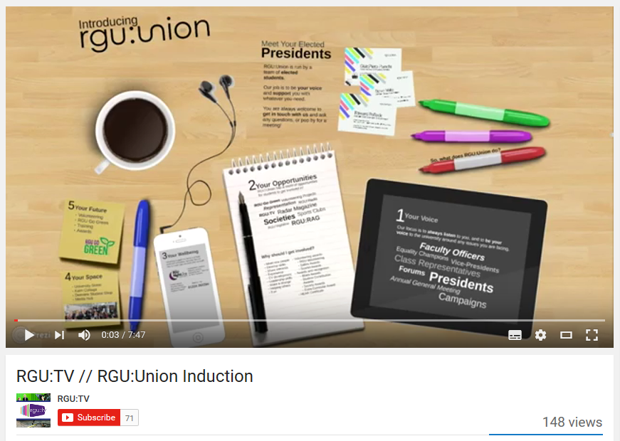

Slide 12
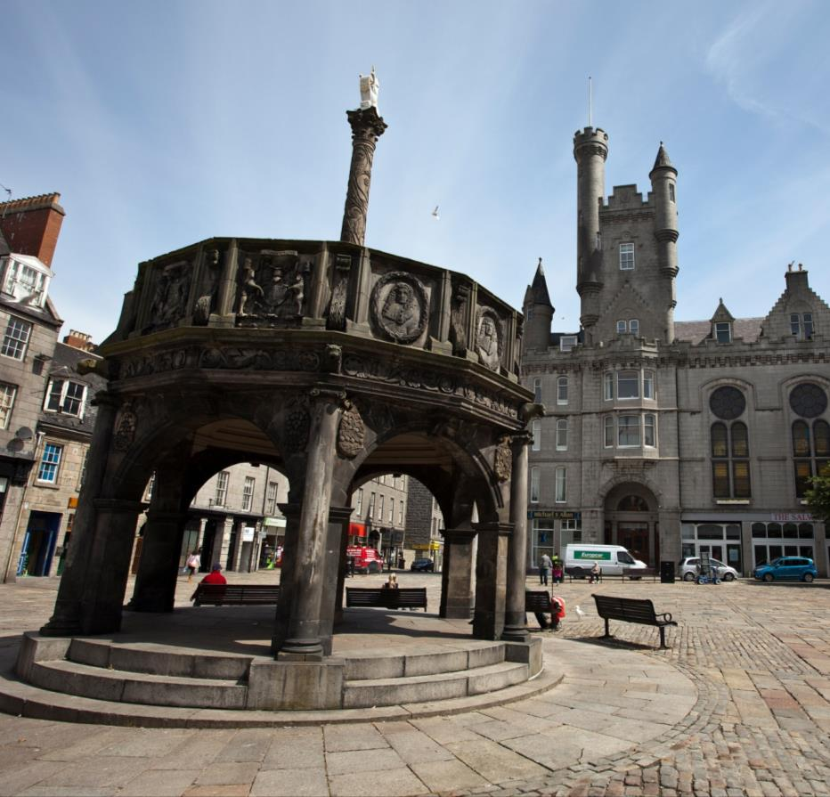
Looking through the lens of transition
What supports, engages and motivates our DL students?
Speaking to students
Speaking to staff
Setting out the key features of high performing courses.

Slide 13
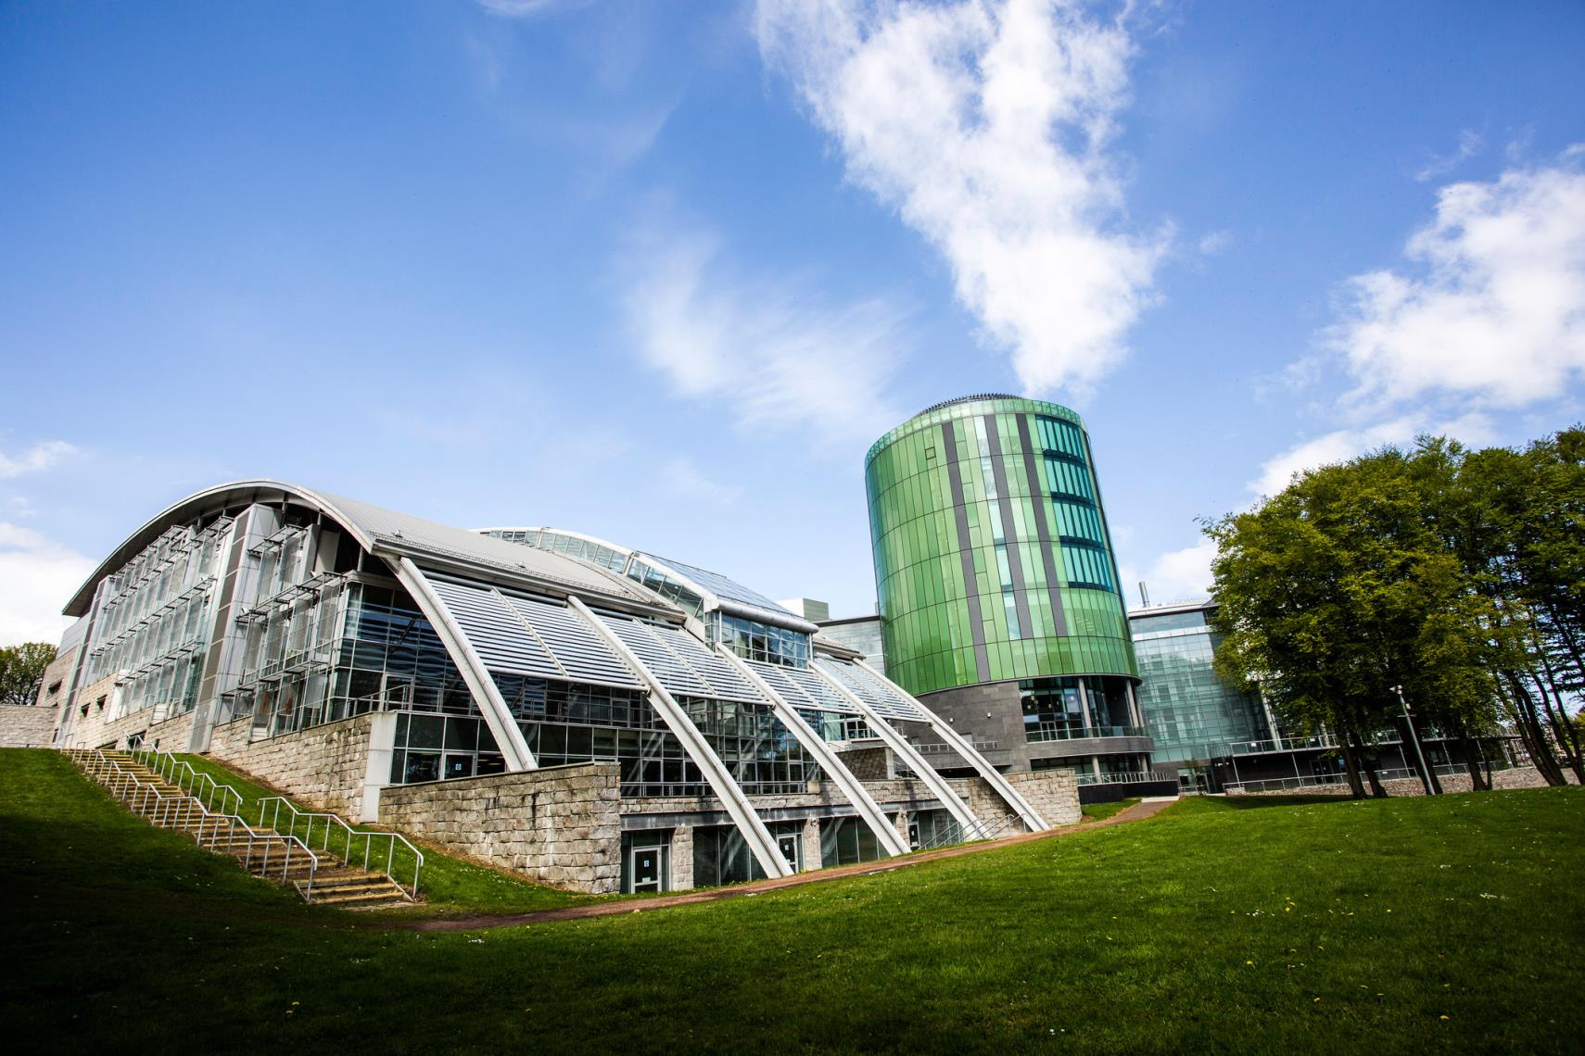
James Dunphy
Head of DELTA
Robert Gordon University
j.dunphy@rgu.ac.uk
Edward Pollock
President (Communication and Democracy)
RGU:Union
prescd@rguunion.co.uk

