Slide 1
Engaging students studying at a distance: the development of a regional students’ association – Highlands and Islands Students’ Association (HISA)
Lorna Stanger, Vice-President (Further Education), HISA
Louise MacDonald, Student Engagement Officer

Slide 2
The context for setting up HISA
Funding from Scottish Funding Council received in February 2013 for 2 year project to develop a new framework for student representation
Regionalisation agenda:
University of the Highlands and Islands established as a Regional Strategic Body
Strengthened commitment to students’ associations
Need for a students’ association to:
Represent further and higher education students
Enable students to inform local and regional governance and decision making
New framework to be operational by August 2015

Slide 3
The challenges

Slide 4
Summary of activities
The evidence base for change:
Market research with our students (completed July 2014)
Existing structures, processes and practices mapped (completed July 2014)
Internal and external good practice reviewed (completed July 2014)
High level options shared at a student conference (October 2014)
Consultation conducted with students and staff (October/November 2014)
Agreement secured to progress with a new framework (February 2015)
Elections for HISA regional officers (March 2015) and HISA operational (July 2015)
Over 1,000 students got involved in the process to design HISA

Slide 5
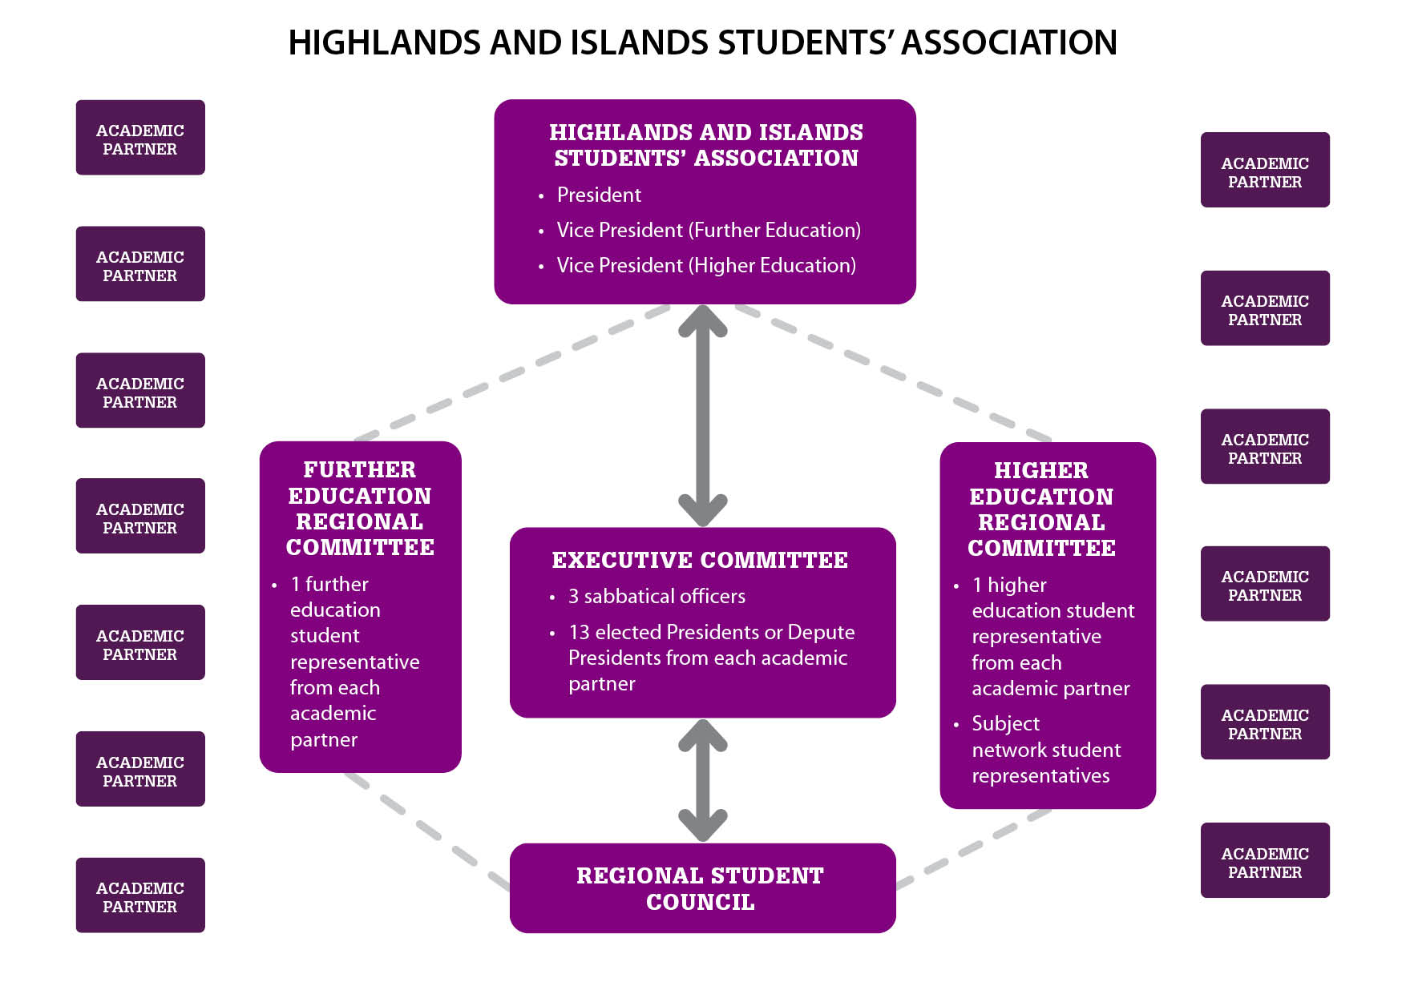

Slide 6
The HISA structure…
#HISA
Ma tha e cudromach dhutsa, tha e cudromach do HISA!
If it matters to you, it matters to HISA!

Slide 7
What is HISA is doing to engage with students?
We use our structure to help us to engage with students locally and regionally
We use available technology to overcome distances, modes of learning and communication and students’ lifestyles:
Videoconferencing
Social media
Online voting
We use our funds to bring people together to attend Regional Council
We endeavour to make sure UHI’s diverse student body is represented:
Exploring new officer roles to reflect our study body
We are engaging with students to help them feel they are part of a community:
Clubs and societies
We ask our students to vote on identified priorities for HISA to focus on
#HISA
Ma tha e cudromach dhutsa, tha e cudromach do HISA!
If it matters to you, it matters to HISA!

Slide 8
What HISA is doing to engage with students?
Local engagement:
HISA Depute Presidents are voting members of our Executive Committee and voting members of their local Boards of Management
HISA Depute Presidents work closely with class representatives to stay close to the student voice
HISA Depute Presidents work closely with local student engagement staff to act on students’ feedback
Regional engagement:
HISA regional officers are members of Court and all key university committees
HISA regional officers have input to strategy and key activities, like ELIR
National engagement:
HISA are active participants at NUS events and help inform and shape national policy
Next steps:
We’re continuously evolving to recognise and meet the needs of our students
We’re trying to integrate more fully with local systems of class representation and working towards a more consistent structure
We’re creating new officer roles to represent our different cohorts of students
#HISA
#HISA
Ma tha e cudromach dhutsa, tha e cudromach do HISA!
If it matters to you, it matters to HISA!

Slide 9
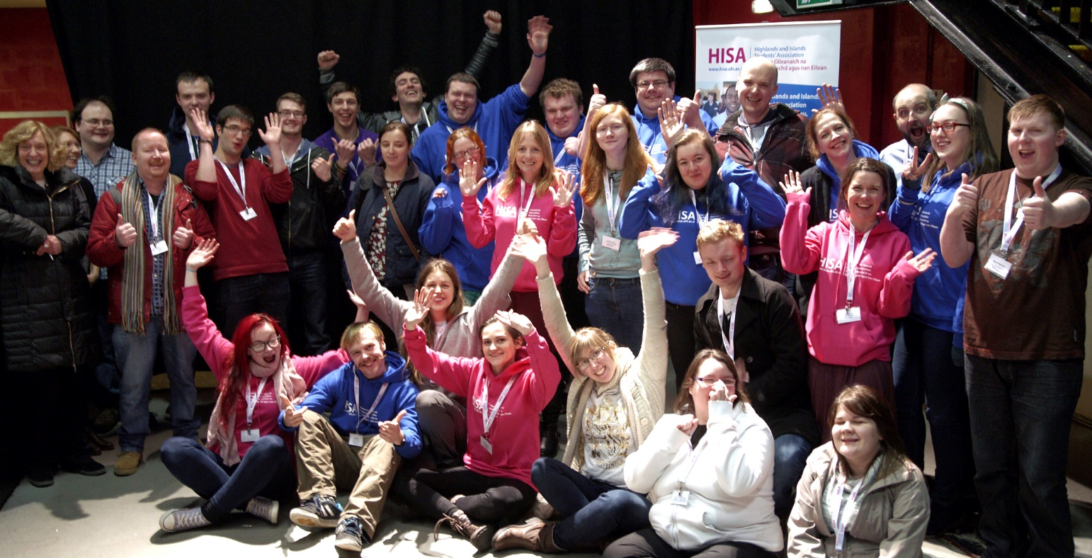
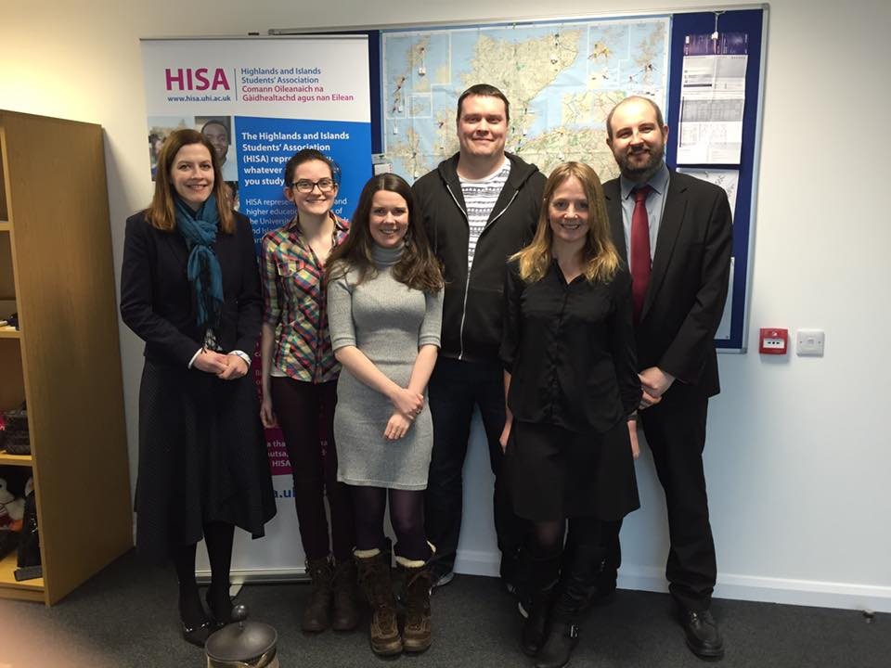
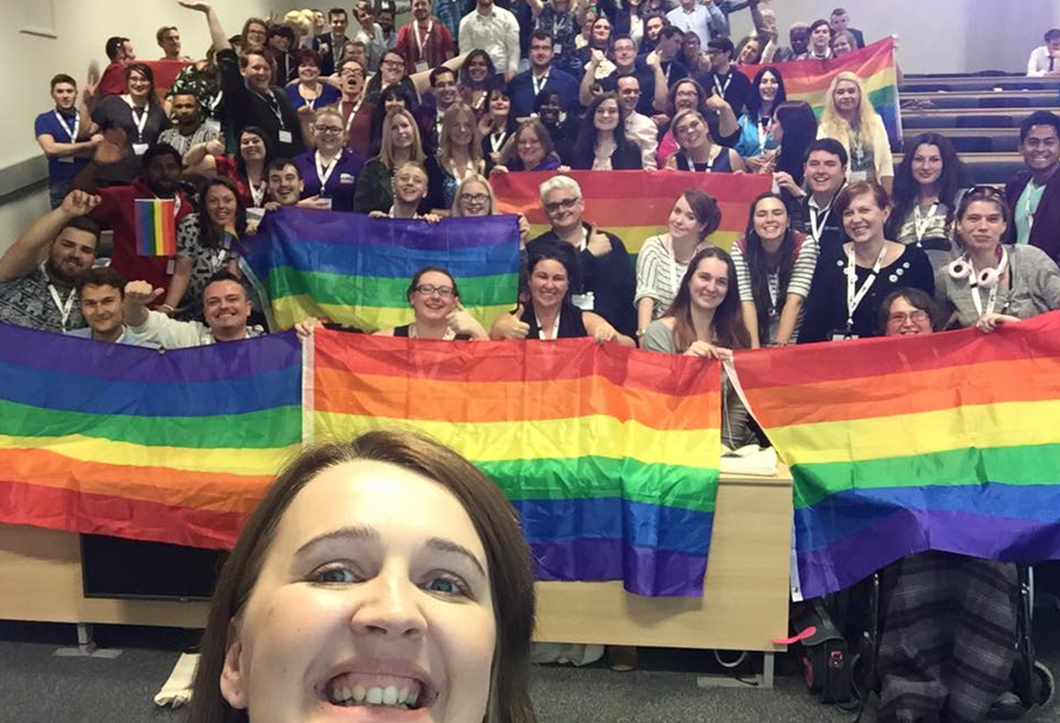
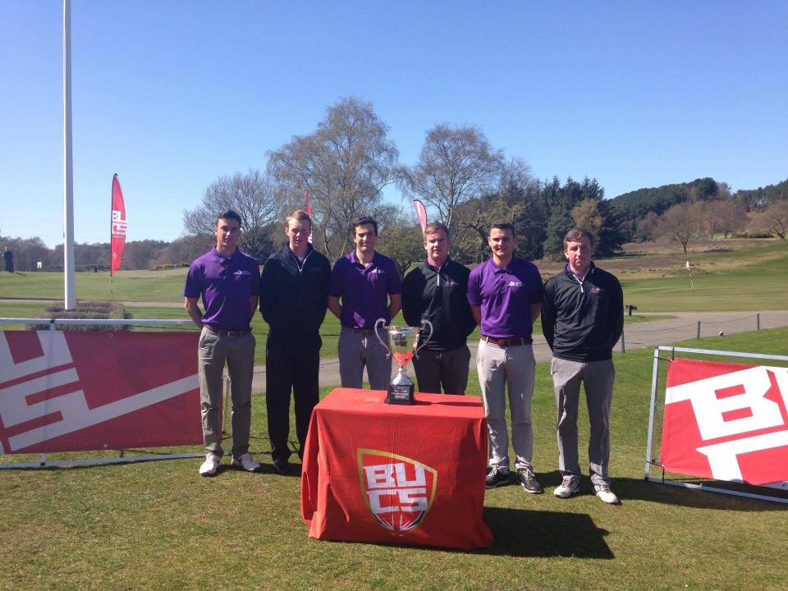
Meet the whole HISA team!
The HISA staff and Sabbatical Officers who support UHI’s 30,000 students…
HISA Regional Council: This is the largest Regional Council hosted by a UHI students’ association.
NUS The Gathering – August 2015
The UHI Golf Club: BUCS Championship
#HISA
#HISA
Ma tha e cudromach dhutsa, tha e cudromach do HISA!
If it matters to you, it matters to HISA!

Slide 10
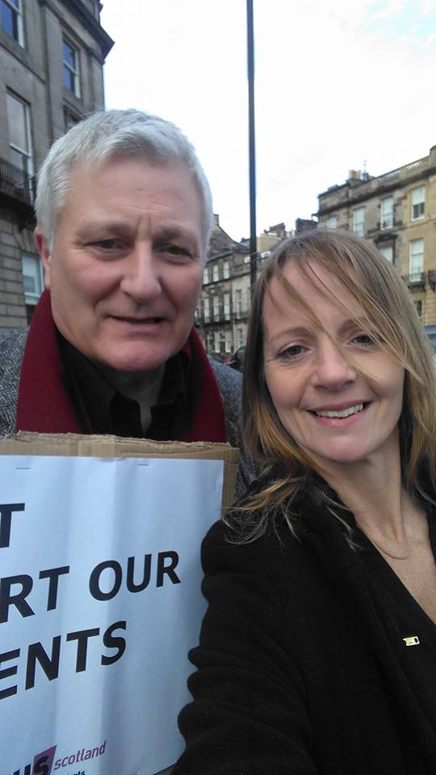
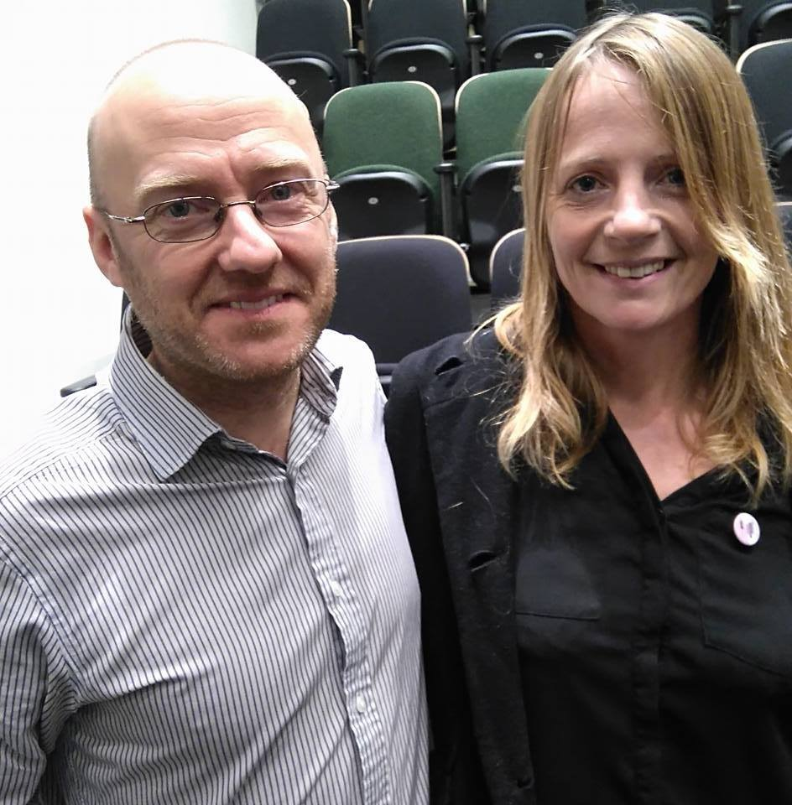
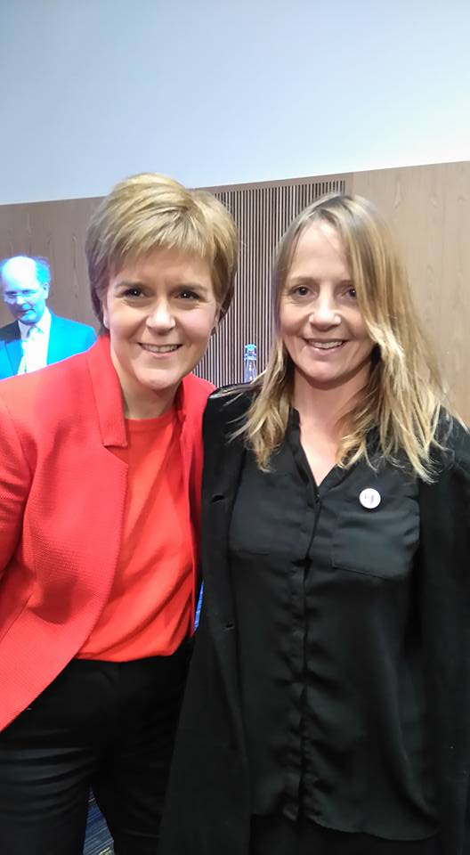
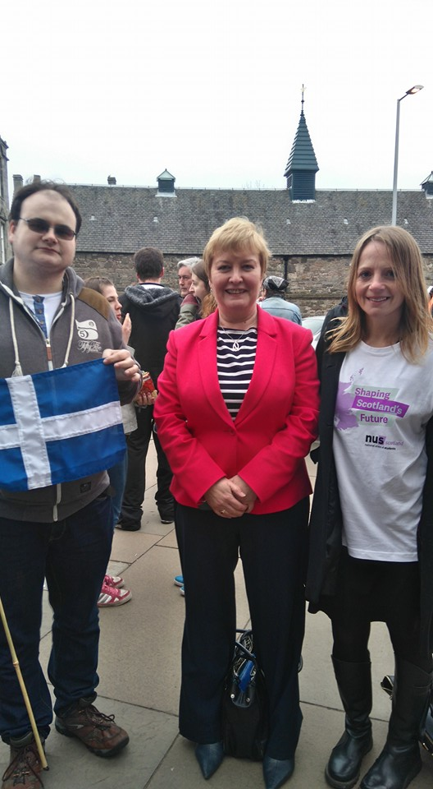
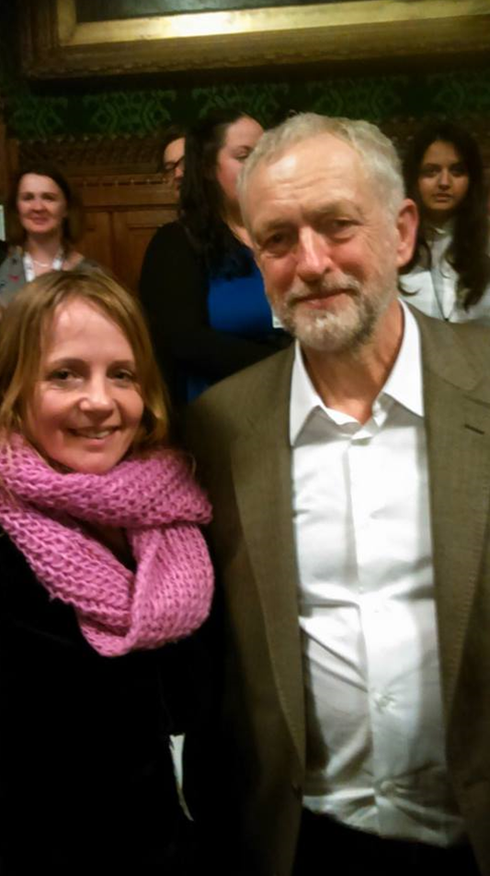
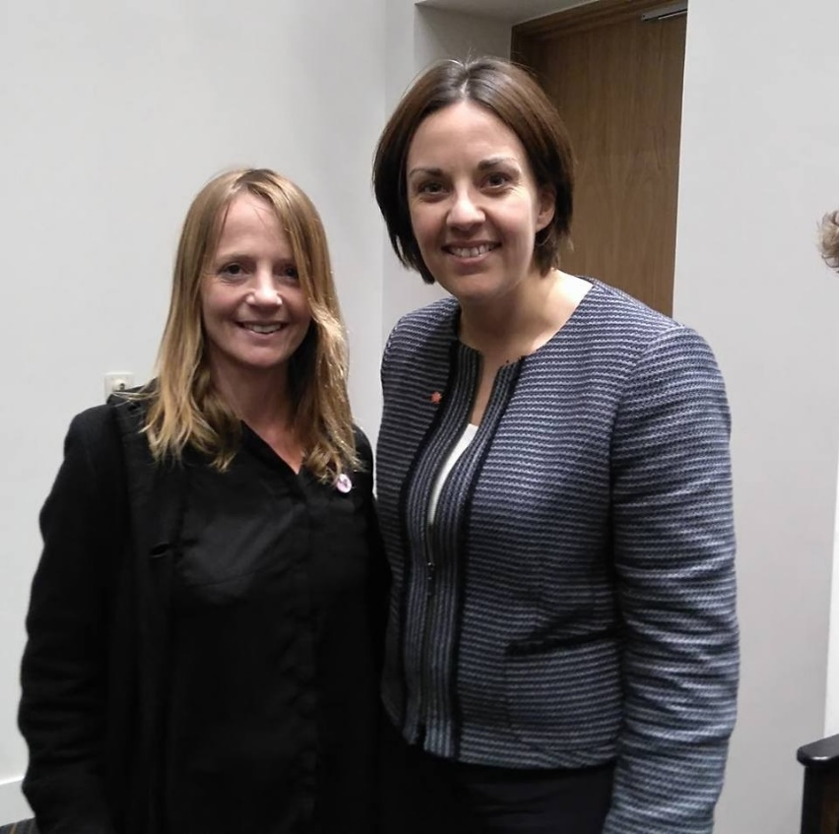
The HISA ‘Who’s who’ of national politics!
#HISA
#HISA
Ma tha e cudromach dhutsa, tha e cudromach do HISA!
If it matters to you, it matters to HISA!

