Slide 1
Kevan MA Gartland Special Advisor & Professor of Biological Sciences
Lesley McAleavy Development Officer (Engage)
GCU Feedback Strategy

Slide 2

Feedback for Future Learning
University-wide campaign to improve how students receive, and use, academic feedback (2011-14)
Partnership between the University and Students’ Association
Driven centrally by Feedback Enhancement Group (FEG)
Wide range of activities and good practice delivered within academic programmes and modules
Aim: to make feedback work better for our students
Notes:
Key driver was NSS:
- Overall Assessment and Feedback:
Q7 – Feedback on my work has been prompt *** (Focus on 3 week turnaround)
Q8 – I have received detailed comments on my work
Q9 – Feedback on my work has helped me clarify things I did not understand
The FEG centred on cross-University collaboration and placed equal priority on staff and student engagement to address the feedback challenge. The group had two clear objectives:
To enhance feedback practice by staff
To ensure greater awareness of, and reflection upon, feedback by students
FEG centrally coordinated but activities were developed and delivered in close collaboration with Schools. Members comprised:
ADLTQs
Academics from all Schools and GCU LEAD
Professional services staff (Student Experience, Strategy and Planning, ISSS)
Students’ Association (Full Time Officer)
Student rep

Slide 3
8 Feedback Principles @ GCU
Outline what students can expect from academic feedback at GCU. Feedback should be:
A dialogue
Supportive of future learning
Timely – normally within 3 working weeks of coursework submission deadlines
Related to clear criteria
Accessible to all students
A continuous process
Available on all forms of assessment
Flexible and suited to students’ needs
Notes:
*** A lot of FFL activity focused on Principle no3 which maps to Q7 of the NSS: ‘Feedback on my work has been prompt’ *** (Focus on 3-week turnaround and ensuring student awareness of this policy)

Slide 4
Feedback Enhancement at GCU
FEG
GCU Feedback Principles
Staff engagement
CPD
Resources and events
Strategy & policy
Student engagement
FFL workshops
FFL online units
Memorable feedback competition
School action plans
Induction, LDCs, academic advising

Slide 5
FFL Activities, 2012-14
Feedback for Future Learning (FFL) website developed: www.gcu.ac.uk/futurelearning
Student facing campaign (social media, email, posters/fliers, events etc.)
Regular staff events (CPD sessions, lunchtime seminars, tailored workshops, scholarly activity, Feedback Fair)
FFL workshop developed in collaboration with Organisational Development in 2012/13
  120+ FFL workshops delivered with 1,500 students
FFL online learning units developed in 2013/14

Slide 6

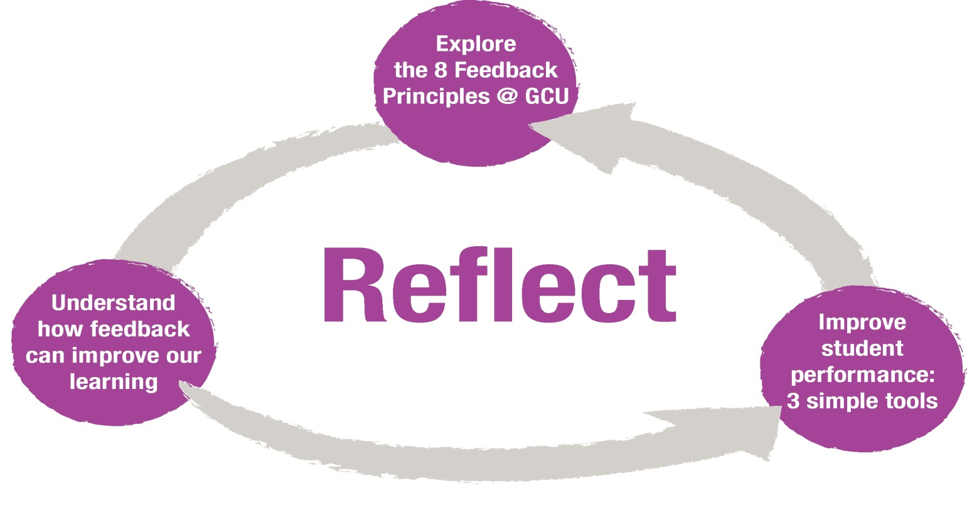
Reflecting on Feedback – FFL Workshops

Slide 7
Online Learning Units
FFL workshop online learning units launched in September 2013; accessible via GCULearn
Expand upon the concepts introduced in the FFL workshop; designed to help students make the most of the feedback that they receive at University and beyond
Aim: a more flexible, programme-centred approach to delivery
Units currently available:
1. Being a Student at GCU
2. Feedback and You
3. Using Feedback Successfully
4. Changing Your Perspective of Feedback
5. Reflecting on Feedback

Slide 8
Purpose of Workshops and Online Learning Units
Explore the nature and purpose of feedback
Promote student engagement with the GCU Feedback Principles
Promote the dialogic nature of feedback
  Encourage deeper reflection upon academic feedback (by introducing simple tools and models to aid reflective practice)
  Signpost student to sources of support at GCU

Slide 9
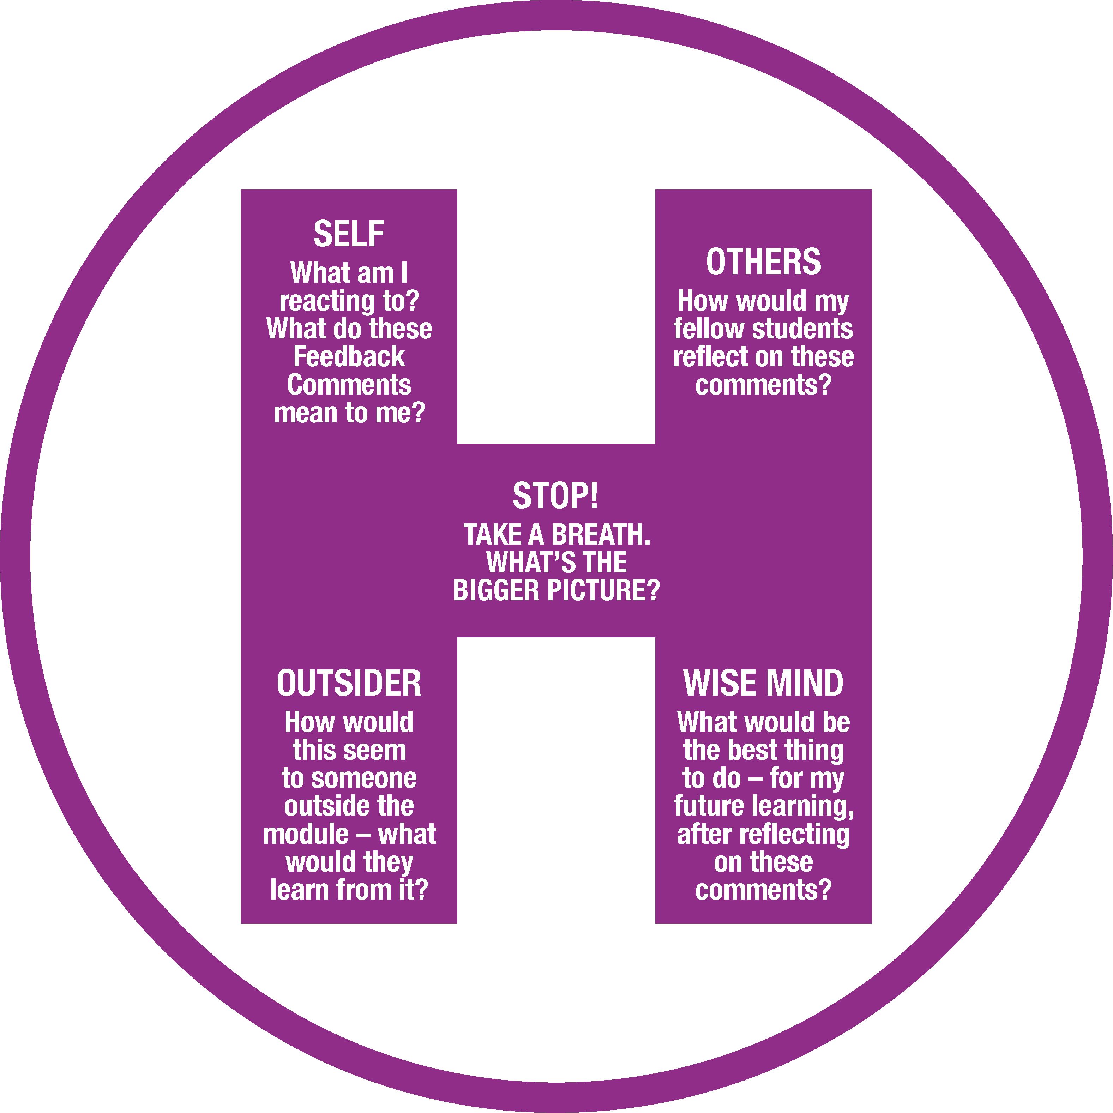
Feedback Tools
Helicopter – Broadening Your Perspective
Adapted from: http://www.getselfhelp.co.uk

Slide 10
Feedback Tools
Gibbs Reflective Cycle
1. Description
3. Evaluation
4. Analysis
2. Feelings
5. Conclusion
6. Action Plan
Gibbs, G. (1988) ‘Learning by doing: a guide to learning and teaching methods’, Further Education Unit, Oxford Polytechnic, Oxford

Slide 11
Evaluation of FFL Workshop
Made me more confident to ask questions about my feedback.
  1,200 evaluation forms received
  93% of students found the workshop to be worthwhile
  Key themes included increased awareness of the need to be proactive and ‘take control’ of academic feedback – e.g. by using the tools provided to reflect upon feedback comments and apply them to future assessments
I hadn’t thought about the powerful impact that getting feedback can have. My thoughts have changed about it now.
It made me think about how I react to getting feedback and what to do to get the most out of feedback.
Allowed me to really think about feedback and understand why it is important, which is something I never would have done before.

Slide 12
Memorable Feedback Competition
  3 Annual Memorable Feedback Competition Surveys gathered data on student perceptions of academic feedback at GCU
  1200+ responses received over 3 years (trebled by Year 3)
  Students demonstrating a greater knowledge of the different types of academic feedback provided
  Increased recognition about the need to be proactive in reflecting upon feedback comments

Slide 13
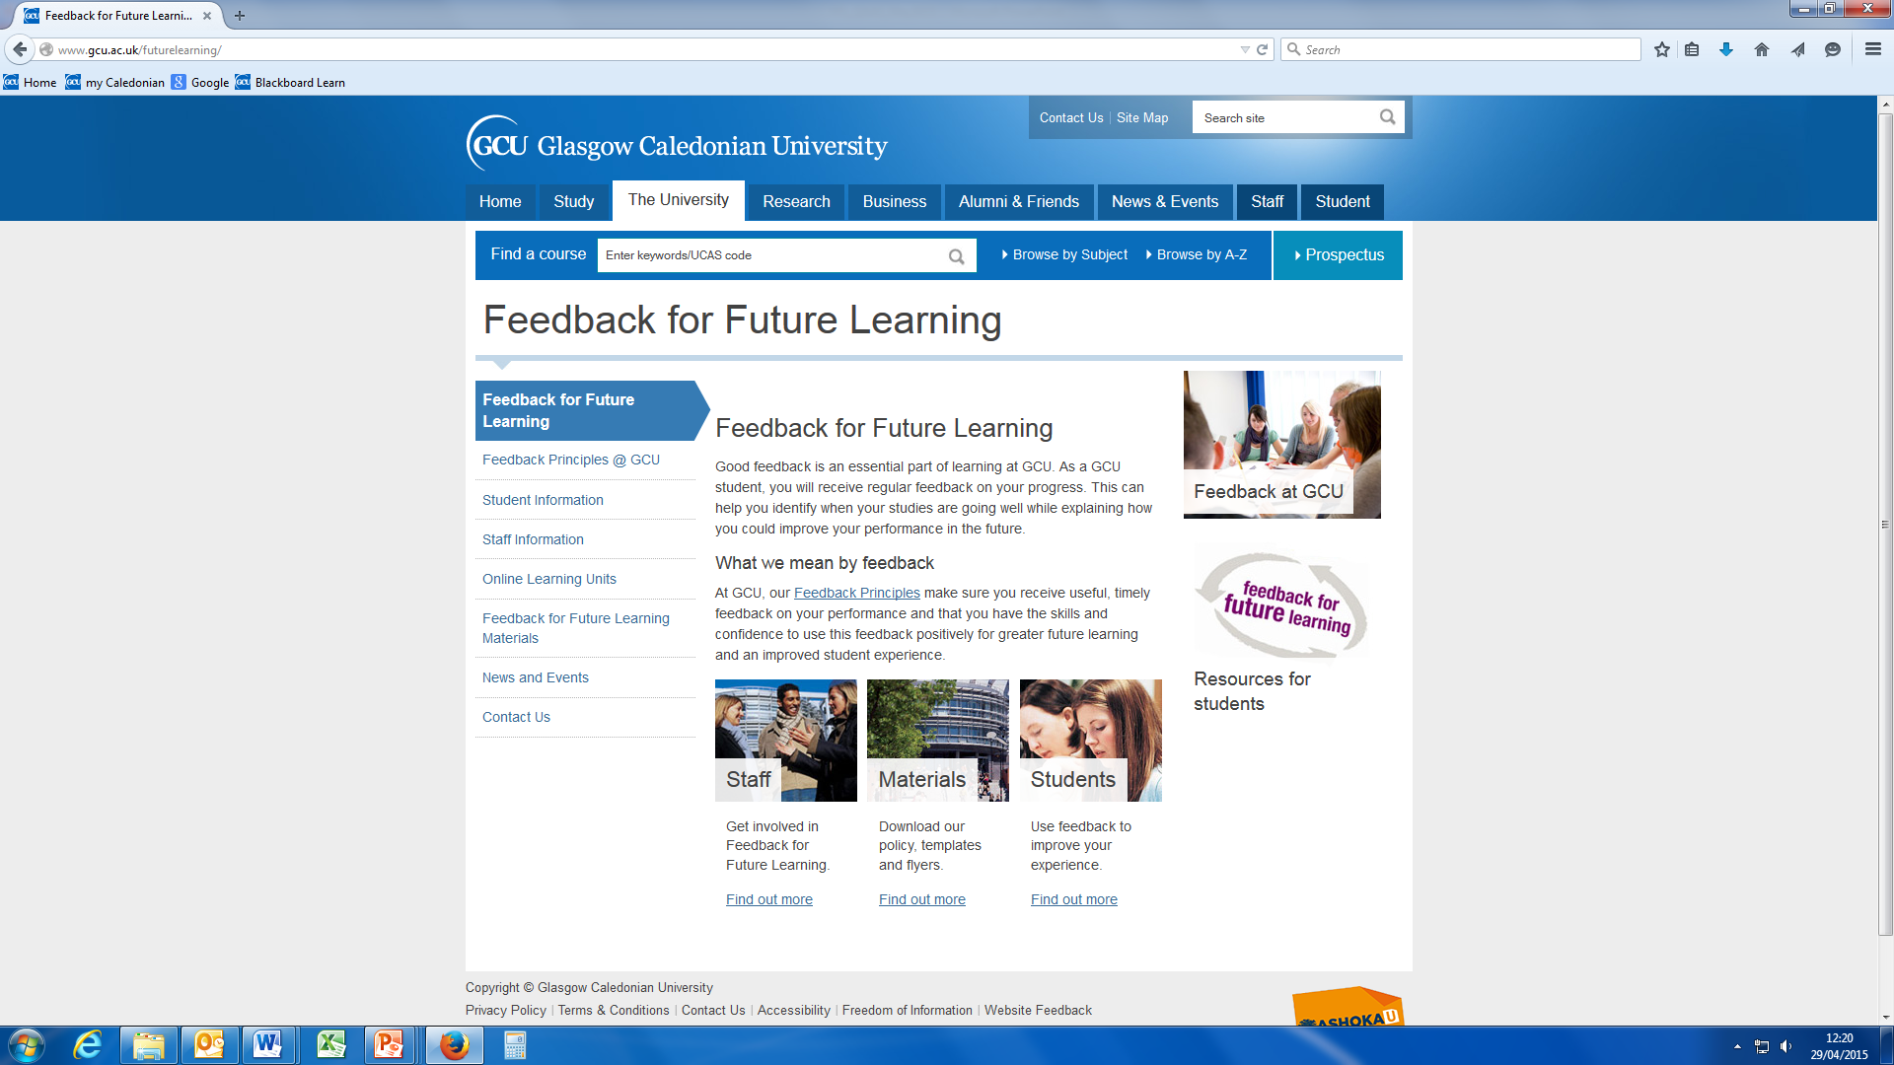
Central Resources
Feedback for Future Learning website: http://www.gcu.ac.uk/futurelearning/
  Staff and student facing resource
Staff Portal containing materials for academics to use within programmes and modules:
    Student induction materials
    FFL workshop materials
    FFL online learning units
    Assessment feedback templates
    Information for academic advisors

Slide 14
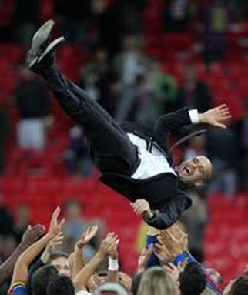
Outcomes
NSS Satisfaction Scores: 9% increase in Assessment and Feedback overall
16% rise Prompt Feedback
14% better Detailed Comments
8% improved Helpful Comments
Greater staff commitment and enhanced student awareness
Every new GCU student can access an introduction to feedback
GCU staff use centrally produced materials and resources

Slide 15
Maintaining the Impact
GCU is committed to continued feedback enhancement post-FEG:
Student Performance Feedback Policy approved by Senate in October 2014; GCU Feedback Principles are now University Policy
Feedback enhancement mainstreamed into core policy and practice
  Strategy for Learning: http://www.gcu.ac.uk/gaq/strategyforlearning2013-2020/
  Student Experience Framework: http://www.gcu.ac.uk/segaq/studentexperienceframework/
Academic Schools each have feedback action plans for 2014/15
  Feedback is included in NSS action plans
  Feedback dialogue is encouraged within PPACT/academic advising sessions
Reduced central support is continuing through Engage: www.gcu.ac.uk/engage
  FFL is now one strand of a wider student engagement and enhancement agenda at GCU
Notes:
The need to ensure high quality feedback on a continuous basis is reflected in key GCU strategies and frameworks. The development of both the Strategy for Learning (SfL) and the Student Experience Framework (SEF) was informed by the FFL initiative.
SfL:
One of ten Curriculum Design Principles outlined in the SfL 2013-20 focuses on ‘broader and deeper learning’, which includes: “learning which is interactive, collaborative and challenging; balanced assessment and greater formative feedback; reflective learning; self and peer assessment” (p5). Appendix B of the SfL suggests that this may be achieved via:
“timely, high quality and constructive formative feedback in a variety of forms, particularly that which is given early within each level of study to reinforce levels of student engagement and their understanding of learning requirements, expectations and assessment processes” (GCU Strategy for Learning 2013-20, p18).
SEF:
Likewise, the GCU Student Experience Framework 2013-17 includes a commitment to “ensure that all students are provided with clear and timely academic feedback” (p14), whilst the GCU SFC Outcome Agreement 2013/14 undertakes to “continue to enhance overall student satisfaction rates and those related to feedback” (p9).

Slide 16


Engage
2014/15: launch of Engage initiative at GCU: www.gcu.ac.uk/engage
  Led jointly by GCU LEAD and the Student Experience Directorate, working in partnership with the GCU Students’ Association
  Academic and professional staff working collaboratively to establish an institutional level approach to student engagement and partnership working
  Engage supports the development and embedding of cross-university enhancement activities such as FFL and academic advising, and showcases the work of discipline specific student/staff partnerships
The work of Engage is underpinned by 4 principles:
  Enhancing the student experience
  Working with students as partners
  Capturing the student voice
  Engaging with the University

Slide 17
References
Feedback for Future Learning Resources: www.gcu.ac.uk/futurelearning
Helicopter Tool: http://www.getselfhelp.co.uk
QAA Enhancement Themes – First Year Engagement and Empowerment: http://www.enhancementthemes.ac.uk/enhancement-themes/completed-enhancement-themes/first-year
  Beaumont, C., O’Doherty, M. & Shannon, L. (2011) Reconceptualising assessment feedback: a key to improving student learning? in Studies in Higher Education 36(6): 671-687
  Gibbs, G. (1988) ‘Learning by doing: a guide to learning and teaching methods’, Further Education Unit, Oxford Polytechnic, Oxford

Slide 18

It made me think about feedback in a positive way which I hadn’t done before. This will be useful for my future learning.
E. kevan.gartland@gcu.ac.uk
W. www.gcu.ac.uk/futurelearning

