Slide 1


Focus on Assessment and Feedback:
Policy, practice and partnership
Partnership
Practice
Policy
Heather Gibson
Debra Macfarlane
Amanda Park
QAA Scotland

Slide 2

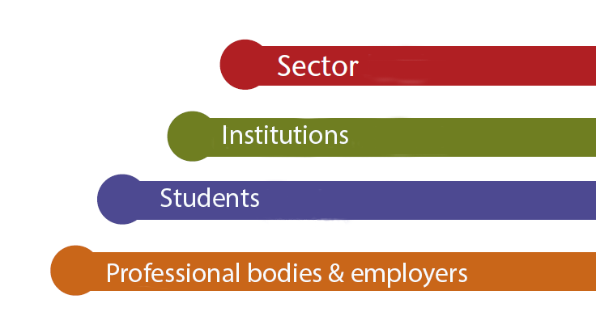

Making Recognition of Prior Learning work : implementing the National RPL Framework for Higher Education (HE) in Scotland
Recognition of Prior Learning
Scottish Higher Education Network
Feedback from ELIR
Heather Gibson
QAA Scotland
Ruth Whittaker
Glasgow Caledonian University
Peter Chatterton
Consultant

Slide 3


Two issues from ELIR:
More consistent implementation of policy across institutions
Communicating and understanding the nature of feedback

Slide 4
Three strands of work
Staff development to support practice in policy making on feedback and assessment
Electronic management of Assessment and Feedback in practice
Mapping partnerships between students’ associations and their institutions to improve feedback

Slide 5
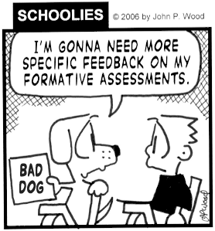
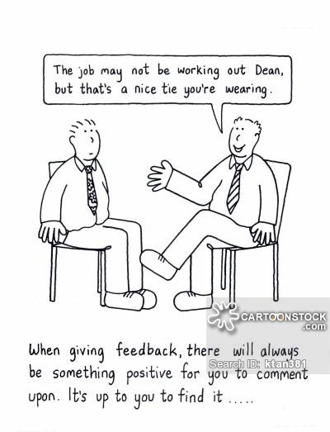
Improving the quality of feedback

Slide 6
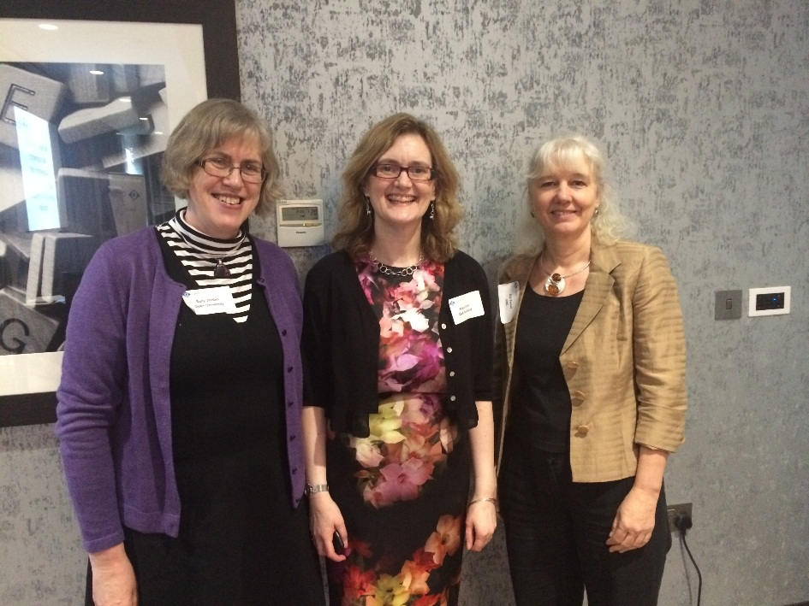
Electronic management of Assessment and Feedback
Event held on 18th March 2015
Aimed at practitioners
Combination of sharing practice and a
workshop session
Sharing practice: Two plenary
presentations & 12 case studies
Workshop – identify 10 key messages
for policy makers to help practitioners develop EMA
Write up here: http://blogs.pjjk.net/phil/qaa-scotland-focus-on-assessment-and-feedback-workshop/

Slide 7
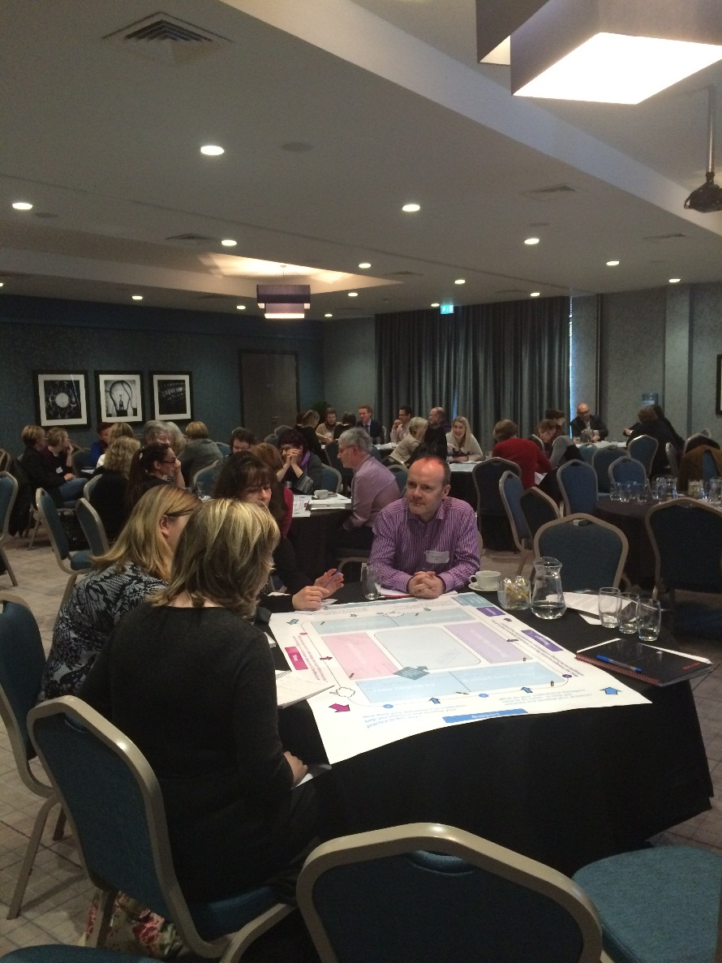
Electronic management of Assessment and Feedback
Aimed to develop 10 key messages
to communicate from practitioners
to policy makers
Used dialogue sheet to facilitate discussions

Slide 8



Focus on Assessment & Feedback
Feedback
Messages
What key messages would you like to tell institutional managers to help you & your colleagues use technology to enhance your assessment & feedback practice?
1. Start here
6
What do your institutional managers need to do better to help you enhance and develop your practice?
I am proud of…
We would like them to….
They help us by… It would help if they…
Thinking about your own practice in using technology to support assessment & feedback – what are you most proud of?
5
Reflection
Support
2
I would like to work at…
Room for
doodles,
thoughts,
drawing,
etc.
Thinking about your own assessment & feedback practice - what would you like to improve?
I would like to try…
How does your department or institution help you enhance and develop your practice in this way?
Pink post-its
4
3
What have you heard or seen today that might inform how you might use technology to enhance your assessment & feedback practice?
Ideas

Slide 9
10 Key Messages from practitioners to policy makers
Remove the ‘e’ from ‘e-assessment’ and ‘e – learning’. Recognise that this activity is now part of everyday practice in our institutions.
Create and encourage a ‘can-do’ culture at all levels in the institution that can accommodate new ways of using technology and will tolerate risk – this will facilitate innovation and development.
Provide support and leadership from the very top down to department level: support from senior management is seen as a key enabler for innovation.

Slide 10
10 key messages – part 2
Work with practitioners in teams as equals. Learn about what practitioners do and the constraints and the challenges that they face.
Learn about the technology: recognise its advantages and limitations, i.e. what it can and cannot do.
Recognise the diversity in ‘e’-learning and ‘e’-assessment approaches. There needs to be different approaches for different contexts and disciplines – one size does not fit all.

Slide 11
10 Key Messages – part 3
Recognise that all staff may need training and support to take advantage of new technologies and that this needs to be adequately prioritised and resourced.
Small and simple fixes can really help, i.e. providing resource for software licences enable staff to work with and experiment with new technology.

Slide 12
10 Key Messages – part 4
Invest in stable and robust IT infrastructures that can be consistently used throughout the institution. Software and systems should ‘talk to each other’ at all levels of in the institution from the central VLE to the individual student.
Use workload models that are designed to support ‘online’ learning and that build in time for innovation and enhancement.

Slide 13
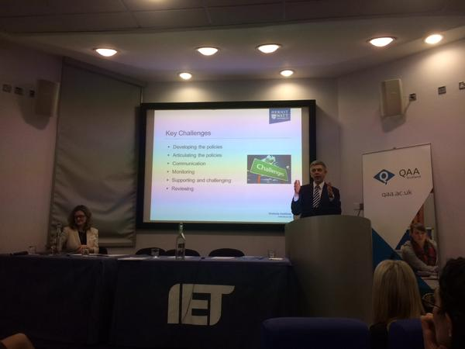
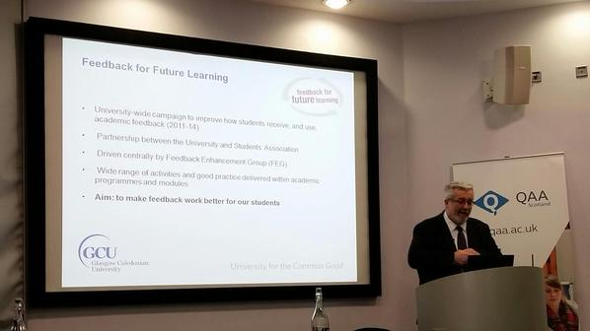
Policy and Practice Summit
Held on 14th May 2015 in Edinburgh
Aimed at senior managers and policy makers
Shared ‘10 key messages’
Plenaries: institutional-wide initiatives to improve assessment and feedback
Institutions sharing policy initiatives and approaches with each other
Workshop session: where are we now with assessment and feedback?

Slide 14
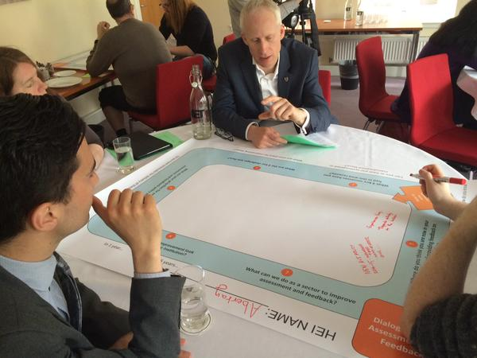
Policy Summit
All institutions shared practice on institutional policy formulation around assessment and feedback, in order to get ideas for their own practice and offer/get advice.
Institutional teams were asked to evaluate the effectiveness of their own policies on assessment and feedback
Teams were asked to think about what improvement in assessment and feedback would look like within their institutions and in the sector

Slide 15
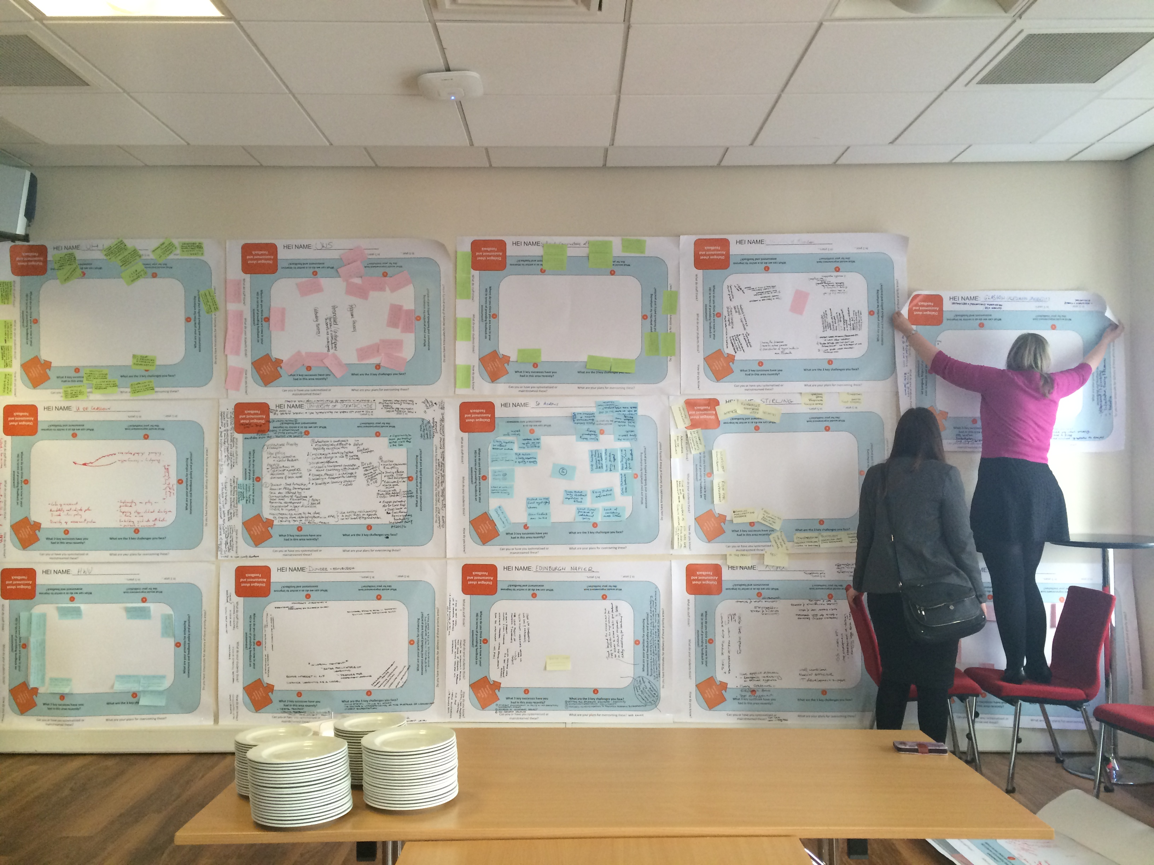

Slide 16
Mapping partnerships between students’ associations and their institutions to improve feedback – main types of activity
Communication
Events
Student Partnership Agreements
Promoting feedback as a learning dialogue
Using and developing toolkits

Slide 17

Discussing student friendly feedback

Slide 18
Student Friendly Feedback
Communicate
Clear
Useful
Timely
Accessible
Fair

Slide 19
Communication
Is key to clear, accessible, fair, timely and useful feedback
Reflects that feedback is ultimately should be a dialogue between us
Helps us trust each other during our learning

Slide 20
Clear
We need to know
  what will happen
  when it will happen
  what is expected of us
  what we did well
  what we didn’t do so well
  where we need to improve
  how we need to improve
  what to do next

Slide 21
Useful
Feedback should
  help us improve
  help us become better learners
  link very clearly to the rest of our course
  inspire us
  motivate us
  value us

Slide 22
Timely
Time is important because
  feedback should be in time to use for the next assignment
  we need to know when our feedback will arrive
  we need to be updated if that changes
  it allows us to work with our feedback as part of our learning

Slide 23
Accessible
Feedback should be:
  available to everyone
  easy to find
  provided in different formats if needed
    written
    spoken
  clear and easily understood

Slide 24
Fair
Feedback should be:
  free from potential, even if unintended, prejudice
    Anonymous marking
    Double marking
  be guided by clear criteria
  be consistent

Slide 25
Resources
All resources are freely available on the web at:
http://www.enhancementthemes.ac.uk/focus-on
For more information contact:
Amanda Park at a.park@qaa.ac.uk

