Slide 1
QAA Focus On: Managing Collaborative Activity
Making it work: building learning communities at a distance
GCU and the Caledonian College of Engineering, Oman.

Slide 2
Establishing the relationship
Caledonian College of Engineering established in 1996 as a private venture to fulfil a need for engineering education.
Initial agreement (in summary) that GCU would
  Provide advice and guidance during set up.
  Appoint the Principal.
  Approve Diploma programmes for delivery at the College.
  Provide opportunity to articulate to Level 3 in Glasgow.

Slide 3
Initial Challenges
Staff buy-in.
Ensuring effective oversight.
Significant costs for staff secondments and travel to Oman.
Lack of student engagement/uptake of articulating pathway opportunities.
Articulating students experienced cultural and language difficulties.

Slide 4
Remedial action
Appointment of a new Principal, previously Asst. Principal at GCU
GCU Quality Assurance systems and processes implemented in 1998.
Foundation programme introduced:
  English, Mathematics and IT Skills refresh
  Study skills, including note taking, library use, report writing, academic referencing
  Conforms to the Oman Academic Accreditation Authority’s national standard for foundation studies.

Slide 5
Remedial action
Incentivised staff participation.
Commitment to 12 week GCU teaching per session.
Workshops and staff development.
GCU PhD registration for CCE staff.

Slide 6
Developing the relationship
One programme piloted to degree level in session 2000/01, with two more in 2001/02.
Expansion over time to delivery in Oman of 10 GCU approved Honours degree programmes.
Removed the need for students to transfer to complete Honours degree awards.
All programme approval and development work undertaken with on-site input from external academic peers from UK HE sector.

Slide 7
Supporting Systems for Expansion
Annually updated Liaison handbook covering;
    Effective Quality Assurance and Enhancement processes
    Assessment regulations and graduation
    Academic Administration
    Academic Calendar

Slide 8
Student Engagement in Quality
Student, Staff Consultative Groups
Representation on Programme Boards
Ability to input to programme approval and review process
Ability to provide feedback at modular level
Opportunity to meet/discuss programme with External Examiners
Frequent visits by GCU staff

Slide 9
Further Development
Development to Masters level in 2008
Improvements in IT give students greater access to GCU systems
Overhaul of GCU learning, teaching and assessment strategies and embedding of a new Strategy for Learning

Slide 10
Enablers
Strategy 2020
Strategy for Learning
Evolving Technologies

Slide 11
Strategy 2020
By 2020, Glasgow Caledonian University will have a global reputation for delivering social benefit and impact through education, research and social innovation. We will be recognised as the University for the Common Good that transforms lives, enriches cities and communities, innovates for social and economic impact, engages globally and aligns with others in partnership and collaboration to deliver our goals.

Slide 12
Strategy 2020
By 2020, Glasgow Caledonian University will have a global reputation for delivering social benefit and impact through education, research and social innovation. We will be recognised as the University for the Common Good that transforms lives, enriches cities and communities, innovates for social and economic impact, engages globally and aligns with others in partnership and collaboration to deliver our goals.

Slide 13
Strategy for Learning
Single goal, to develop graduates who will be:
‘Proficient in their discipline, enterprising, responsible and capable of fulfilling leadership roles in different organisational and cultural contexts.’

Slide 14
Strategy for Learning
Distinctive approach to learning, based on engagement-led learning and real world problem solving.
Intended to promote an outstanding student experience.
Applicable to all GCU programmes.

Slide 15
Strategy for Learning
Distinctive approach to learning, based on engagement-led learning and real world problem solving.
Intended to promote an outstanding student experience.
Applicable to all GCU programmes.

Slide 16
Strategy for Learning
GCU SfL
Engaged learning
Real world Problem solving
Entrepreneurship
Responsible Leadership and Professionalism
Global learning
Divergent thinking
Flexible, Inclusive, Accessible learning
Broad & Deep Learning

Slide 17
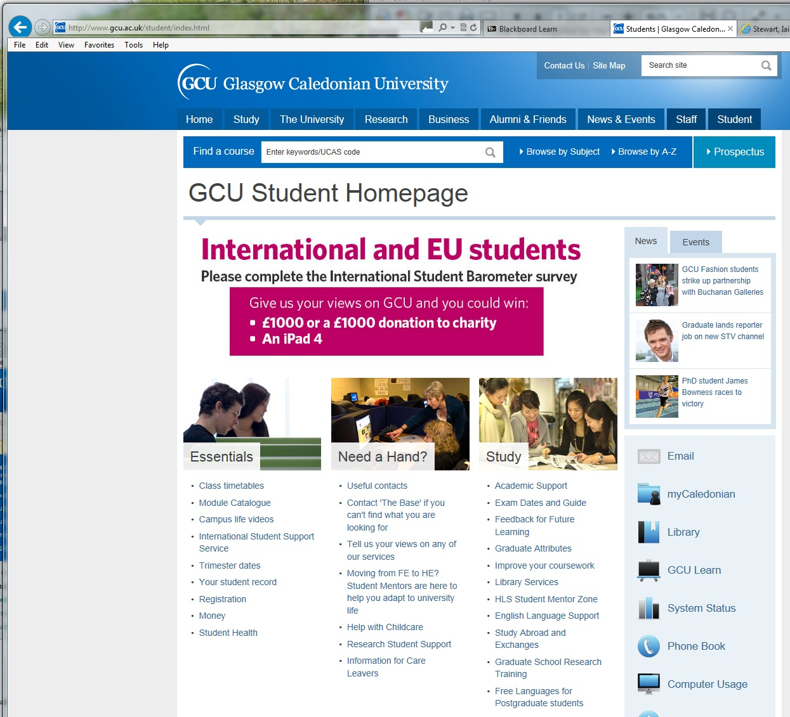
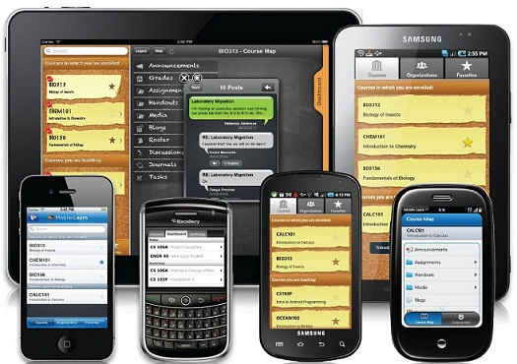

SfL Enablers : Digital Development / University Systems
Cross platform - always available

Slide 18
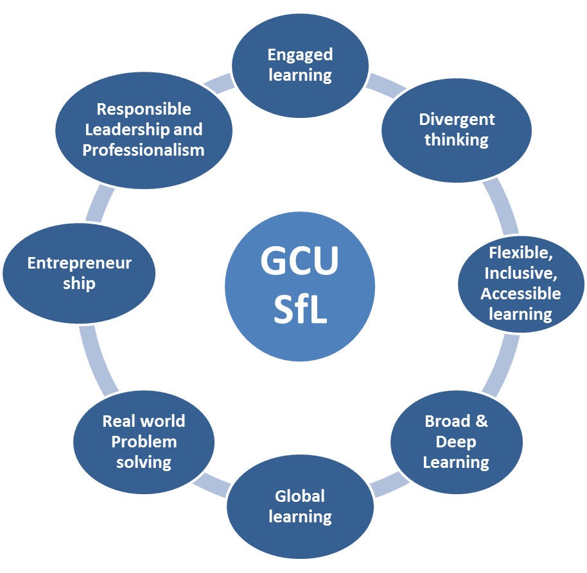
Engaged Learning
Help students to engage to maximise their potential
Develop sense of belonging, commitment to individual student experience
Acknowledge students as partners in shaping and enhancing the student experience.
Achieved through learning opportunities which are:
  Project based, interdisciplinary, group based, co-designed and personalised.

Slide 19
Divergent Thinking
Developing the capacity to tackle complex global challenges and real-world problems.
Generating creative ideas by exploring many possible solutions, drawing on ideas from different disciplines and areas, through which often unexpected connections are made.
Use of collaborative web-based technologies to support geographically dispersed groups as well as social networking platforms.

Slide 20
Mapping to UK- SPEC (C.Eng)
Use a combination of general and specialist engineering knowledge and understanding to optimise the application of existing and emerging technology.
Apply appropriate theoretical and practical methods to the analysis and solution of engineering problems.
Provide technical and commercial leadership.
Demonstrate effective interpersonal skills.
Demonstrate a personal commitment to professional standards, recognising obligations to society, the profession and the environment.

Slide 21
Embedding Strategy for Learning at CCE
Greater emphasis on group based activities.
Students encouraged to undertake industry based/funded projects.
Discussion forum through social media and CCE learn.
Access to GCU Learn.
Use of industry speakers/guest lecturers.
Staff exchange visits to/from GCU facilitate good practices in learning and teaching.
College scholarships for industrial training abroad.

Slide 22
Future Developments
Potential expansion of Masters provision
Review of current undergraduate provision
OAAA visit to CCE in 2016/17

Slide 23
Alumni feedback
“Caledonian College has given me some wonderful opportunities, not only learning experiences but also some knowledge in management and responsibilities.”
“the years spent on the Construction Engineering programme at Caledonian College were the most formative and beneficial years of my life. Apart from academic coaching which is of the highest standard in the region, I also had numerous opportunities to participate in curricular, co-curricular and extra-curricular activities. Foremost among these was my participation in the Student-Staff Consultative group of which I was chairman and was able to take on numerous student-related issues and work towards solutions in the best interests of all parties involved.”

Slide 24
Alumni feedback
“Caledonian College has given me some wonderful opportunities, not only learning experiences but also some knowledge in management and responsibilities.”
“the years spent on the Construction Engineering programme at Caledonian College were the most formative and beneficial years of my life. Apart from academic coaching which is of the highest standard in the region, I also had numerous opportunities to participate in curricular, co-curricular and extra-curricular activities. Foremost among these was my participation in the Student-Staff Consultative group of which I was chairman and was able to take on numerous student-related issues and work towards solutions in the best interests of all parties involved.”

