Slide 1


Dr Susie Schofield, Senior Lecturer

Slide 2
Overview
Purpose of feedback
The problems
Our programme
interACT principles
The interACT process
Lessons learnt
Next steps
Notes:
Feedback takes significant academic time, but how do we know this feedback is read, understood, relevant and acted upon? Without dialogue how can tutors gauge student goals, understanding and engagement, and how can feedback be used to develop students’ self-assessment skills? interACT (interactive assessment and collaboration via technology), funded by JISC, was developed to provide a best-practice informed platform to support feedback dialogue in an online distance learning programme.
In this paper I present the principles underpinning interACT, the rationale behind using a wiki, lessons we have learnt from the perspectives of the student, academic, technologist and administrative staff, and how interACT could be applied in a blended environment.

Slide 3
What is feedback?
“Feedback should help the student understand more about the learning goal, and more ways to bridge the gap between their current status and the desired status” (Hattie & Timperley, 2007; Sadler 2010)
“Feedback should be conceptualised as a dialogical and contingent two-way process that involves coordinated teacher–student and peer-to-peer interaction as well as active learner engagement” (Nicol, 2010)

Slide 4
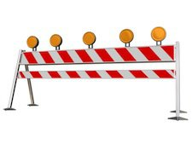
The problem
Feedback is time-consuming
It’s often monologic
Do we know if our feedback is
  Read?
  Understood?
  Relevant?
  Acted upon?
Isolating for tutors
Whose benefit is giving feedback for?

Slide 5

Our programme:
Masters in Medical Education
Face to face / blended / online
Each assignment has specific learning outcomes AND generic learning outcomes
3 exit points:
  Certificate (developing the teacher)
  Diploma (developing the leader)
  Masters (developing the researcher)
Assignments build up in size per module

Slide 6

Our students (and part-time tutors)

Slide 7

1. Feedback should be dialogic in nature
interACT Educational Principles
Feedback is often viewed as something that is ‘given’ to a student to correct their errors
However feedback should be seen as a process of communication
Communication is an on-going evolving dialogue
  Meaning is negotiated between individuals
  Takes account respective ideas, feelings and points of view
Notes:
Viewing feedback as something that is ‘given’ to a student to correct their errors aligns with a narrow, transmissive view of learning. It does not take into account the dynamic and interpretive nature of communication (Higgins et al, 2001; Ajjawi, 2012). Feedback should be seen as a process of communication and therefore a socially constructed phenomenon whereby power, identity, culture, social norms and beliefs, emotions and gender imbue all communicative (and therefore feedback) acts (Higgins et al., 2001; Carless, 2006). Communication is an on-going evolving dialogue, such that understanding and interpretation are informed by previous communicative interactions (Ajjawi and Rees, 2012). Meaning is negotiated between individuals, taking into account their respective ideas, feelings and points of view. Indeed, each participant’s experiences (their frames of reference) influence the way the message is formed and interpreted (Ajjawi and Rees, 2012). Feedback should be viewed as dynamic and evolving, involving relationships between participants with individual and overlapping frames of reference that are context dependent.
In this project we adopted the perspective that feedback is a communicative act and a social process in which power, emotion and discourse impact on how messages are constructed and interpreted. Therefore, feedback is “conceptualised as a dialogical and contingent two-way process that involves co-ordinated teacher-student and peer-to-peer interaction as well as active learner engagement” (Nicol, 2010, p.503). Neglecting dialogue can lead to dissatisfaction with feedback. The transmission model of feedback ignores these factors and importantly the role of the student in learning from the feedback. Simply providing feedback does not ensure that students read it, understand it, or use it to promote learning.
The quality of feedback, is crucial with students reportedly being dissatisfied with the feedback they receive because it lacks specific advice to improve, is difficult to interpret, has not been promptly delivered or is potentially destructive to students’ self-perception and confidence (Higgins et al., 2001, 2002; Nicol, 2010). To be effective, feedback needs to be “meaningful, understood and correctly acted upon” (Orsmond et al., 2005 p.369). Improving the overall quality and consistency of the feedback process is one of the aims of this project. Dialogue between tutors and students serves to reduce misconceptions and differing perceptions about assessment and feedback (Carless, 2006).

Slide 8
2. Assessment design should afford opportunities for feedback to be used in future assignments
Developmental perspective on feedback
Should not be viewed as a single occurrence
Should be viewed as a series of pedagogical opportunities
Taking a programmatic approach enables evidence of learning from feedback to be documented and for feedback to serve to help improve learners’ work in the future
Notes:
This principle relates to taking a programmatic approach to assessment and so demands a developmental perspective on feedback. Rather than viewing feedback as a single occurrence or a ‘knee jerk’ reaction to a piece of work (Boud and Molloy, 2013), it should be seen as a series of pedagogical opportunities optimised across the lifetime of the programme. Taking a programmatic approach enables evidence of learning from feedback to be documented and for feedback to serve to help improve learners’ work in the future – also known as feedforward.

Slide 9
3. Feedback should develop evaluative judgements and monitoring of own work
Learning is enhanced when learners are:
  Self-regulating
  Actively engaging in setting learning goals
  Selecting strategies for achieving these goals
  Monitoring their progress toward these goals
Reflecting on feedback and processing it through self-explanation has been shown to improve self-monitoring and evaluation
Notes:
Feedback should serve the function of progressively enabling students to better monitor, evaluate and regulate their own learning, independently of the teacher. Learning is enhanced when learners are self-regulating, actively engaging in setting learning goals, selecting strategies for achieving these goals and monitoring their progress toward these goals (Nicol and Macfarlane‐Dick, 2006). This principle fits in with capabilities for life-long learning where graduates are required to seek external, credible sources of data to inform their performance and progress. Enhancing students’ ability to accurately self-monitor should reduce reliance on teachers and is a skill that should transfer into their working lives beyond university (Boud and Falchikov, 2006).
The rationale here is that tutors’ tacit knowledge around assessment is the result of multiple evaluative judgements and seeing different ways of addressing the task (Nicol and Macfarlane‐Dick, 2006). Therefore tutors develop an internal calibration for quality and comparability. Although assessment criteria and standards are an attempt at defining what is expected to students, they cannot fully communicate such tacit knowledge. Students need to be given the opportunity to take part in the process of making academic judgements to help them develop ‘appropriate evaluative expertise themselves’ and so make more sense of and take greater control of their own learning (Sadler, 2010, Boud and Associates, 2010). Such structured opportunities should help them to develop the ability to evaluate the quality, completeness and/or accuracy of their work and also to develop the confidence to communicate their judgments (Boud and Associates, 2010, Sadler, 1989).

Slide 10
4. Students should be empowered to seek feedback
This principle fits in with capabilities for life-long learning where graduates are required to seek external, credible sources of data to inform their performance and progress
Evaluating feedback from peers has shown that students made more complex improvements to their work after receiving feedback from multiple sources
Engaging in the process of providing peer review is beneficial to students’ learning
Notes:
Self-assessment cannot be seen as a global skill and is notably unreliable (Kruger and Dunning, 1999). This makes the role of feedback even more important in helping learners to calibrate their judgements about their work and in maintaining competence (Sargeant et al., 2010). Lockyer and colleagues (2011) conducted a qualitative study of external data sources used by physicians to inform their self-assessment. They identified that data of varying quality, often according with their choices and judgement and with implicit standards, are typically used. Therefore, physicians may benefit from regular and routine feedback and guidance on how to seek out data for self-assessment. Recently, two articles in medical education have emphasised the importance of inculcating feedback-seeking behaviours in medical students and trainees (Crommelinck and Anseel, 2013; Bok et al., 2013).
Self-regulation hinges on learners being able to access and interpret information that indicates how their present performance relates to their learning goals (Nicol and Macfarlane‐Dick, 2006). Requiring students to reflect on feedback and to process it through self-explanation has been shown to improve self-monitoring and evaluation (Roscoe and Chi, 2008). Evaluating feedback from peers has also shown that students made more complex improvements to their work after receiving feedback from multiple sources (Cho and MacArthur, 2011). Further engaging in the process of providing peer review is beneficial to students’ learning as they learn about feedback, alternative ways of approaching the task, and different standards of work, prompting an assessment of how they can improve their own work (Nicol, 2013).

Slide 11
Key innovations embedded in InterACT:
Programmatic design of assessment with emphasis on sequencing of assignments, formative tasks and feedforward
Structured opportunities for self-evaluation and feedback-seeking in the cover page
Scaffolded reflection on feedback and structured processing of feedback by students and staff
Creation of a space for dialogue on assessment and feedback between students and staff
One programmatic repository for each student’s work giving quick access to individual student and all staff

Slide 12
Framework for feedback dialogue
Stage 1: cover page
Individualised per assignment
  To encourage and develop self-evaluation skills
    Objectives; academic writing; referencing
  To promote student–tutor dialogue
Invites students to identify specific areas for feedback
Asks students to identify where current work is informed by previous feedback
Quick access to student email

Slide 13
Student downloads assignment rubric and cover-page
Student completes and submits cover-page and assignment
Tutor marks assignment and comments on cover-page
Tutor sends email to student

Slide 14
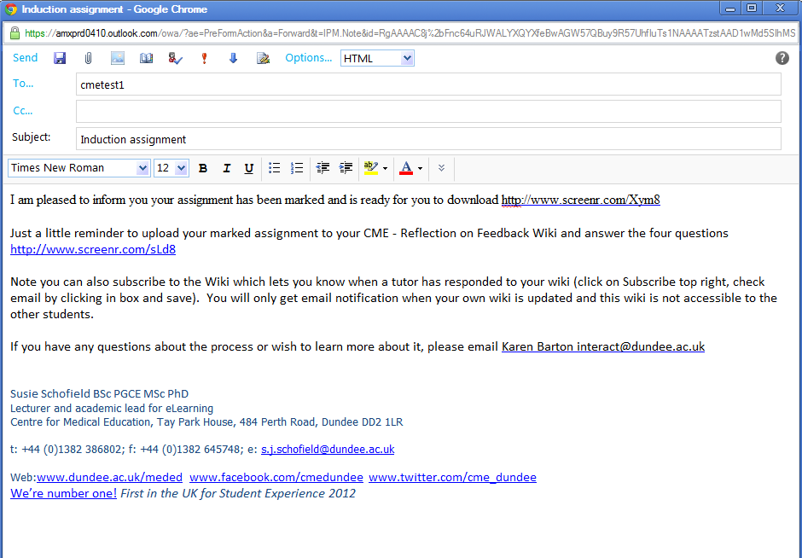

Slide 15
Framework for feedback dialogue
Stage 2: reflective journal using wiki
Engages students in processing of feedback
Individualised per student (but all tutors have access)
Pre-populated one page per core assignment
Student loads marked assignment and answers 4 reflective questions:

Slide 16
  How well does the tutor feedback match with your self-evaluation?
  What did you learn from the feedback process?
  What actions, if any, will you take in response to the feedback process?
  What if anything is unclear about the tutor feedback?

Slide 17
Student downloads marked assignment
Student uploads document into wiki
Student reflects on feedback/answers questions; tutor receives automatic alert
Tutor comments on student reflection; student receives automatic alert

Slide 18
Aspects I would like feedback on …..
Ideas of not preparing too rigidly in order to be flexible within sessions – practical advice would be welcomed!
As the first essay I have written in nearly 20 years, I would like to know whether the standard overall was acceptable
Please advise me how I can enter a specific page number in a reference when using Endnote (I wanted to add “p. 58” to the first reference used in the text since this is an exact quote, but failed to find out how I can do it, despite using the help option of the software).
Feedback on whether my peers have had similar thoughts for their own teaching, or other ideas that have been commonly developed would be beneficial in case I have not thought or considered them.
any part of it

Slide 19
How did previous feedback inform this assignment …..
It made me realise that instead of focusing on a single or a few key teaching principles, I focused on many of them without going into much detail. Also I had used bullet points in the text.
Feedback that my writing style was agreeable was reassuring. I appreciated knowing my use of literature was valid and supportive in the previous assignment, so have tried to continue applying the literature to my work.
I tried to be careful to define and reference jargon
It was really helpful in writing present assignment

Slide 20
“The feedback process is very enlightening and wish I had this back when I was in college and didn't understand why I got the grades I got! It is a very personalized means of improving. Through my work in Oman Medical Specialty Board we continuously work with our Faculty to ensure that they provide constructive feedback (written and face-to-face) at every assessment point through a Resident's training, but I never experienced it myself in such a structured manner. So I guess the bottom line is, it works! the more feedback you receive the better you get next time around. A very simple yet powerful learning tool.”

Slide 21
Lessons learned
Creating assessment and feedback dialogue in online distance learning is important
A wiki provides programmatic support
Pre-populating wiki pages with questions important
Majority of students find it valuable for their learning, that it promotes self-evaluation, and that it reduces isolation
Student engagement with wiki process increased with use of screencasts

Slide 22
Lessons learned
Tutors have found it rewarding, promoting connection and encouraging reflection on their own feedback-given practices
Staff training revealed different attitudes to FB
Challenges have included streamlining the process and improving the quality and timeliness of the feedback
Subscribing to wiki crucial for management
Admin support needed for this help

Slide 23
The problem
Feedback is time-consuming
It’s often monologic
Do we know if our feedback is
  Read?
  Understood?
  Relevant?
  Acted upon?
Isolating for tutors
Whose benefit is giving feedback for?

Slide 24
Contact details
Karen Barton
Centre for Medical Education
Email: interact@dundee.ac.uk
Susie Schofield
Centre for Medical Education
Email: s.j.schofield@dundee.ac.uk
Rola Ajjawi
Centre for Medical Education
Email: r.ajjawi@dundee.ac.uk
Twitter: @r_ajjawi
http://blog.dundee.ac.uk/interact/
http://youtu.be/S5bBFEbXDD0
http://jiscdesignstudio.pbworks.com/w/page/50671082/InterACT Project
Many thanks to JISC, our Reference Group and all our staff and students

Slide 25
References
Hattie, J., & Timperley, H. (2007). The Power of Feedback. Review of Educational Research, 77(1), 81-112.
Nicol, D. (2010). From monologue to dialogue: improving written feedback processes in mass higher education. Assessment & Evaluation in Higher Education, 35(5), 501 - 517.
Sadler, D. R. (2010) Beyond feedback: developing student capability in complex appraisal. Assessment & Evaluation in Higher Education, 35:5, 535-550.

Slide 26
Discussion points
Improving quality of self-evaluation
Faculty development needed
Increasing student buy-in
Further streamlining
Potential for blended learning
  E.g. UG medical school case studies

Slide 27
