Slide 1
Making the most of what we’ve got: How we maximised the use of Grademark to facilitate learning and assessment
Jamie McDermott
Programme Leader - MSc Occupational Therapy (pre-registration)
Lori Stevenson
Lecturer in Psychology & Academic Development Tutor
John Smith
Learning Technologist
School of Health and Life Sciences

Slide 2
Outline
What we did?
Why we did it?
What we have learned?

Slide 3
Why we did it?
Feedback for Future Learning (FFL)
8 GCU principles
National Student Survey action plan
Need to increase efficiency of the assessment process
Desire to maximise the use of Grademark functionality to make the process of marking as efficient as possible
Enhancing the learning experience for students

Slide 4
What?
Time 1 – Subject Area of Occupational Therapy
To utilise Grademark for marking
To pilot a rubric, embedded within Grademark, as a means of providing feedback, feed forward and to generate marks in the following module:
Inclusive environments for occupational performance
(BSc (Hons) Occupational Therapy – Level 2)
Key GCU Feedback Principles in action!

Slide 5
Rubric
A tool that articulates the expectations for an assignment by listing the criteria and that describes levels of quality from excellent to poor, showing how marks are distributed
Three essential features:
Evaluation criteria
Quality definitions
Scoring strategy
Just as much value in teaching as for assessment

Slide 6
Rubric functionality within Grademark
Can have as many criteria as required
Has a maximum of ten points or ‘bands’
Can be used to provide feedback, feed forward
Can be used to allocate marks
“All possible with a few clicks of the mouse”

Slide 7
Dipping our toes in the water

Slide 8
Process
Developing the rubric
Feedback
Feed forward
Principles of mark distribution:
100% should be possible
0% should be possible
40% should be possible
All other ‘bands’ should be mid-point
U/F should be 30%

Slide 9
GCU Learn rubric: Inclusive Environments module

Slide 10
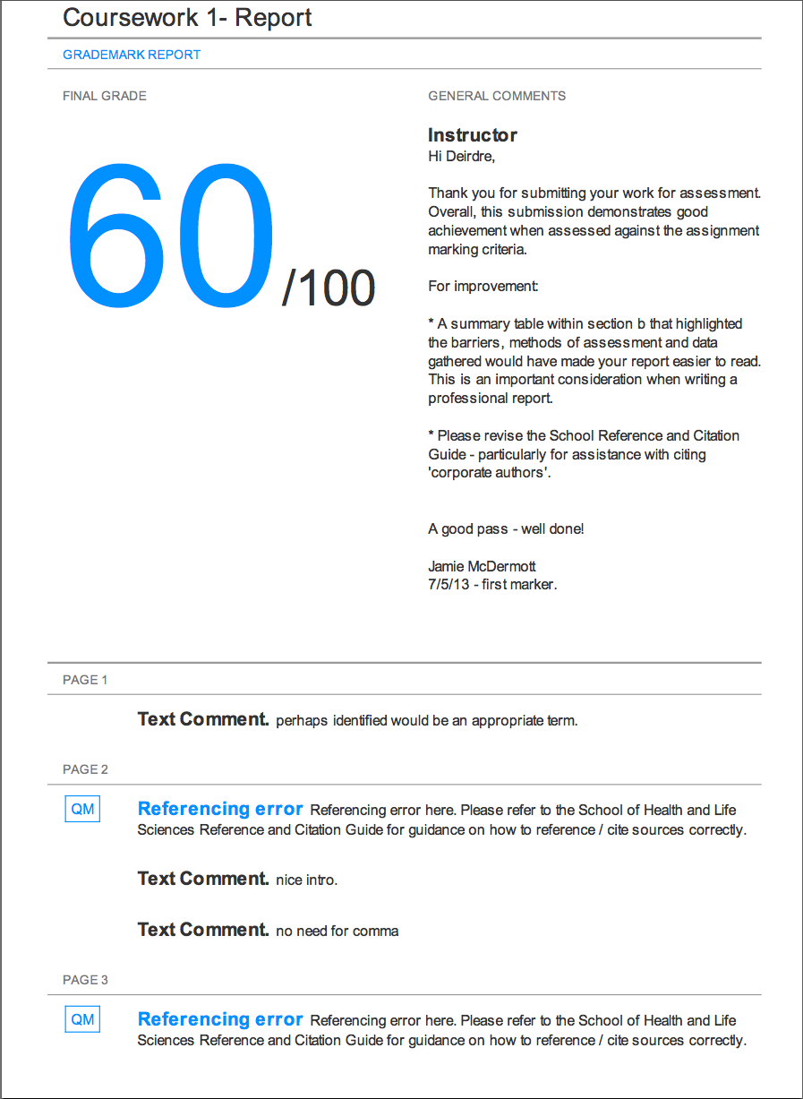
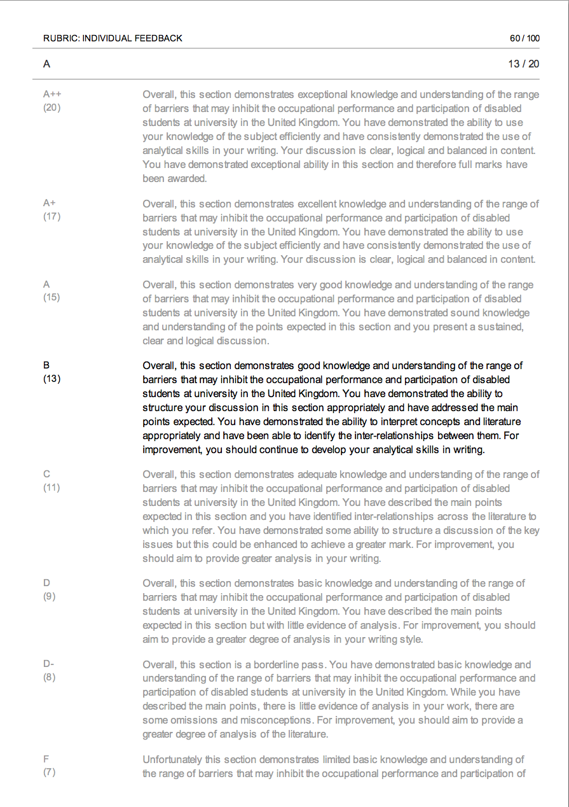
The feedback ‘product’

Slide 11
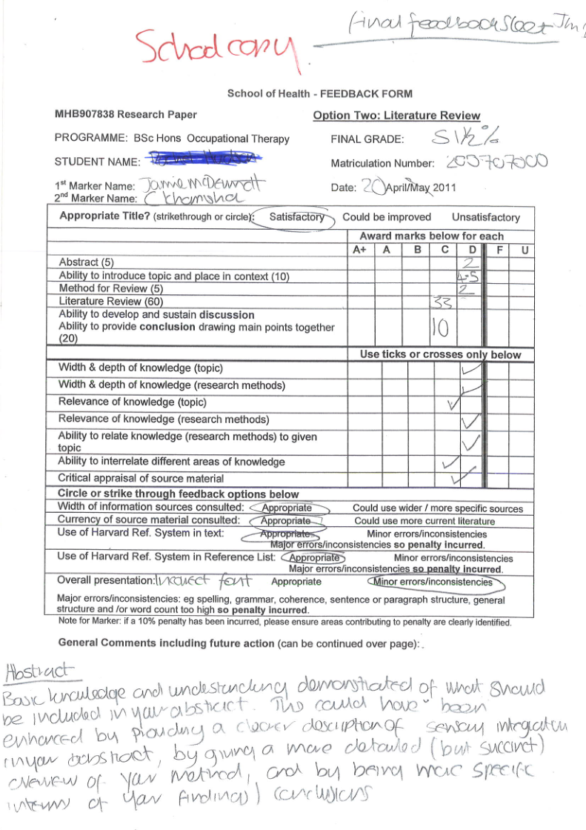
In comparison to….

Slide 12
What we did
Time 2 – Subject Area of Psychology
GCU Learning & Teaching event
Discussion with module staff re potential
Information gathering re use of rubrics, language used, weightings etc
Focussed in on assessment & learning objectives for module
Drafted, redrafted & finalised rubric

Slide 13
LDC embedded lecture on rubric delivered to students
Four previously submitted essays marked by staff using rubric
Essays then placed on GCULearn. Students asked to mark them using the rubric
This forms the basis of a formative teaching exercise in class
Rubric adapted in response to student feedback

Slide 14
Module evaluation
100% of the students found the feedback and rubric to be helpful
What did you like?
What did you not like?
What would you change if you could?

Slide 15
Evaluation
“I found the feedback easy to understand because it typed rather than handwritten. I also feel there was more feedback available because there wasn't any limited space to write as there would be on a paper copy of the essay. Finally, I have a tendency to lose things, so the fact my essay with feedback is available electronically for me to go back and view whenever I need to is great! To be honest I can't think of anything I didn't like about it. Hopefully someone else can give you some feedback on this”

Slide 16
‘I really liked the rubric. It explains clearly what you have to do to get a particular mark. It made me focus in on different aspects of my essay writing in a way I haven't done before.’
‘I had a copy of the rubric in front of me when I was writing my essay it was a huge help, as was the lecture and the tutorial’
‘Why have these not been used before?’

Slide 17
So why use a rubric?
The process of designing a rubric encourages reflection on what makes acceptable / unacceptable performance for both staff and students
Clarifies what constitutes evidence of learning
Creates a shared understanding of the ‘true’ meaning of marking criteria
Increases reliability of assessment
Increases confidence in assessment
Can save the most valuable resource – time!
‘….it gave me back my Christmas!’

Slide 18
Grade comparisons
 | total | SD | 1sts | 2.1s | 2.2s | 3rds | fails
2013/14 | 214 | 10.4 | 9 | 80 | 92 | 17 | 16
 |  |  | (4%) | (37%) | (43%) | (8%) | (8%)
2014/15 | 190 | 13.9 | 28 | 72 | 64 | 14 | 10
 |  |  | (15%) | (39%) | (34%) | (7%) | (5%)

Slide 19
What we learned
Grademark did make the process more efficient – but only when the full functionality was utilised, including rubrics
Rubric development needs to be viewed as an integral part of planning assessment tools – should be developed at same time as the assessment
Rubrics provide opportunities for additional formative activities in the classroom
Rubric just as much a tool for learning as it is for assessment
Never underestimate the power of a small scale enhancement project

Slide 20
Ongoing issues
Success of PID rubric in Division of Psychology has led to adoption in a further four modules with four others in the planning stage.
A divisional training event planned for April 2015
Plan for full SHLS adoption for next session
Staff training – importance of consistency of level of feedback
Use of rubric with exams

Slide 22
Discussion
Are you making the most of what you’ve got?

Slide 23
Questions?
Jamie.McDermott@gcu.ac.uk
Lori.stevenson@gcu.ac.uk
J.J.Smith@gcu.ac.uk

Slide 24
Useful references
Early project work: www.rsc-scotland.org/?p=4597
Andrade, G H. (2000). Using rubrics to promote thinking and learning. Educational Leadership, 57, 13-18
Arter, J. & McTighe, J. (2001). Scoring rubrics in the classroom: Using performance criteria for assessing and improving student performance. Thousand Oaks, CA: Corwin Press/Sage Publications
Moskal, B.M. (2003). Recommendations for developing classroom performance assessments and scoring rubrics. Practical Assessment Research & Evaluation, 8 (14)
Popham, W.J. (1999). Classroom assessment: What teachers need to know (2nd Ed.). Needham Heights, MA:
Allyn & Bacon. Popham, W.J. (1997). What’s wrong - and what’s right - with rubrics. Educational Leadership, 55, 72-75
Wiggins, G. (1998). Educative assessment: Designing assessments to inform and improve student performance. San Francisco, CA: Jossey-Bass Publishers

