Slide 1
Supporting Student-Led Learning Communities via Virtual Campuses
Nina Anderson
Head of the Quality Enhancement Unit
University of the West of Scotland

Slide 2






History 101

Slide 3


Current Affairs 2016

Slide 4

Corporate Strategy

Slide 5



VLE – VC - SLLC

Slide 6
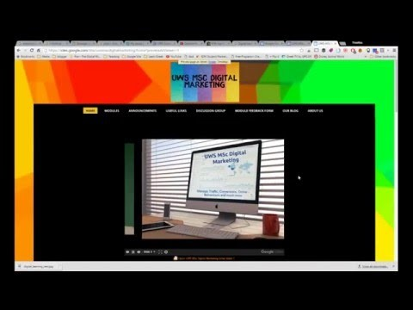
Digital Marketing – Innovative Approach
https://youtu.be/T5sx8JD3pmw

