Slide 1
Supporting Students at University of Dundee regardless of Distance: New York to Newbigging the principles are the same….
Lynn Boyle l.y.boyle@dundee.ac.uk
Twitter: @boyledsweetie

Slide 2

Notes:
New York

Slide 3

Notes:
or Newbigging, good to know the difference if you have had a few drinks but if you are working with students in distance learning it really doesn’t make a difference.

Slide 4
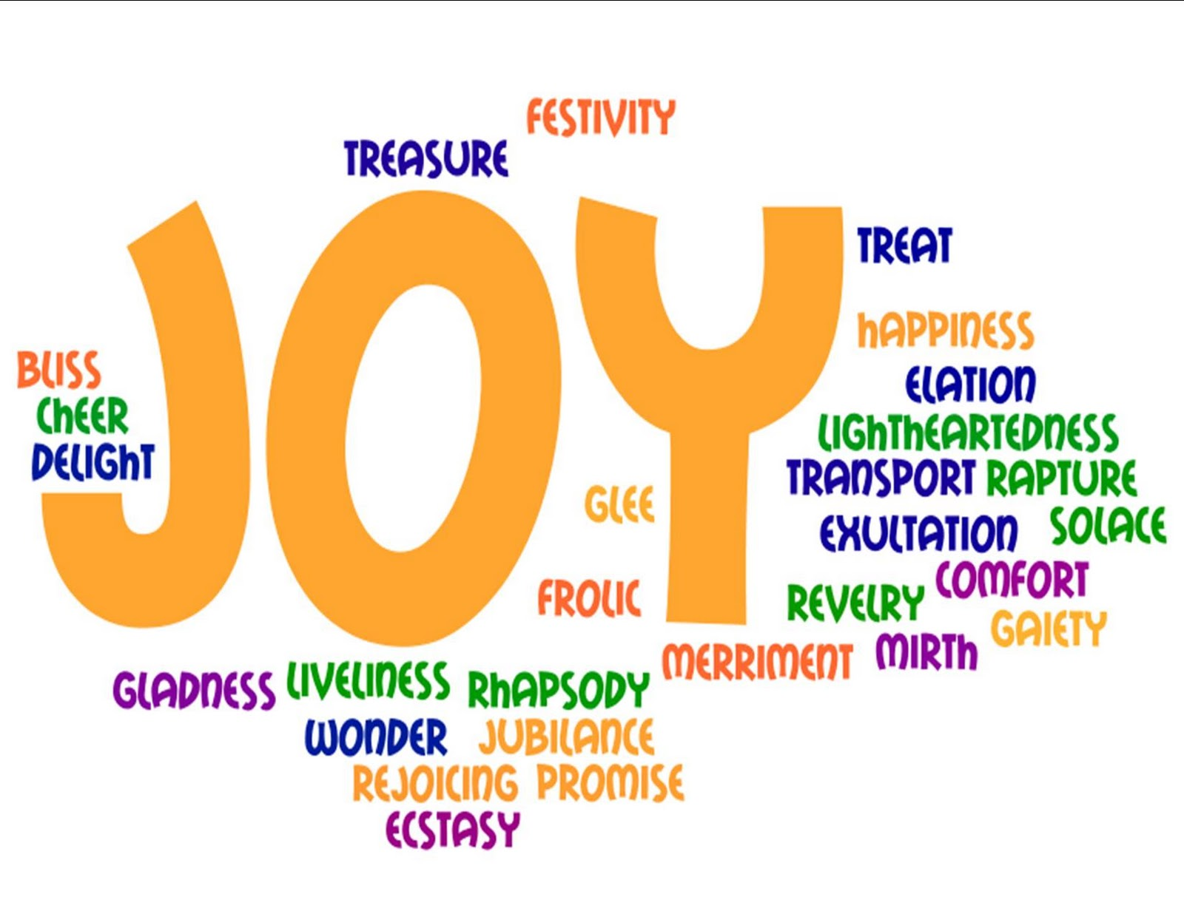
Notes:
Joy should be mentioned before I go any further, I mean Joy in the sense of job satisfaction and pleasure in working with students. In the willingness to participate, contribute, collaborate and to work with students you may never meet.

Slide 5

Notes:
Students can spot a fraud, they know who is insincere and it is not a popularity contest. Being a teacher online is very much like being a face to face tutor, you just have to find different meeting points.

Slide 6
feedback in distance learning programmes will be less effective if there is a lack of transparency and little opportunity for interaction between tutors and students.
Ros i Soléé and Truman (2005)
Notes:
Opportunity for interaction is the key to success and the lecturer has to make the first move, create spaces and opportunities which suit the varied times and places students can access the University

Slide 7
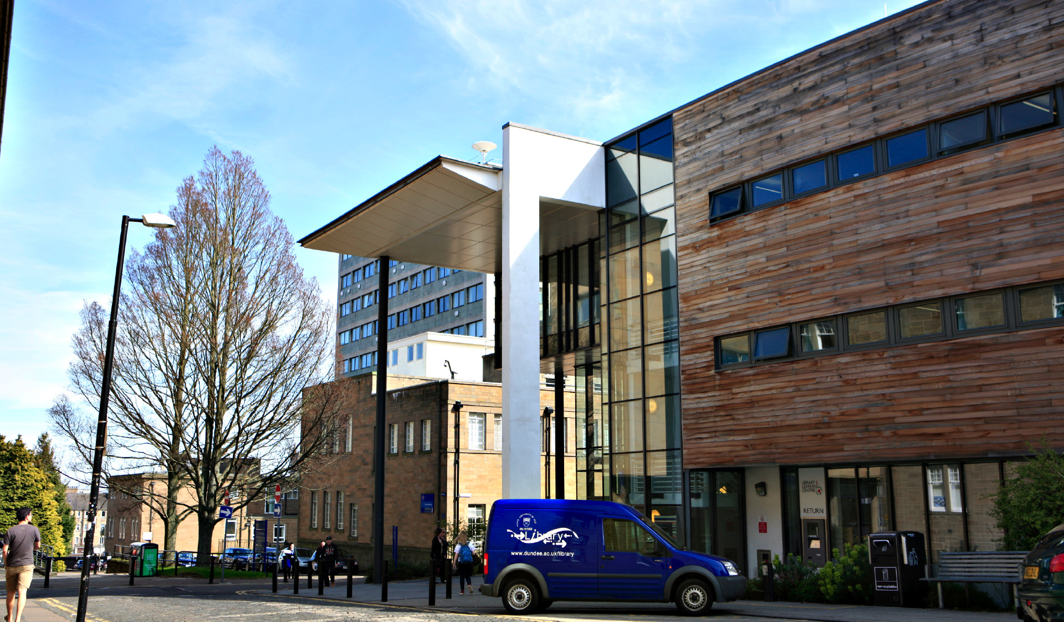
Notes:
The University of Dundee is a campus based University and in my opinion it is really rather bonny,

Slide 8
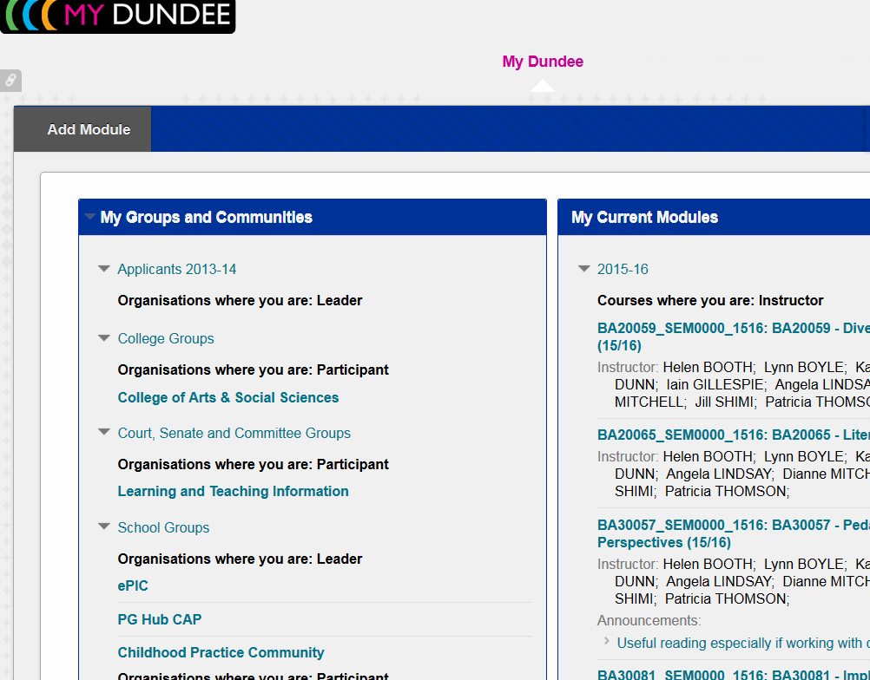
Notes:
However most of our students only ever see this

Slide 9
“for a significant portion of modern-day students, the attractiveness of ‘flexibility’ as a feature of distance education is tempered by necessity and so an appreciation of ‘flexibility’ cannot prima facie be taken as indicative of a preference for autonomous or independent learning”(Rush, 2015)

Slide 10
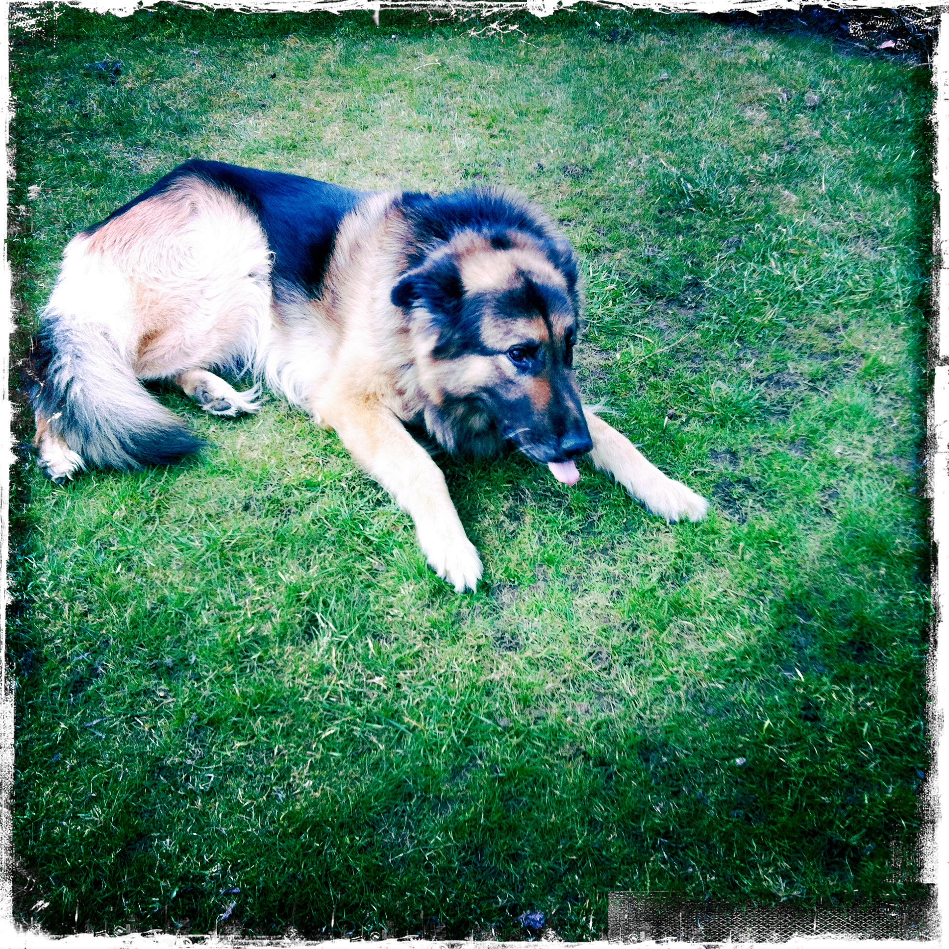
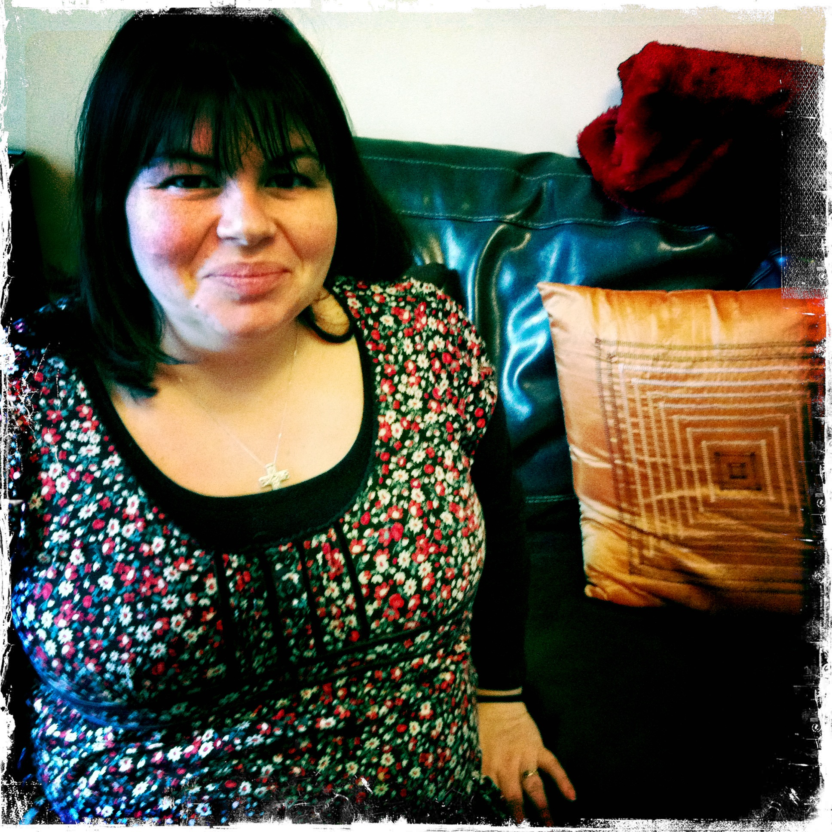
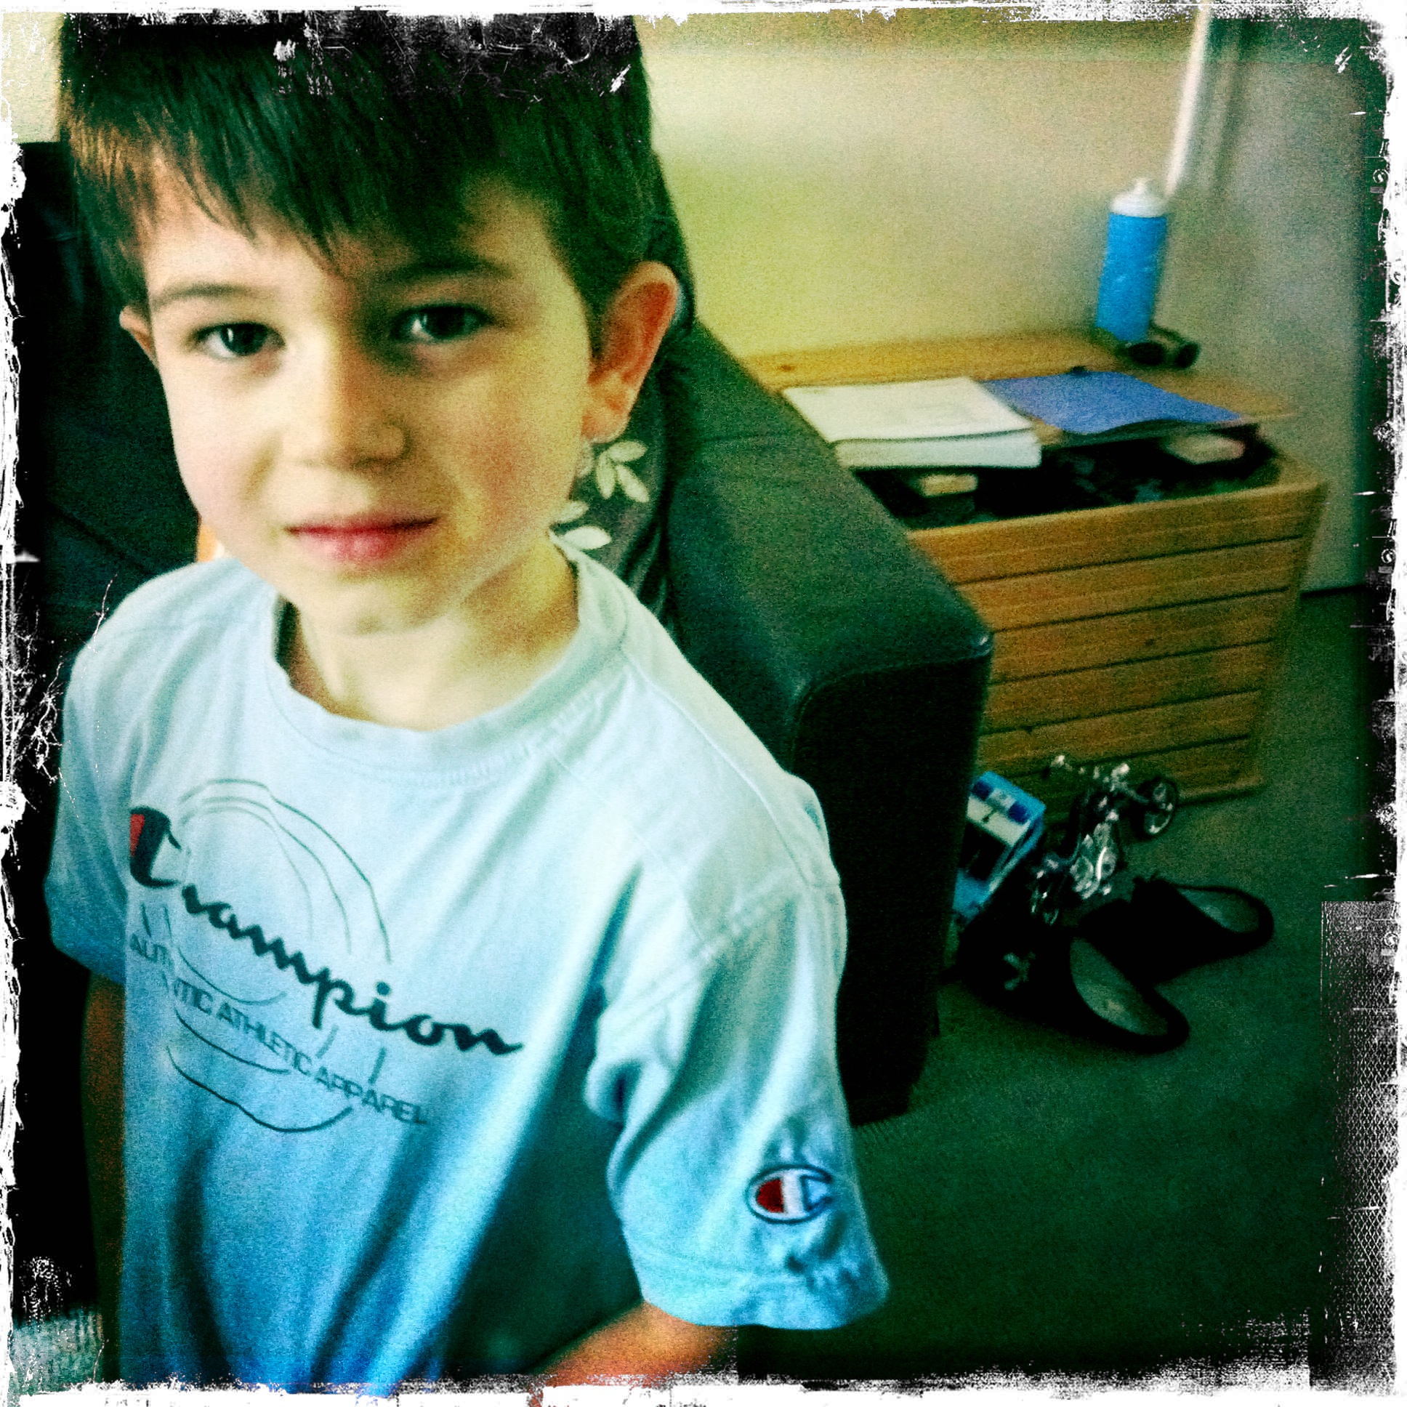
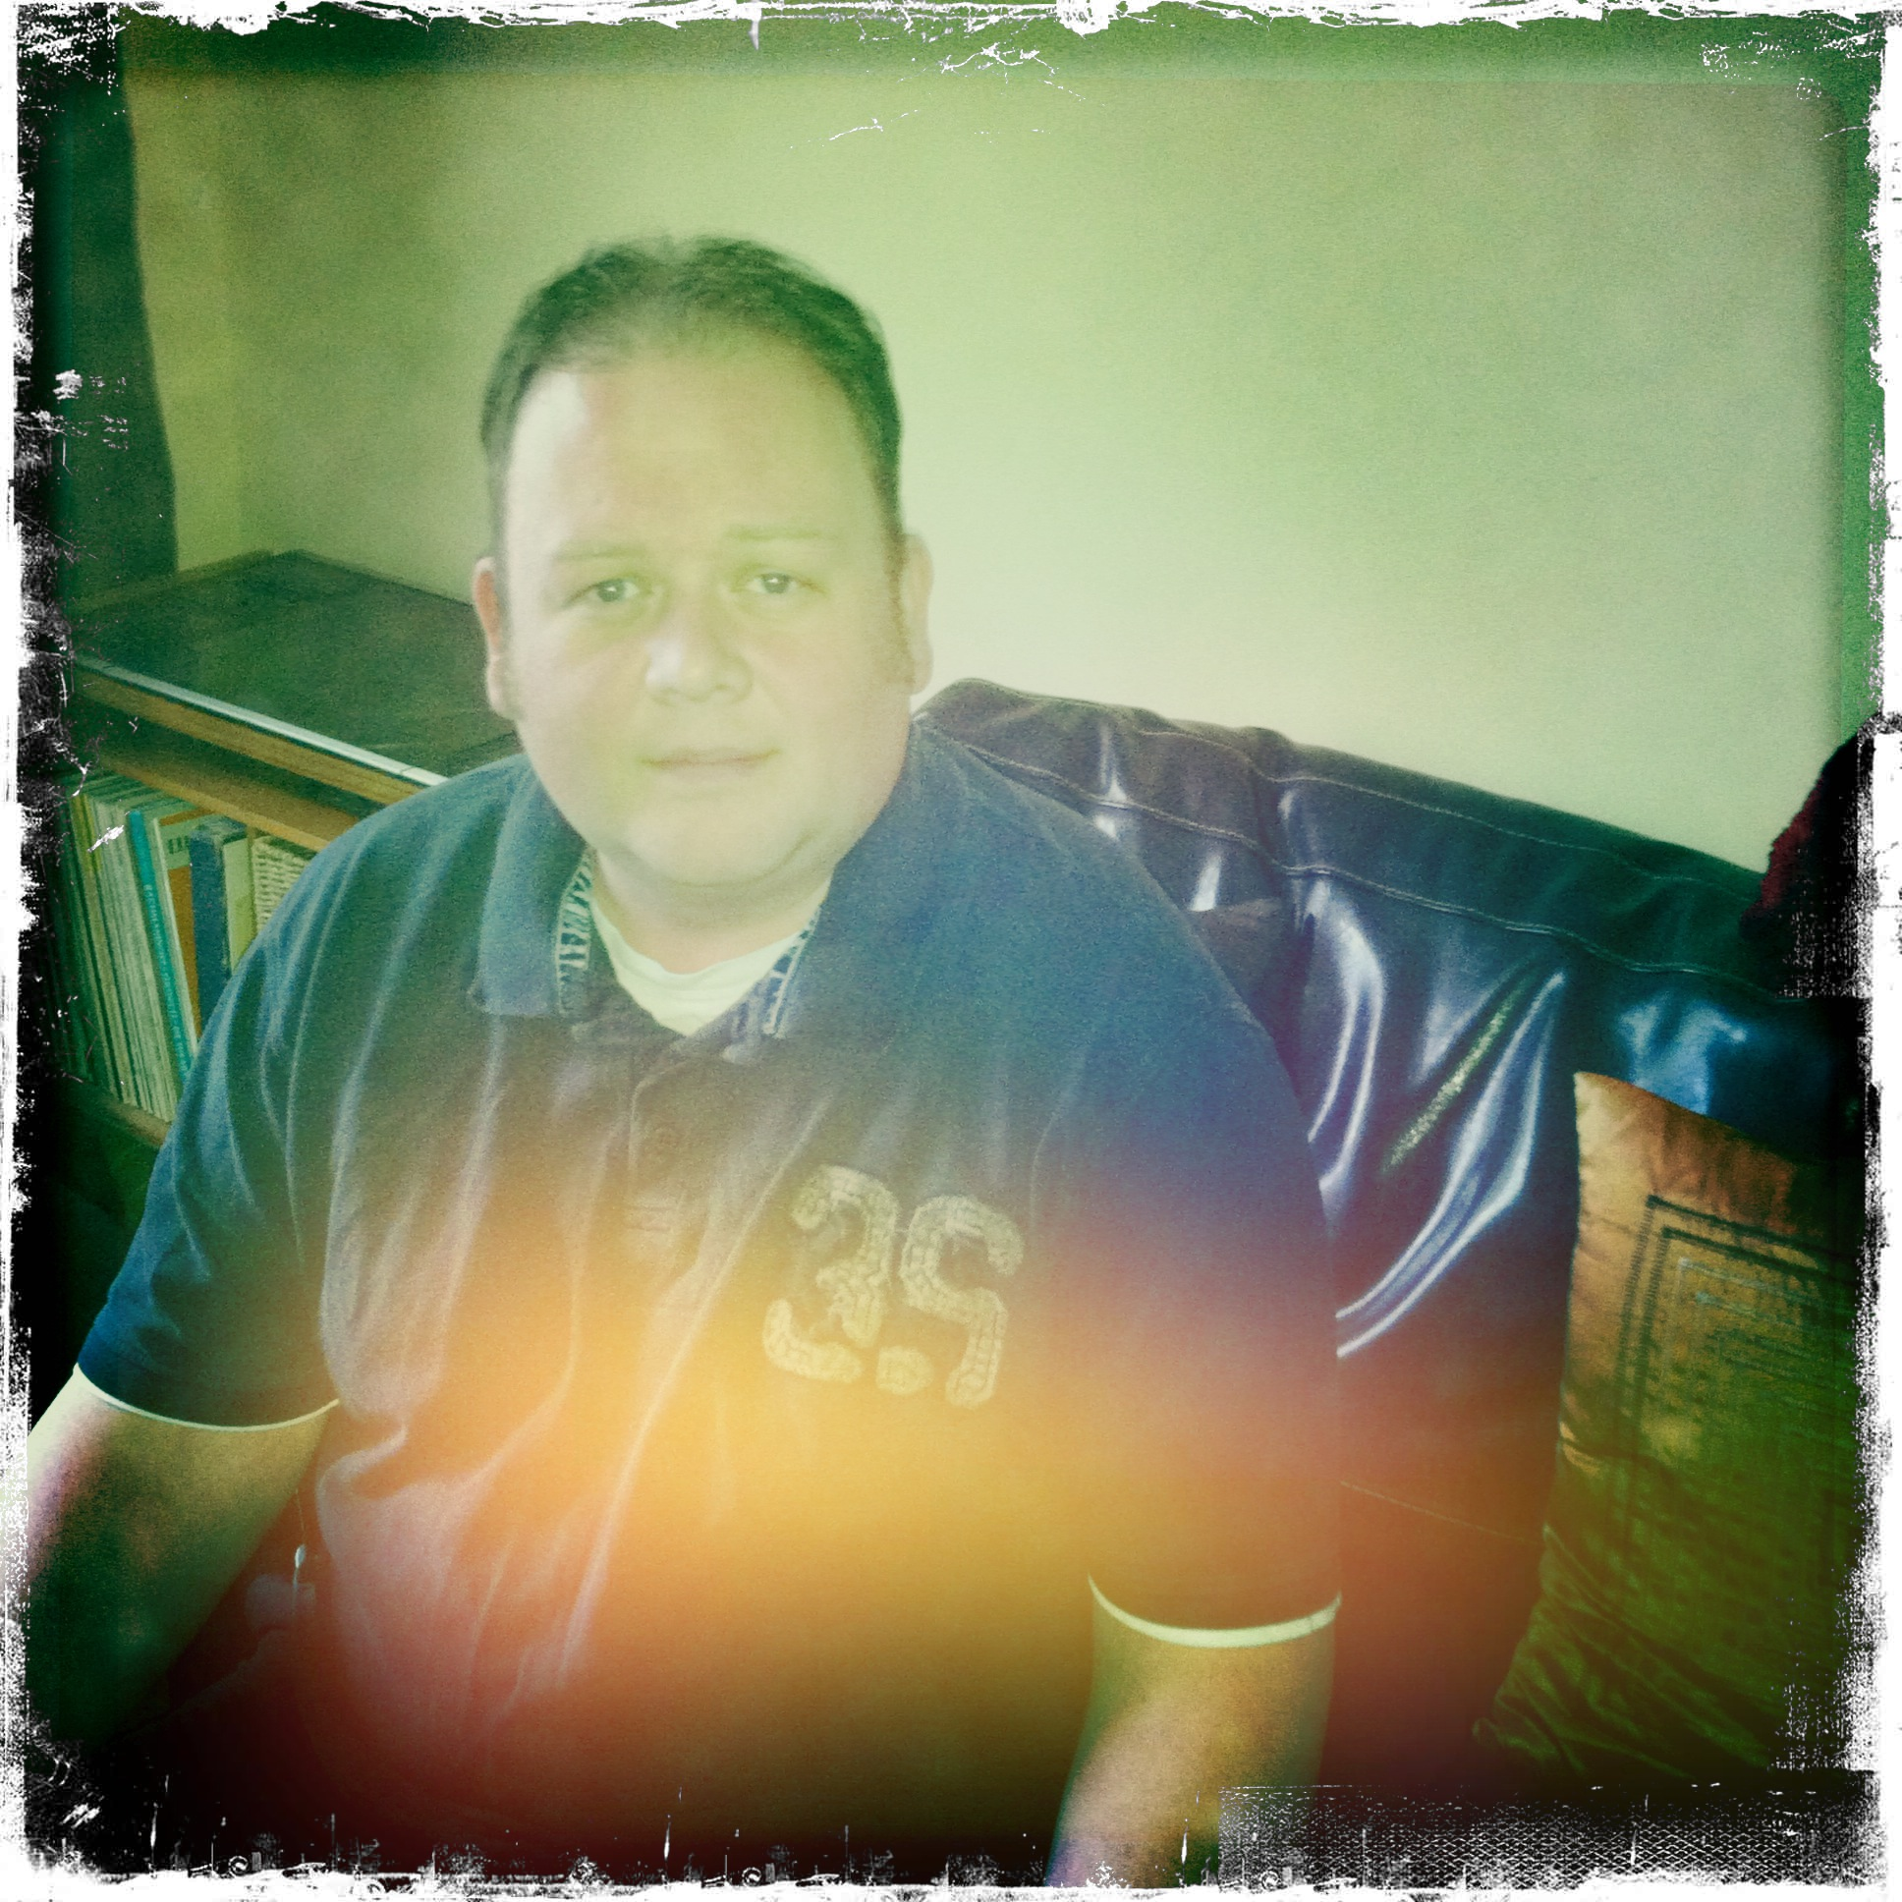
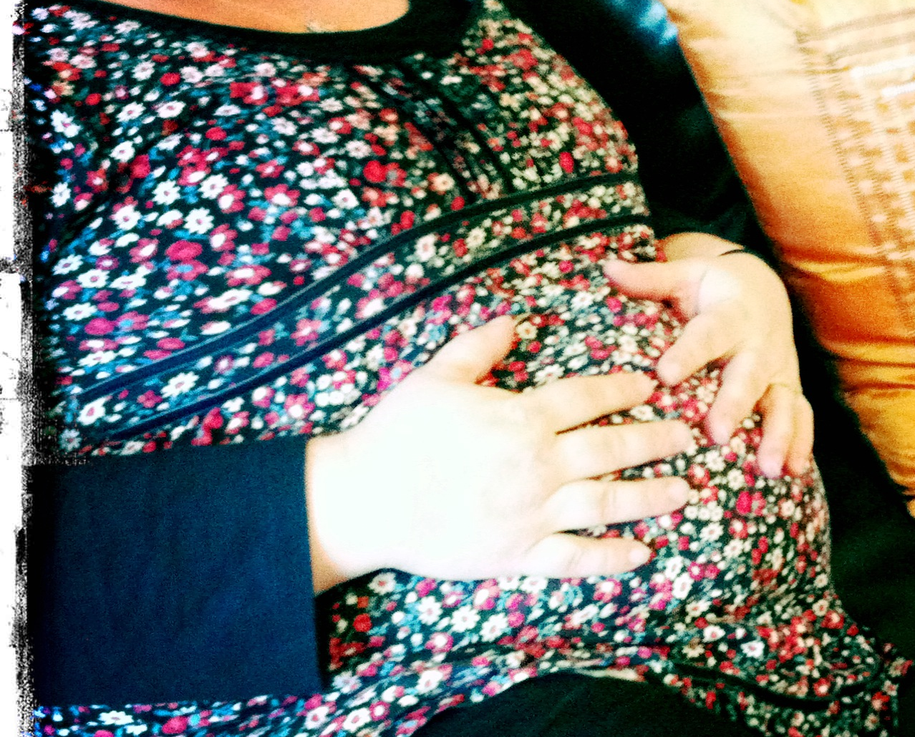
Notes:
I want to talk to you about Rhona age 30 who is a typical student, who works full time as well as looking after a family and a new baby on the way. This is Roodie

Slide 11
Roodie – Needs walking
Ricki – Needs to walk Roodie because Ross is late for school
Ross - Needs a school uniform and can’t find one because Rhona forgot to wash it.
Rhona - Forgot to walk the dog, forgot to wash the uniform, has a full time job, is expecting a new baby and needs a BA Childhood Practice degree to keep her job as a Nursery Manager.
Rhona- Needs get her head around referencing and forgot to wash the uniform because she was studying from 8pm until midnight after she had finished work and some of her daily chores. She hates the bloody dog.

Slide 12
What Rhona Needs…..
Support
Reassurance
Online Classes when she can attend them - Or recordings of those classes
Places to hang out online and talk to her fellow classmates
Easy access to the online library
Materials which are easy to navigate and connect with
Somebody to walk the bloody dog
Notes:
What Rhona needs is more help in the first couple of modules than anywhere else in her studies, once she has relaxed and her confidence has been boosted she can BECOME an autonomous learner.

Slide 13
Spoon – Feeding
Notes:
At this point can I just say that I want this phrase banned from all academia, it is an excuse for not discussing progression and transitions for students.

Slide 14
“As a distance learner the online session makes you feel like you are in a virtual classroom” (CP student, 2015)
Notes:
Connectivity seems obvious in a world driven by social media where we are never more than 10 seconds away from ‘connecting’ to someone. However connecting with students in online programmes of study requires the lecturers to reach out first. I conduct a weekly recorded online classroom using Blackboard Collaborate

Slide 15
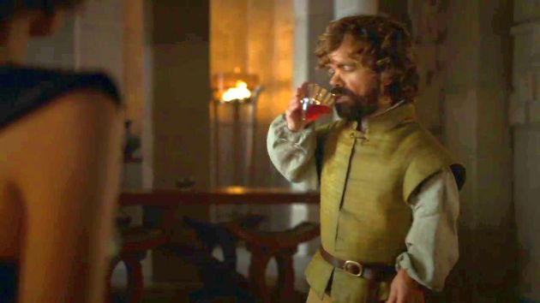
I drink and I know things….
Notes:
Students have expressed that they want feedback and interaction that is personal. This personal interaction is not about becoming friends on Face Book or telling students about your personal life. And it is not about being a 24 hour tutor. It is about learning and learning together.

Slide 16
“ Referencing is tricky isn’t it, I find memorizing does not work, I always need the text book’
  ‘When I was studying, I found that creating a reflective diary was useful’
      ‘I had not thought of that before, thanks for the idea’

Slide 17
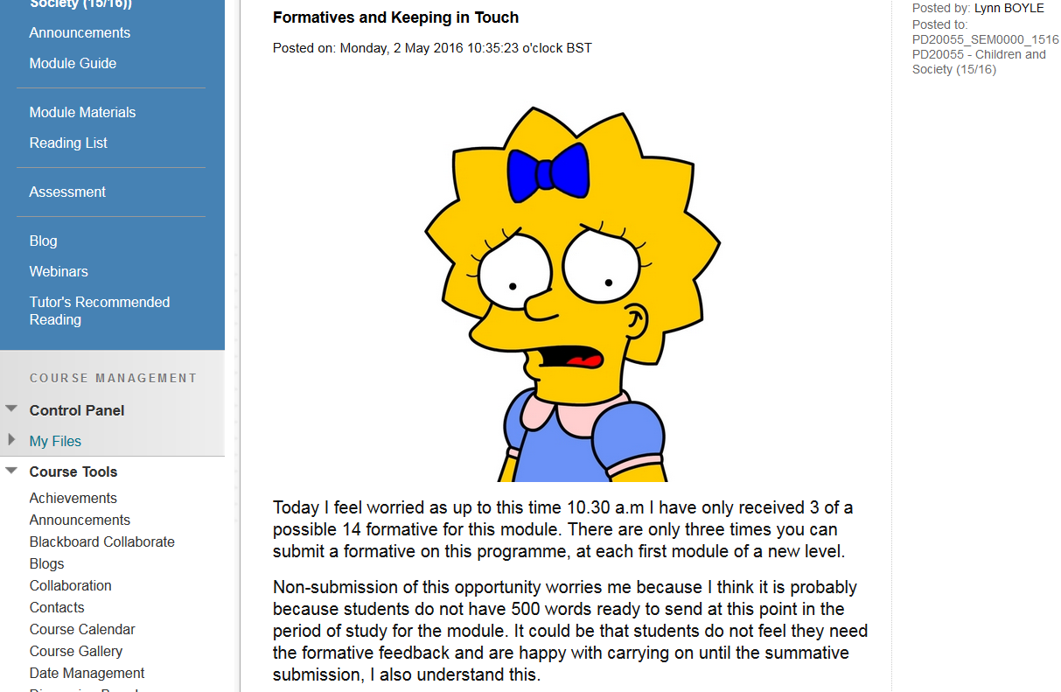
Notes:
I also use images in announcements and e mail and speak to the students in the first person as I would if I were in a classroom

Slide 18
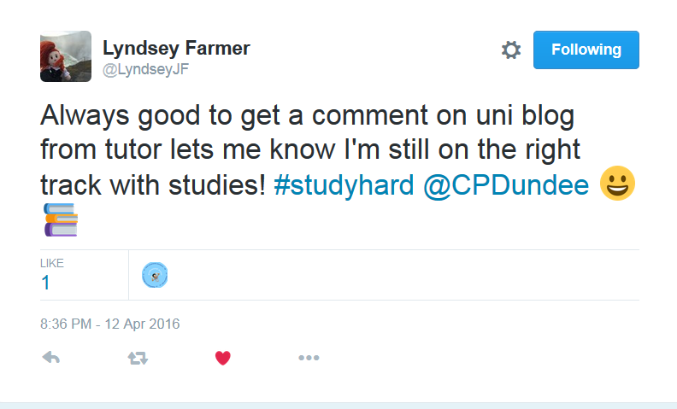
Notes:
We know our students like interaction so we use module Blogs and have a course Twitter page where we also chat and share #’s

Slide 19
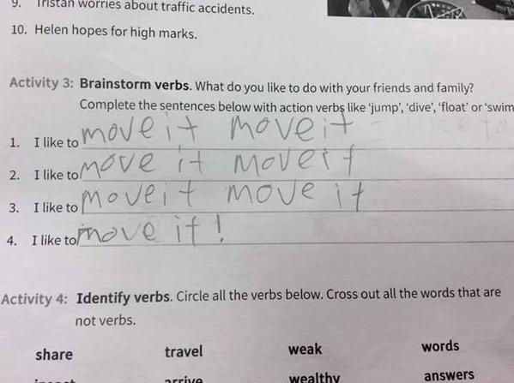
Notes:
There is always time when you enjoy your job, I want to talk to my students, I want to learn from them, I want to ensure they progress and I don’t have pre conceived ideas about their cumulative flaws. I want to be connected and to them and support them but also assure them the support will not be needed as they progress. I also want my students to enjoy learning…

